Slide 1
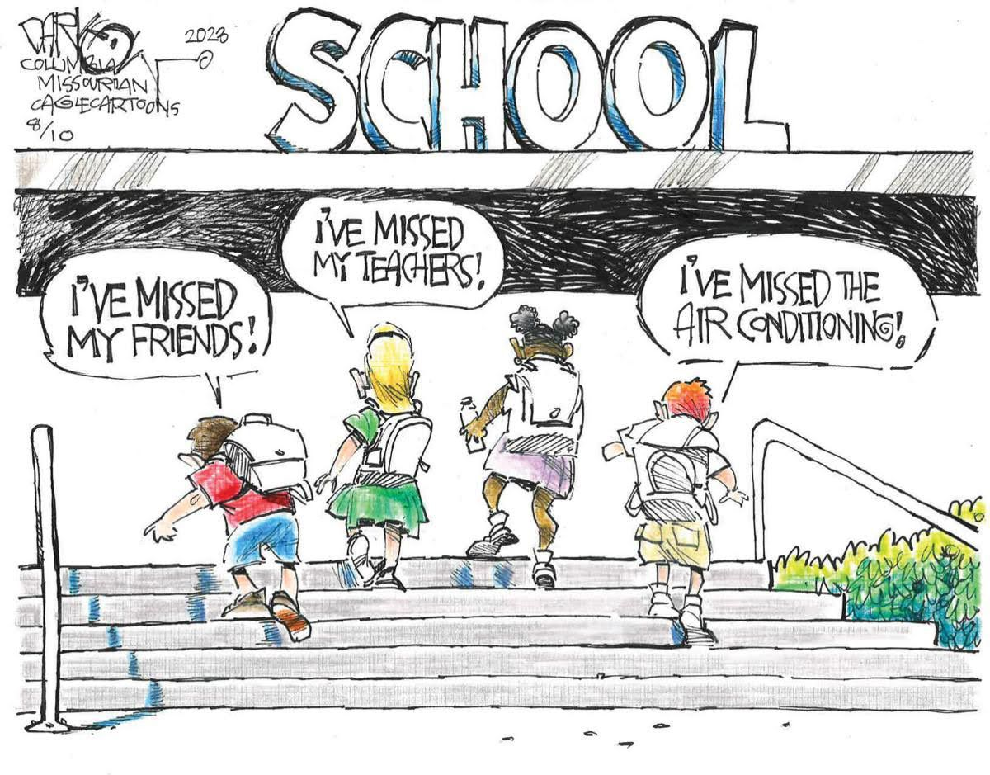
ENGLISH CLUB Join our club to have great fun in learning how to speak and enjoy English learning at KTGSS !

Slide 2
My name is Grace .
This is my friend Alicia .
We love learning in English , but sometimes we feel bad when we are asked to speak in English in class.

Slide 3
Join us to become more comfortable with English as the year progresses! Term1 2023-2024 1.Mid Autumn Festival Riddles 2.Halloween Games 3.Chinese Cultural games and tea drinking 4.Christmas celebration and stories from around the world 5. Chinese New Year 6. Easter bunny competition

Slide 4
When we spend time in our English club , we celebrate and understand the world around us and talk about it in English .

Slide 5
We celebrate our culture

Slide 6
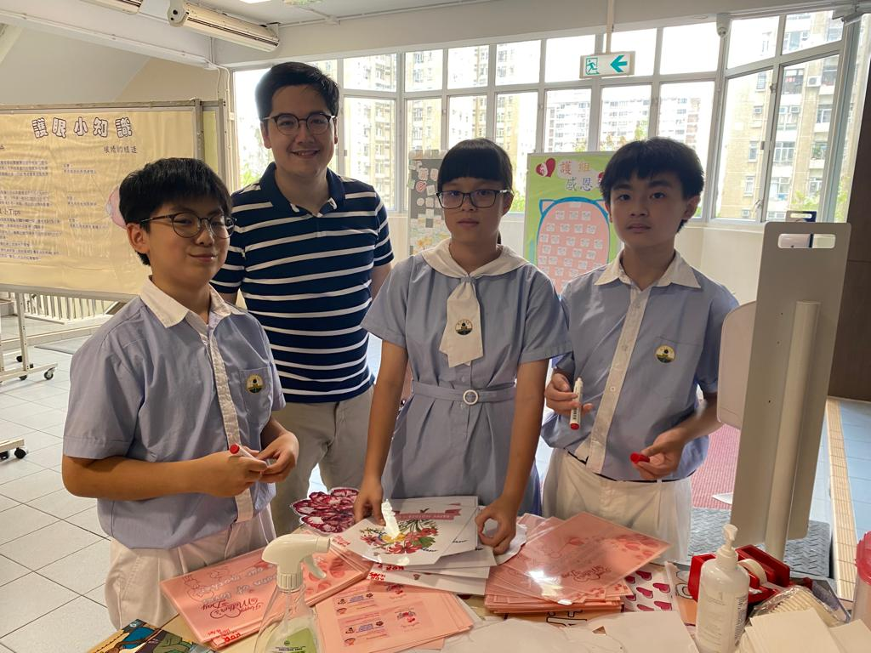
Promoting a fun and lively atmosphere at school

Slide 7
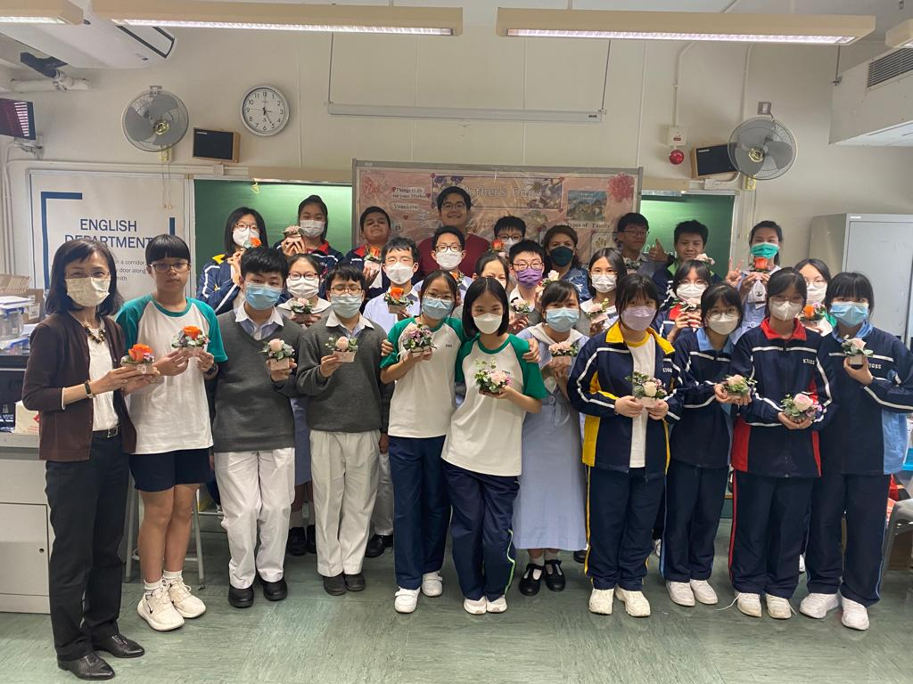
Mothers Day Floral arrangement

Slide 8
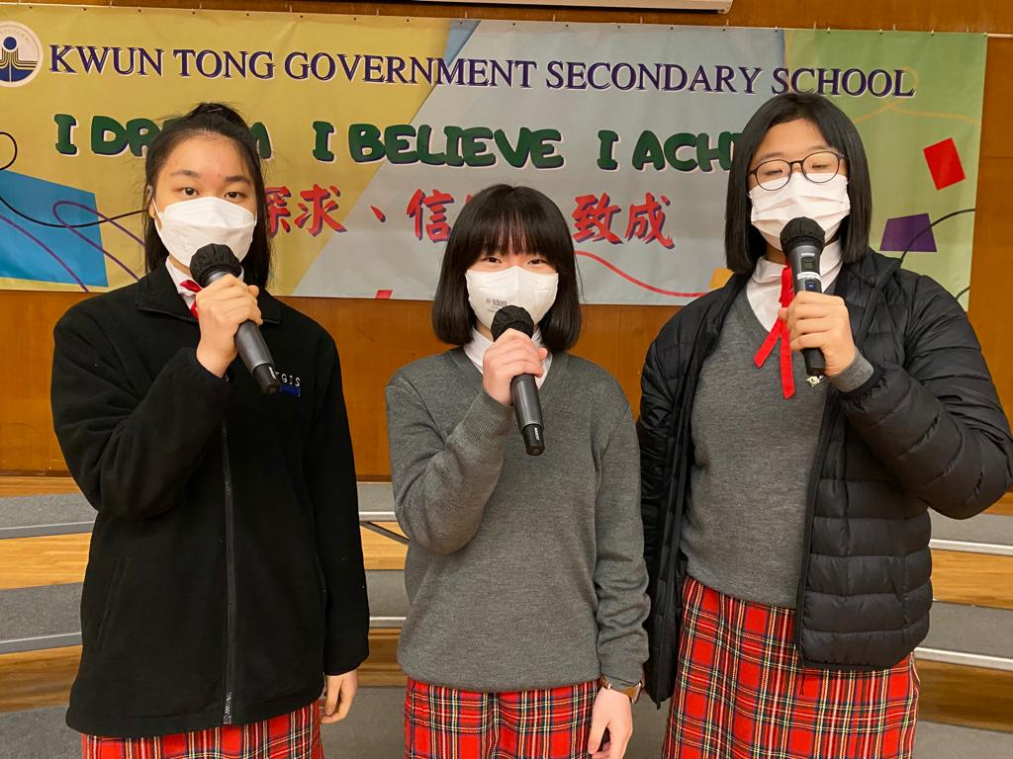
Public speaking is an important part of our club activities.
We do Public speaking training for 15 minutes at the start of every meeting!

Slide 9
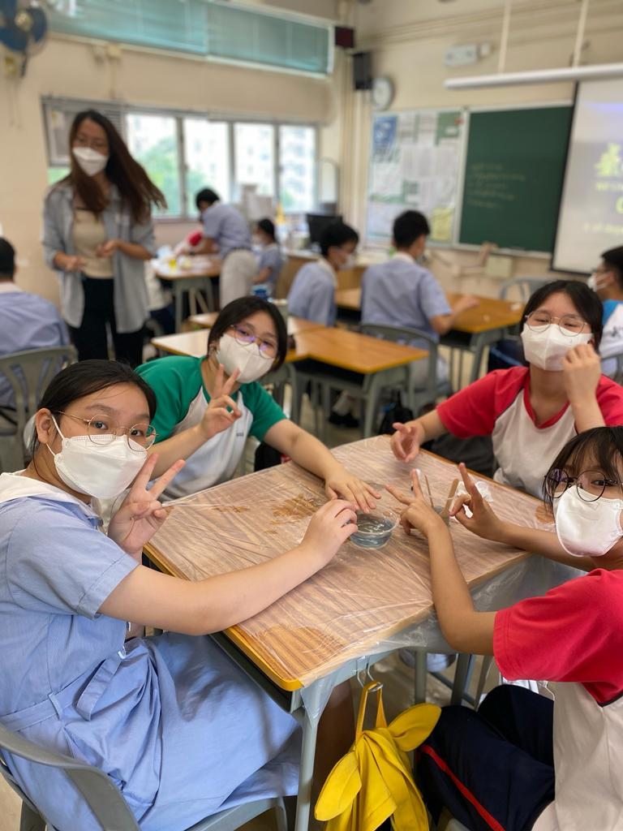
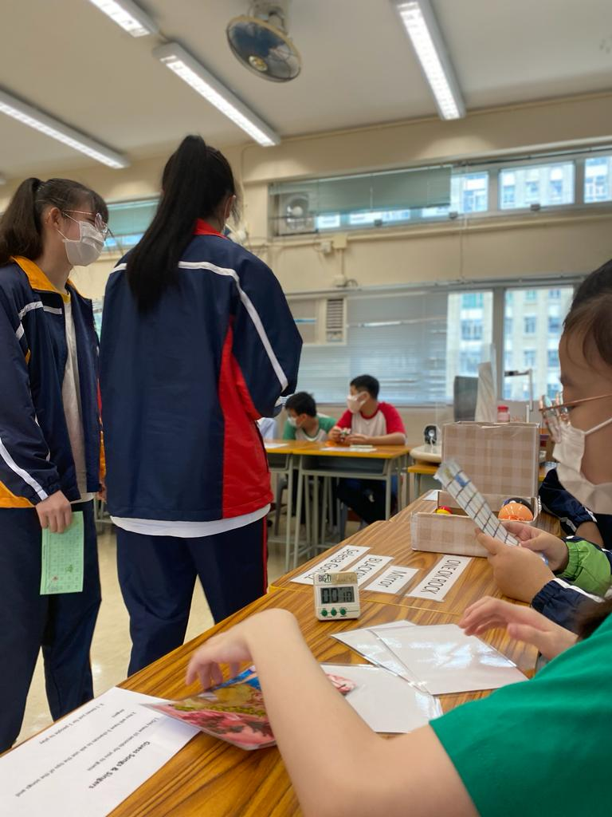
Our fun games include craft work with English instructions

Slide 10
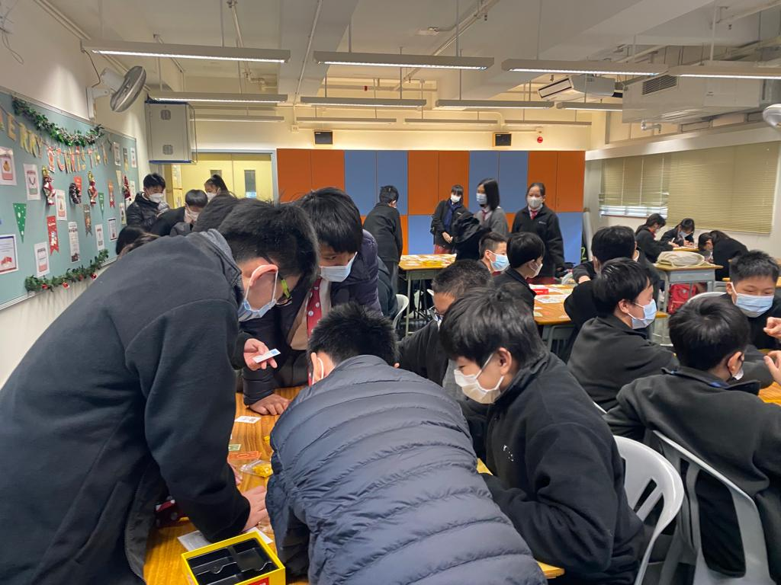
English board games are a fun way to learn how to follow rules in English

Slide 11
School will be so much fun with so many good activities to look forward to.

