Slide 1
ART CLUB
Teacher i/c : Ms Chan Chan
Max. number of club members: 36
Club meeting day(s): Thursday
Club meeting time: 3:45pm-4:30pm (Art Room)
Club meeting frequency: once a month

Slide 2
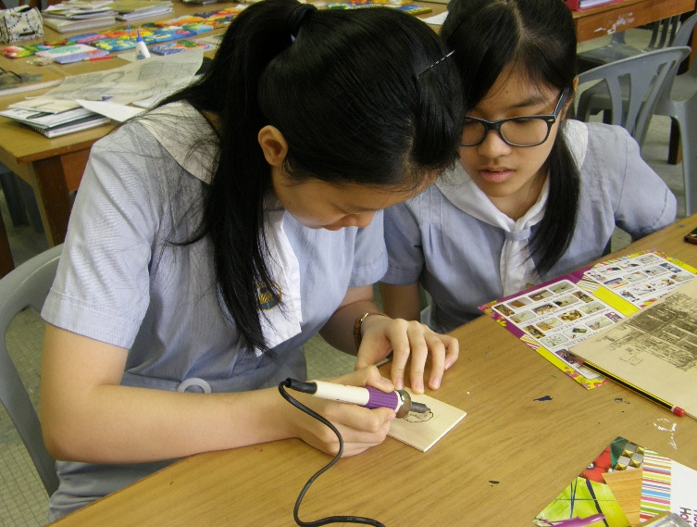
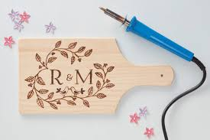
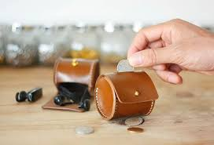
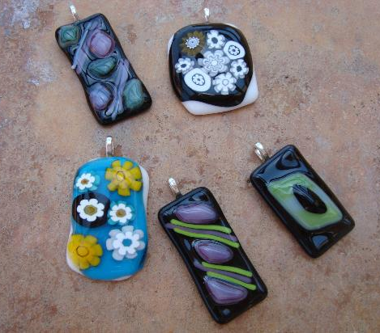
Art Workshops

Slide 3
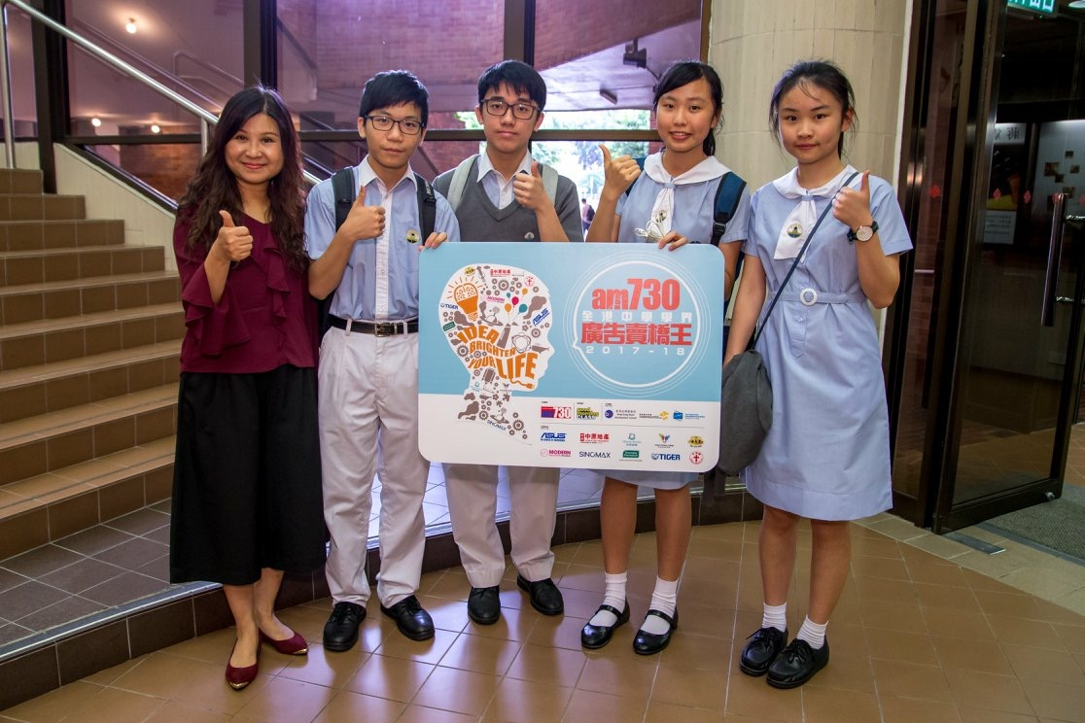
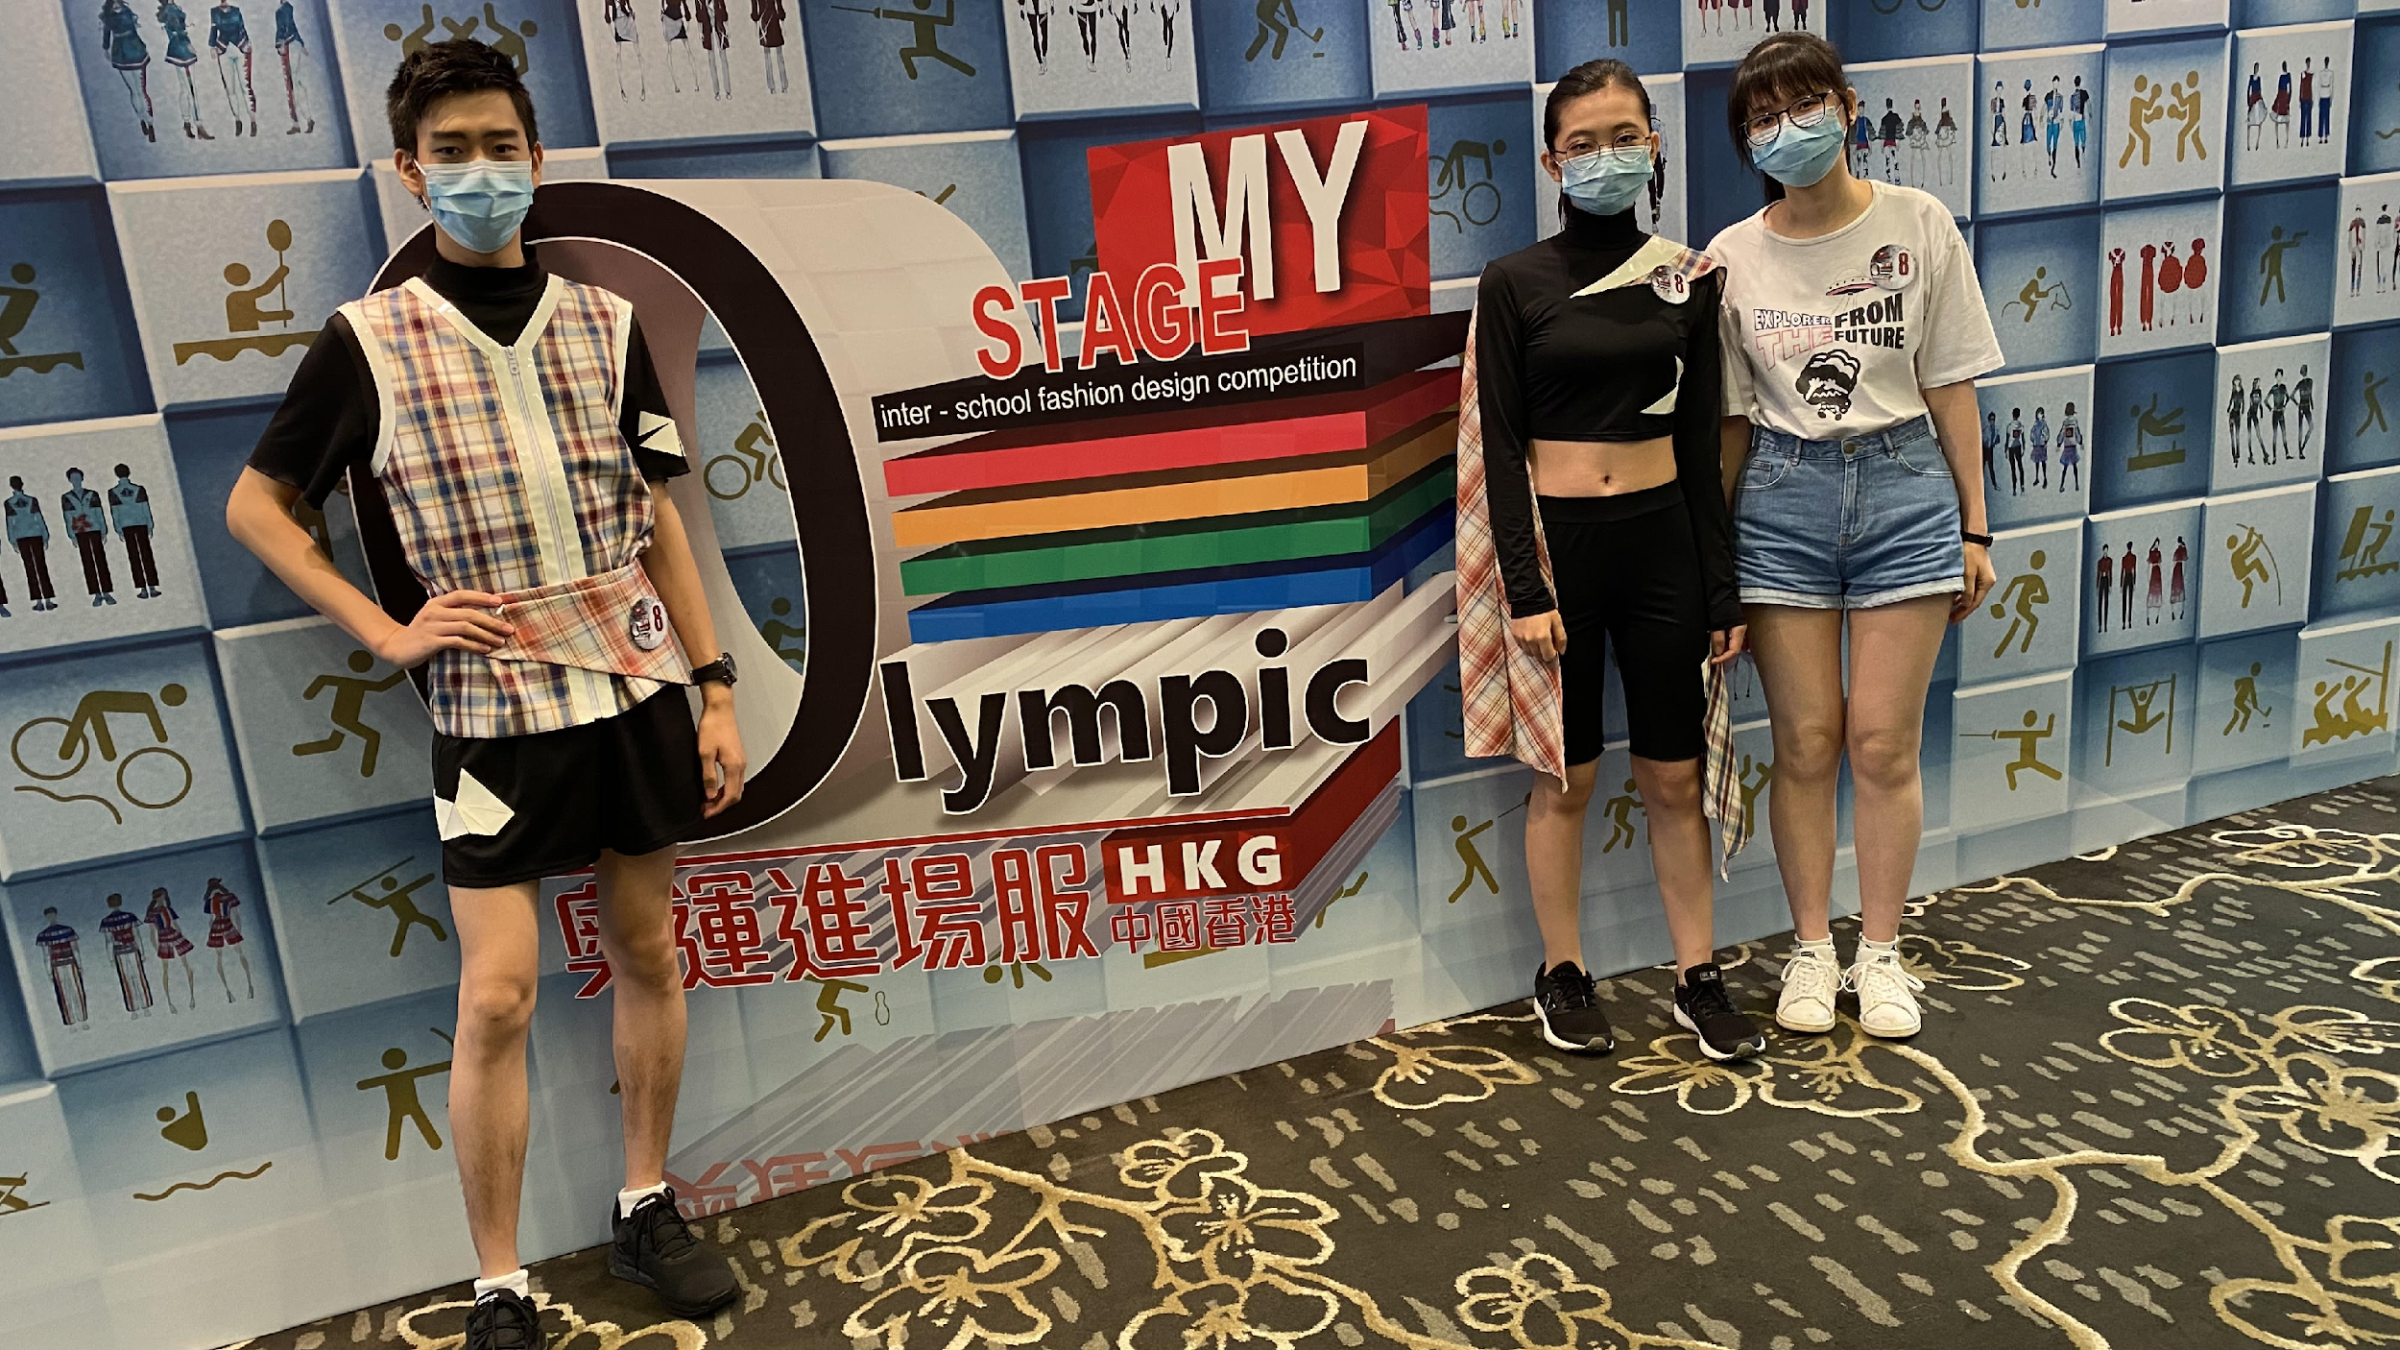
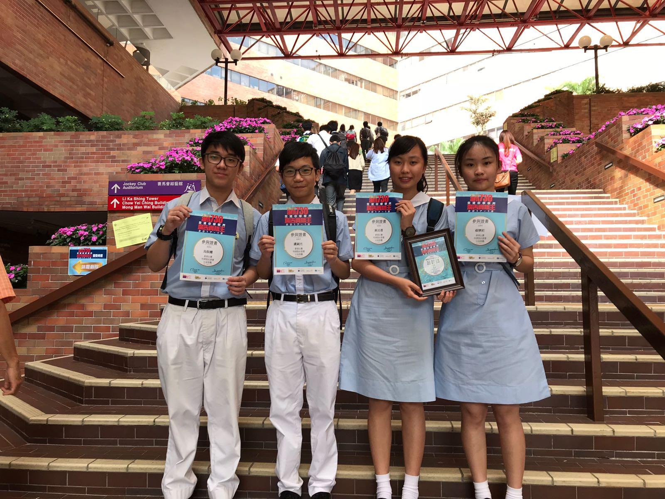
Competitions

