Slide 1
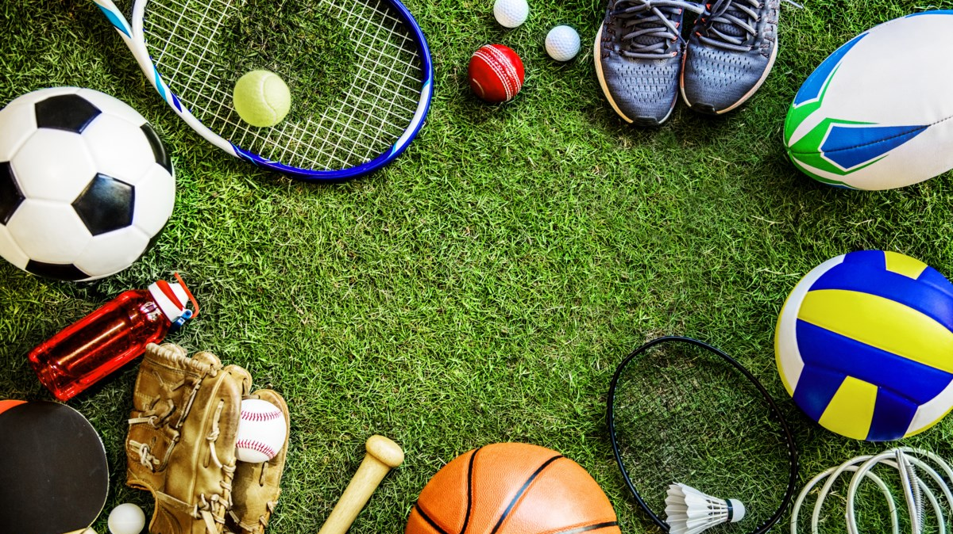
Sports ECA of KTGSS
2022-23

Slide 2
Badminton Club & Team Ms Lui Pui Ha Mr Lai Ting Pong

Slide 3
Badminton Club & Team Ms Lui Pui Ha Mr Lai Ting Pong

Slide 4
Badminton Club & Team Ms Lui Pui Ha
Max. no. of members: 30
Meeting day : Wednesday/ Friday
Meeting time : 4-6pm
Meeting frequency : Once a week
Remarks : Please wear sports uniform and bring your badminton racket

Slide 5
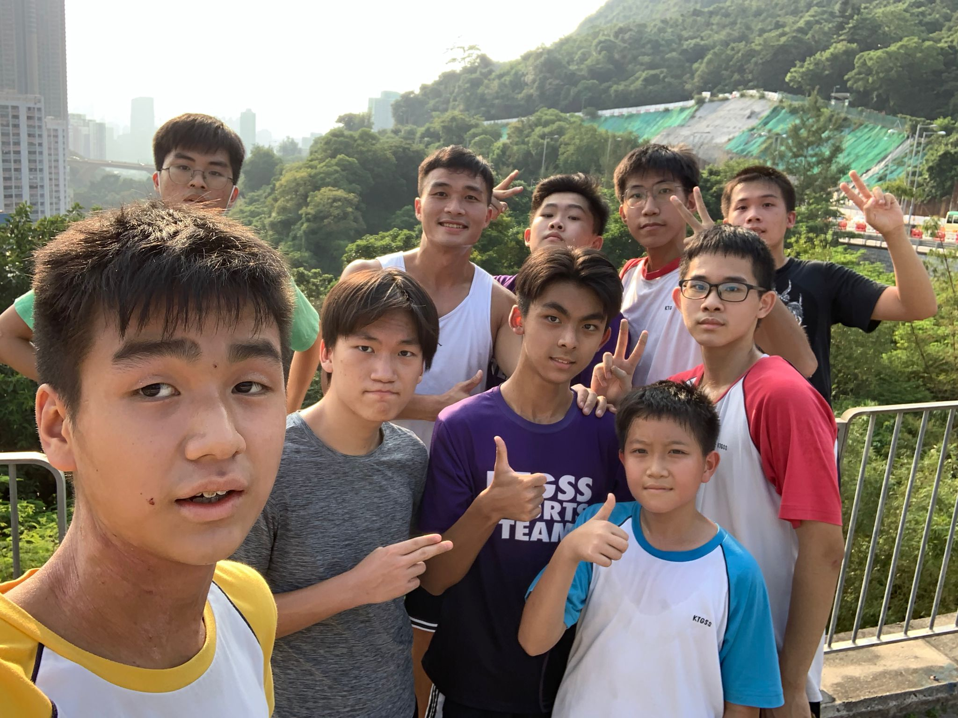
Basketball Club & Team Mr Yau Shing Kit

Slide 6
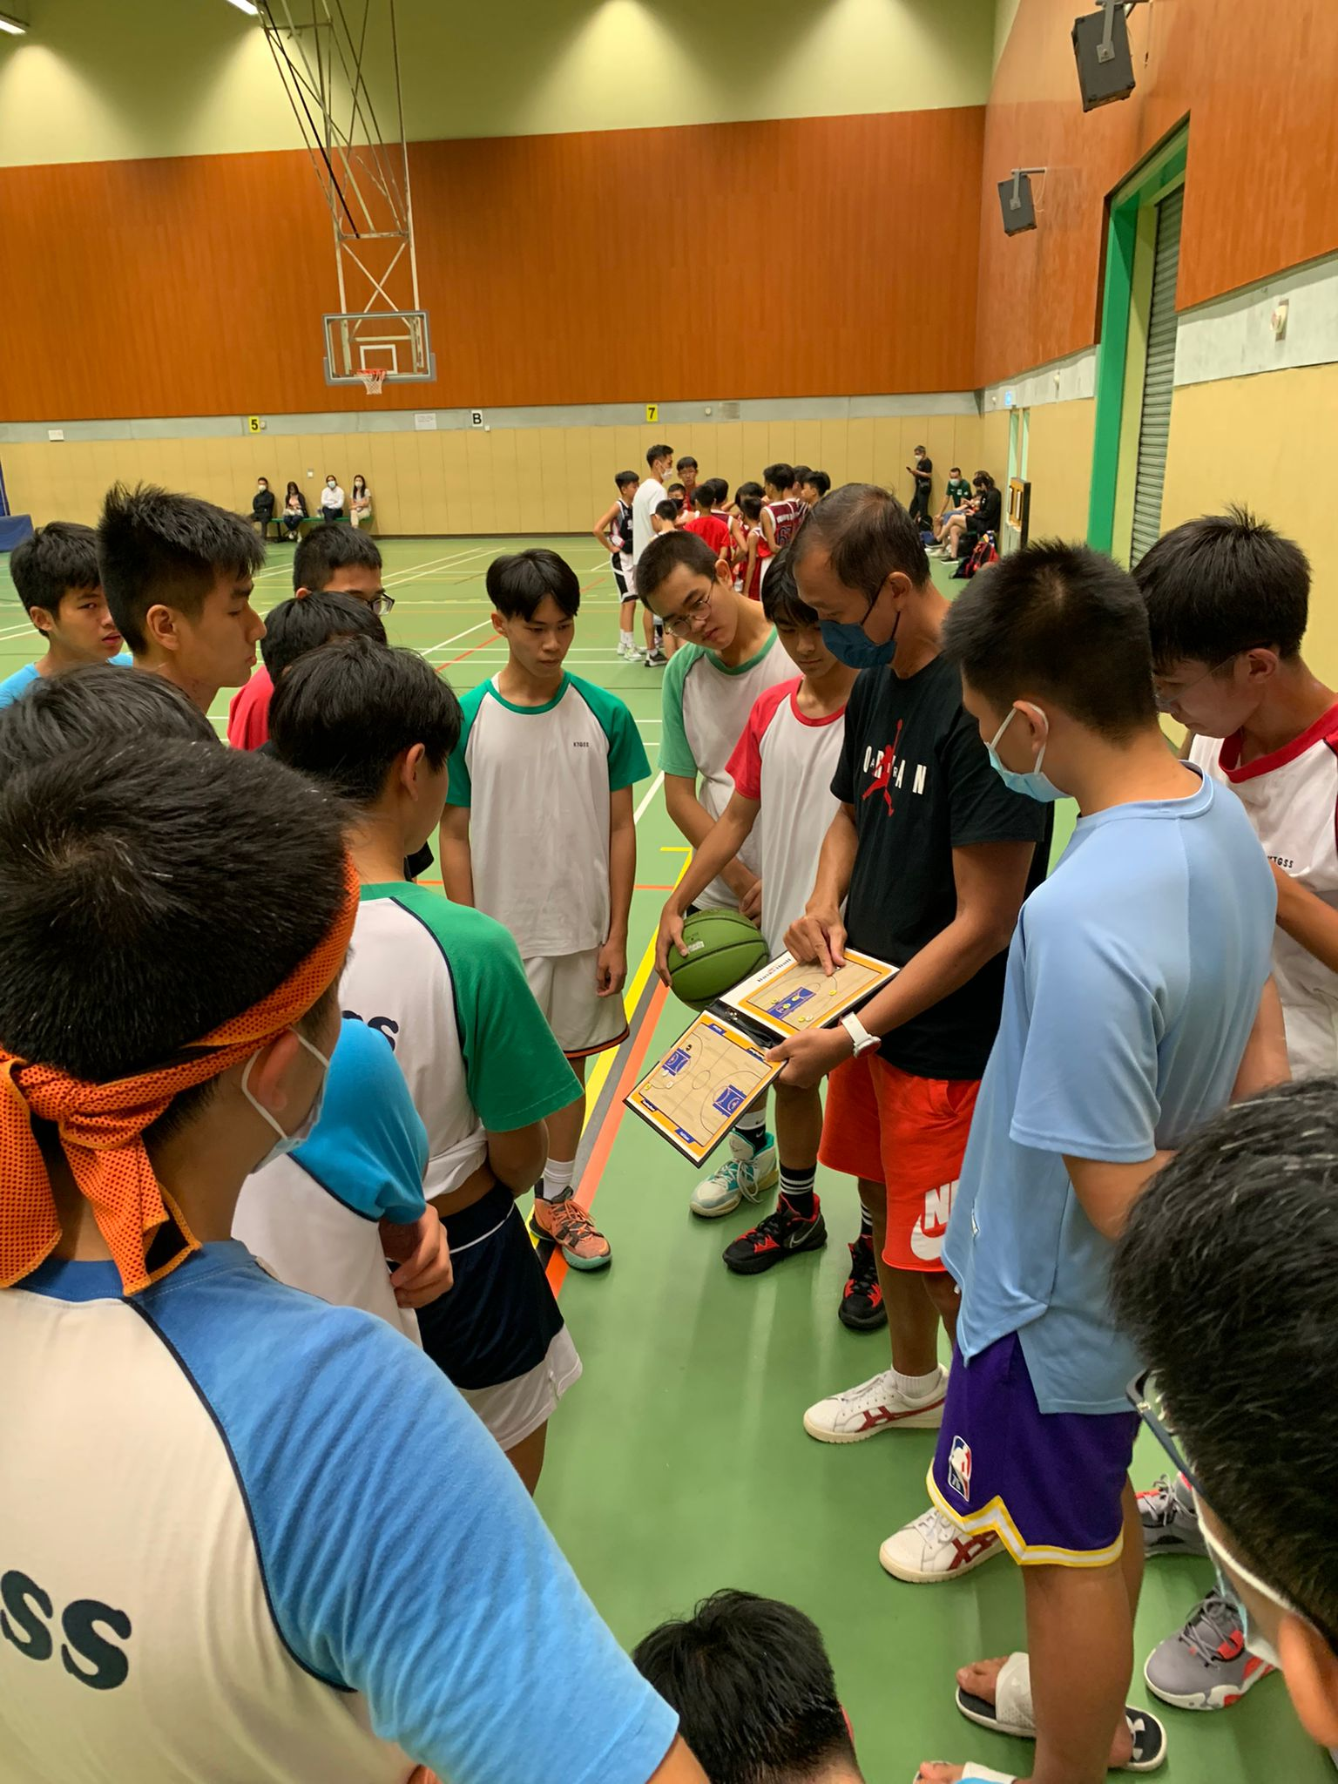
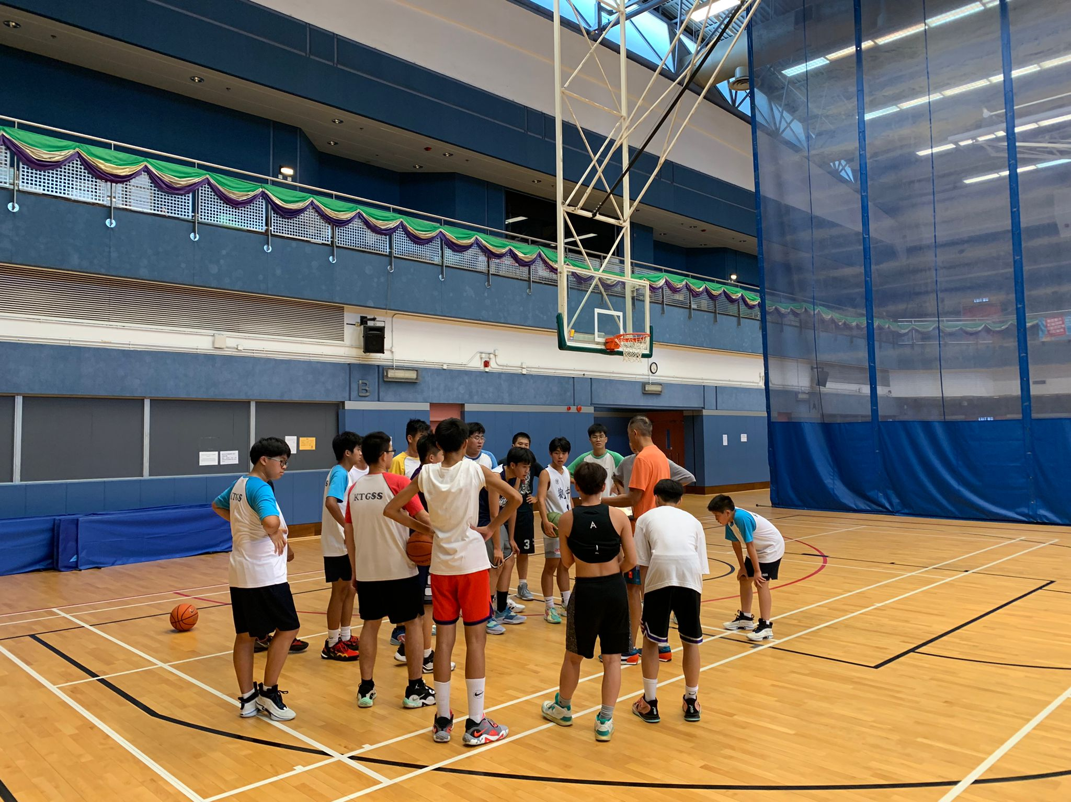
Basketball Club & Team Mr Yau Shing Kit

Slide 7
Basketball Team (Girls) Ms Leung Fung Ying

Slide 8
Basketball Team (Girls) Ms Leung Fung Ying

Slide 9
Basketball Club & Team Mr Yau Shing Kit
Max. no. of members: 30
Meeting/Training day : Tuesday/Thursday (Girls)
Wednesday/Friday (Boys)
Meeting time : 4-6pm
Meeting frequency : Twice a week

Slide 10
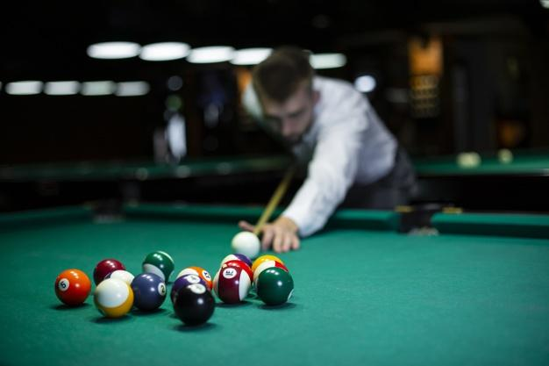
Billiard Club Ms. Leung Fung Ying

Slide 11
Billiard Club Ms. Leung FungYing
Max. no. of members: 30
Meeting day : Wednesday
Meeting time : 4-6pm
Meeting Date: 19/10-14/12
Remarks : @Shun Lee Sports Centre

Slide 12
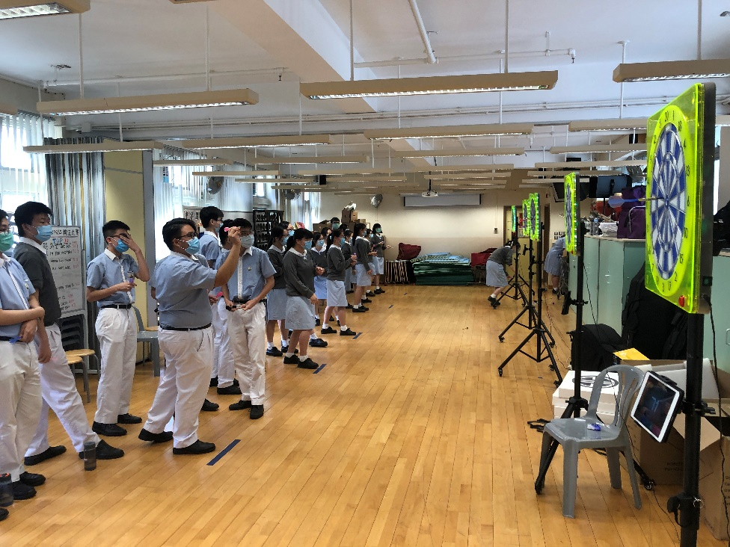
Darts Club Mr Yau Shing Kit

Slide 13
Darts Club Mr Yau Shing Kit
Max. no. of members: 40
Meeting day : Friday
Meeting time : 4-6pm
Meeting frequency : Once a week

Slide 14
Football Club & Team Mr Yau Shing Kit
1st term Meeting/Training arrangement :
3/10
Venue: Shun Lee Sports Centre/ School Playground

Slide 15
Netball Club & Team Ms Leung Fung Ying

Slide 16
Netball Club & Team Ms Leung Fung Ying

Slide 17
Netball Club & Team Ms Leung Fung Ying
Max. no. of members: 30
Meeting day : Saturday
Meeting time : 9-11am
Meeting frequency : Once a week

Slide 18
Table Tennis Club & Team Ms Leung Fung Ying

Slide 19
Table Tennis Club & Team Ms Leung Fung Ying

Slide 20
Table Tennis Club & Team Ms Leung Fung Ying
Max. no. of members: 30
Meeting day : Wednesday
Meeting time : 4-6pm
Meeting frequency : Once a week

Slide 21
Volleyball Club & Team Mr Yau Shing Kit

Slide 22
Volleyball Club & Team Mr Yau Shing Kit

Slide 23
Volleyball Club & Team Mr Yau Shing Kit
Max. no. of members: 50
Meeting/Training day : Friday
Meeting time : 4-6pm
Meeting frequency : Once a week

Slide 24
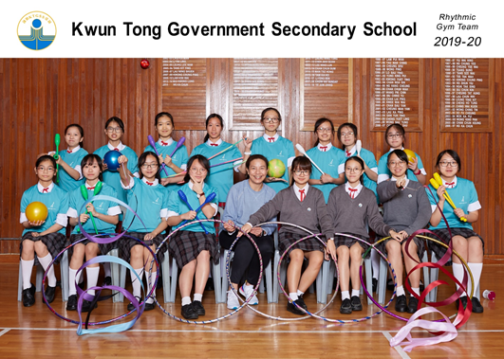
Other Sports Team
Athletics Team : Mr Yau Shing Kit
Rhythmic Gym Team : Ms Leung Fung Ying
Remarks: Students have good performance will be invited to join school team to participate in inter-school competition.

