Slide 1
Geography Club
2022-23

Slide 2
Objectives
1. To arouse the interest of students to geography by organizing
related activities.
2. To let students have more knowledge in geography.
3. To provide leadership training for senior forms geography
students.
4. To widen the scope of view of the subject.

Slide 3
What is geography
the study of the physical features of the earth and its atmosphere, and of human activity as it affects and is affected by these, including the distribution of populations and resources and political and economic activities.

Slide 4
Brief introduction to Hong Kong geopark
What is a geopark ?
A unified territory with a single boundary.
Being open to public.
Significant coverage and scope of geoheritage.
A natural area of special geological significance and natural beauty.
Not a geological park but an area integrated with geology, ecology, natural landscape, local culture and history.
Tools to promote earth science and sustainable development through geo-tourism and education.
Covered and managed with a sound protection and management system.
An area where science and local communities were engaged in a mutually beneficial manner.

Slide 5
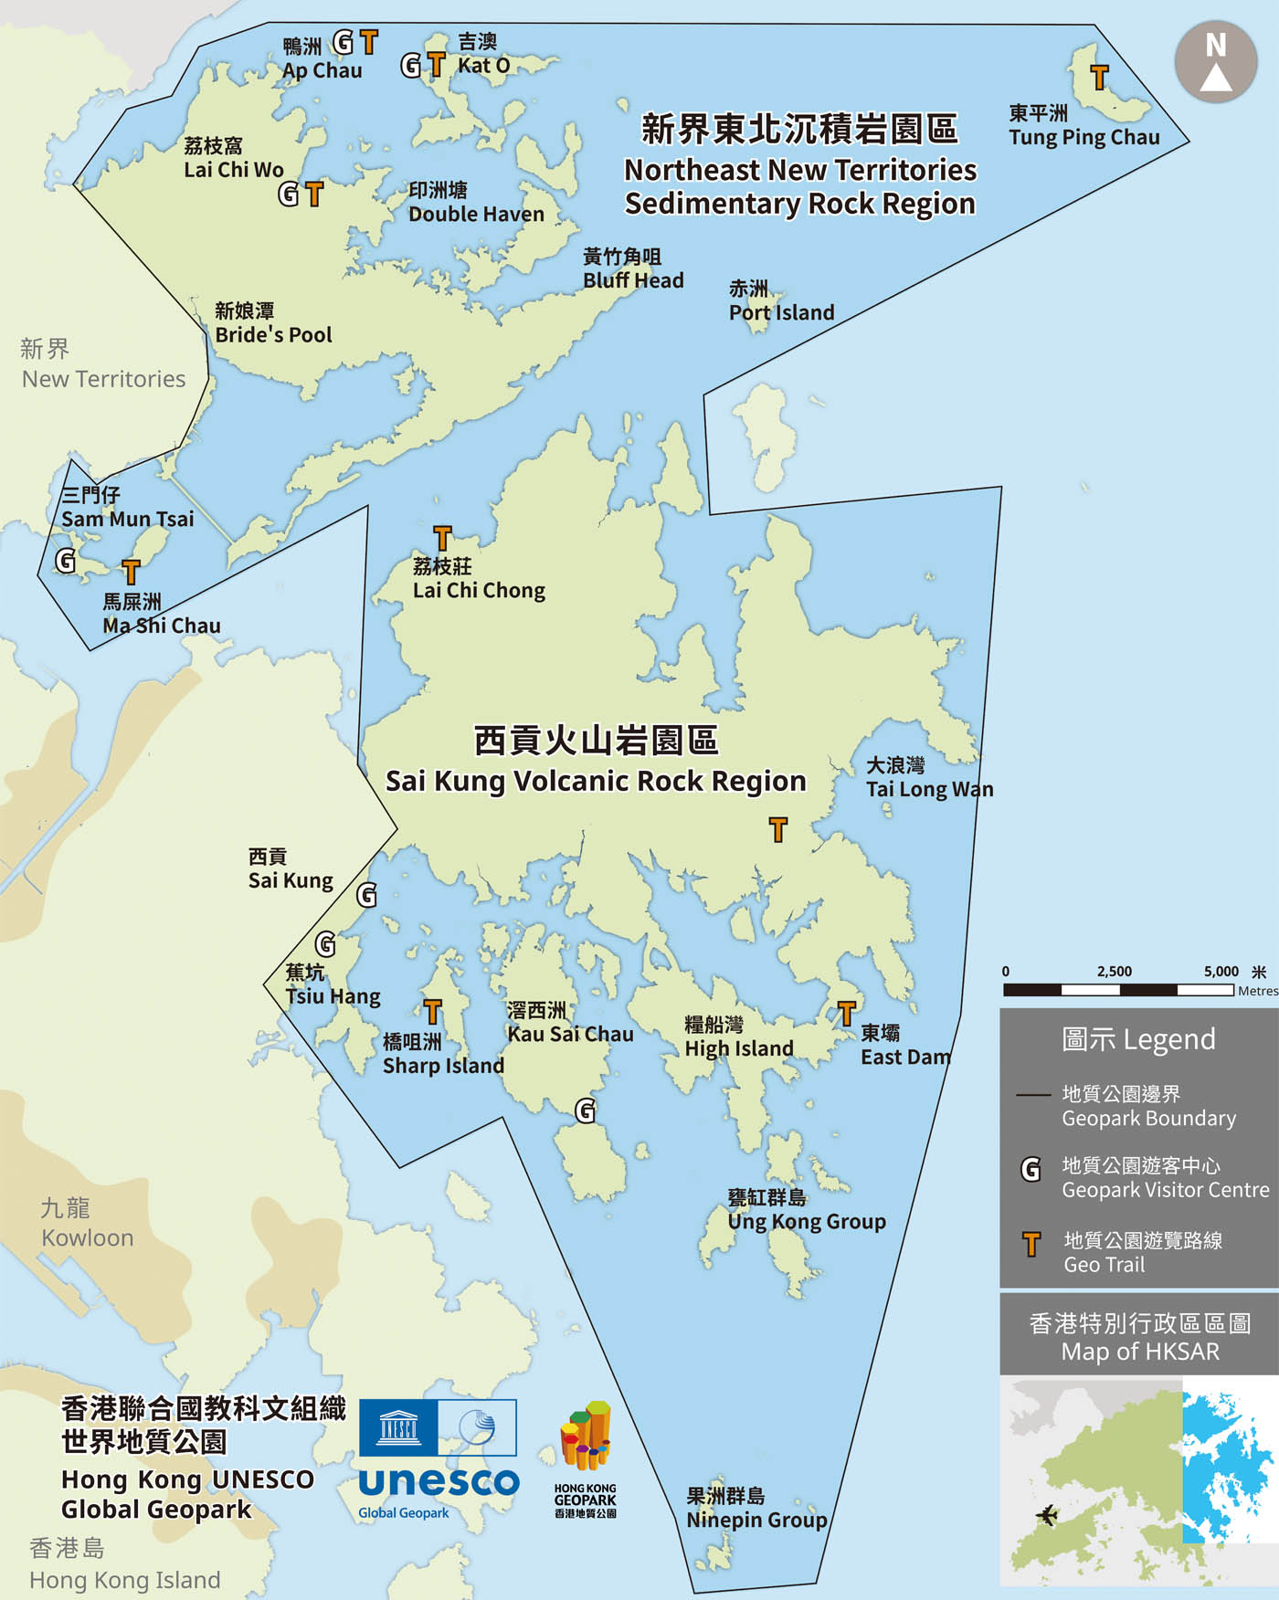
Hong Kong Geopark-The world-class geological landscapes
Where is the geopark ?
The geopark is divided into two main regions:
Sai Kung Volcanic Rock Region (西貢火山岩園區) | High Island (糧船灣） | Ninepin Group (果洲群島)
 | Sharp Island (橋咀洲) | Ung Kong Group (甕缸群島)
Northeast New Territories Sedimentary Rock Region (新界東北沉積岩園區) | Bluff Head-Port Island (黃竹角咀-赤洲) | Tolo Channel (赤門)
 | Double Haven (印洲塘) | Tung Ping Chau (東平洲)

Slide 6
Features of Hong Kong Geopark
Hong Kong’s diverse and intensive geological heritage, witch is just stone’s throw from the city.
Legal protection for all geo-sites in the geopark.
Hong Kong’s rich experience in protected area management and planning.
Diversed ecological habitats and wildlife, along with a strong foundation in ecological research and vast experience in the promotion of nature conservation.
The general support and active involvement of local communities.

Slide 7
Why was Hong Kong able to establish a geopark?
Showcasing geological sites of international importance and a complete geological history in its single, unified boundary.
The geological sites are protected by longstanding, well established legal regulations.
The geopark has the support of a broad range of Hong Kong citizens, local communities, non-government groups and other stakeholders.
Hong Kong has relatively rich experience in nature conservation and science popularisation.
The ecological and cultural heritage in the geopark enhance the travel experience of visitors to Hong Kong.
The local communities have been actively engaged in village revitalization and the geopark’s development.

Slide 8
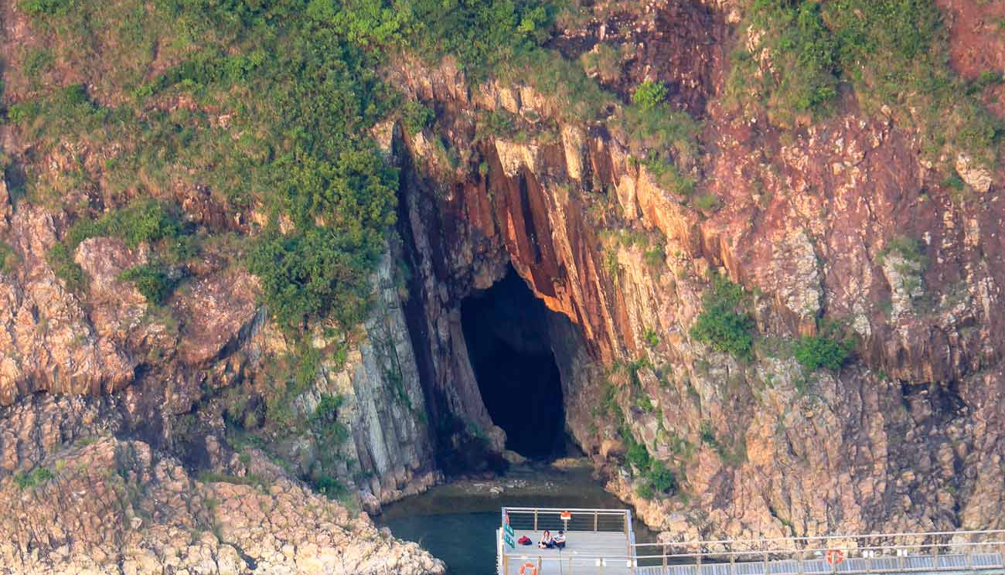
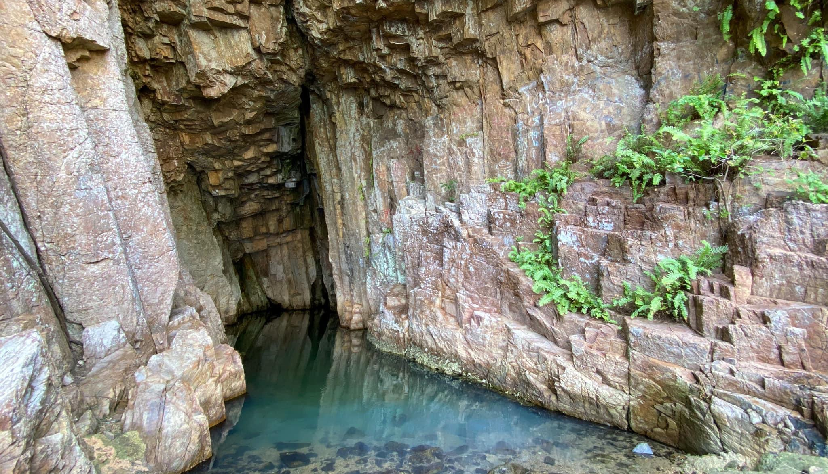
High Island reservoir-Sea Cave
A wooden walkway at the end of the trail takes you near the entrance to a sea cave, which looks slightly out of place below East Dam. This area — originally part of the narrow waterway running along the fault line between High Island and Sai Kung Peninsula — was blocked off to form the reservoir. The cave was created, slowly over time, as waves wore away the coastline’s softer rock.

Slide 9
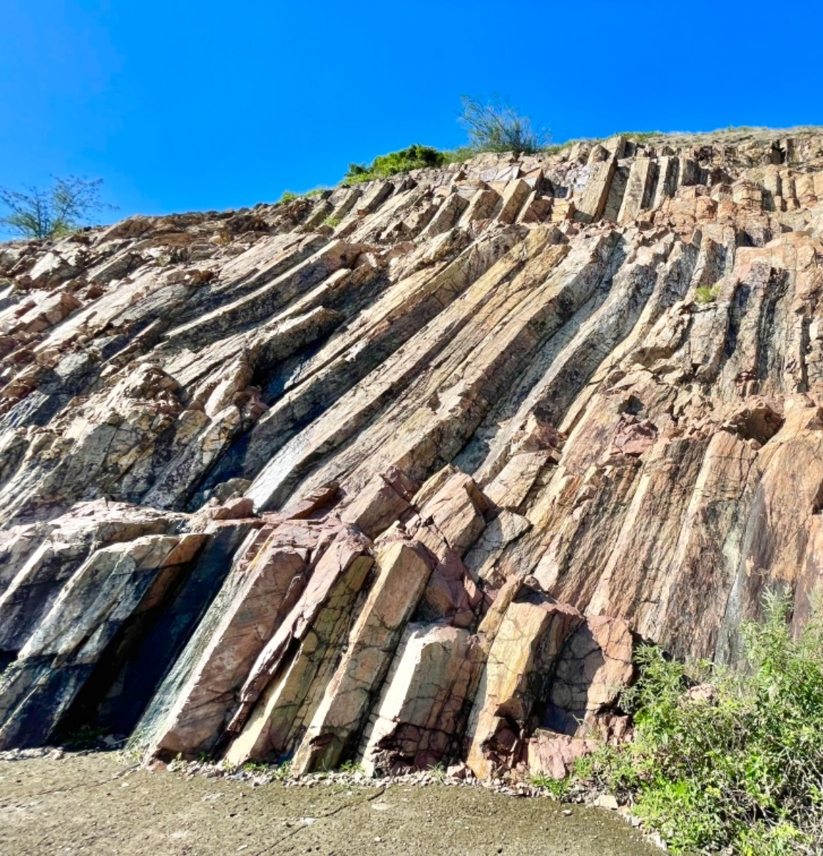
High Island reservoir-Hexagonal Rock Columns
The stunning, light-coloured rock columns found in the Geopark’s Sai Kung Volcanic Rock Region — created as dense volcanic ash and lava cooled following massive eruptions 140 million years ago — are estimated to cover an area of more than 100 sq km — including some located underwater. Those that are visible rise up to a height of 100 metres and have an average diameter of 1.2 metres.

Slide 10
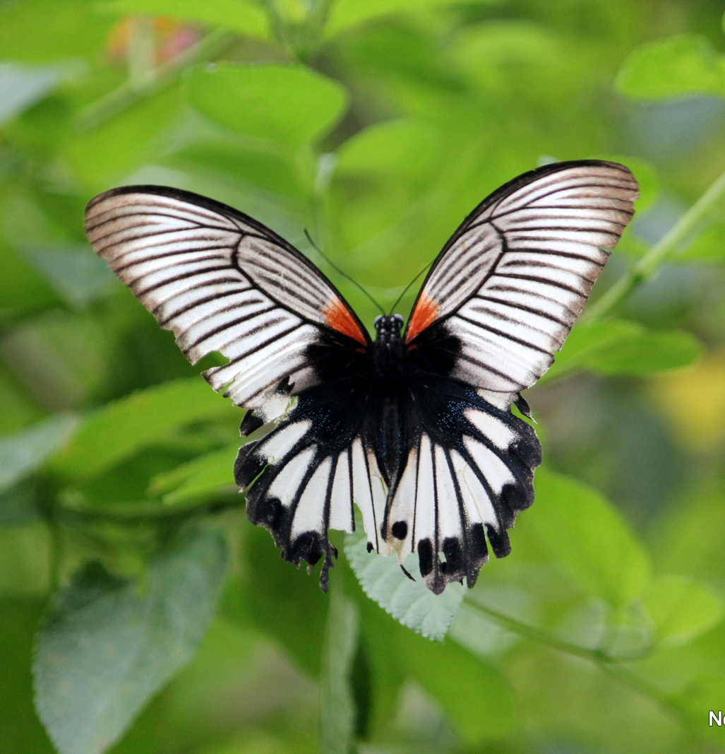
Fung Yuen Butterfly Reserve
Situated in the valley behind the 300-year-old Hakka village of Fung Yuen sprawls the Fung Yuen Butterfly Reserve, a protected site that’s home to more than 200 species of butterflies, including the pretty Common Birdwing and White Dragontail varieties. As well as rare breeds of butterflies, you may also spot some unusual breeds of terns (seabirds). Visit on the last Sunday of each month for the Butterfly Festival — a selection of exhibitions and guided tours.

Slide 11
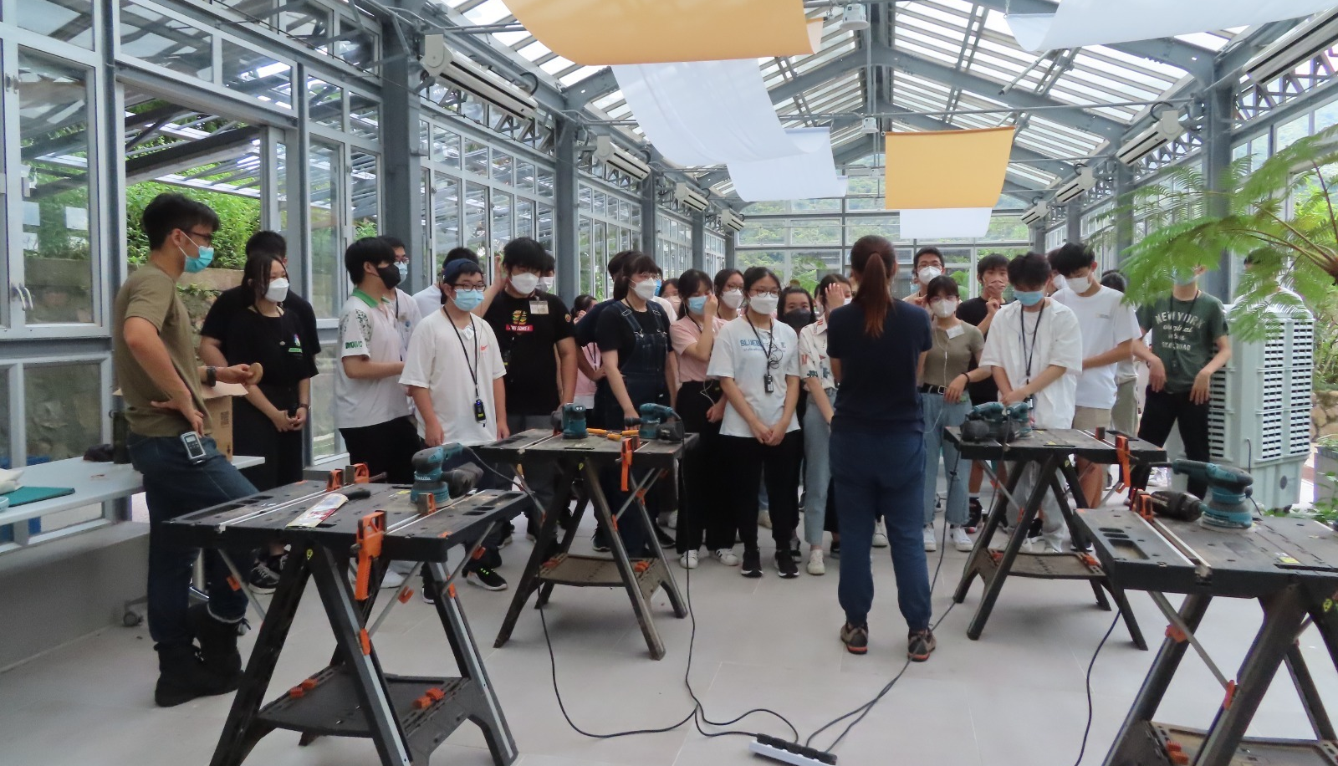
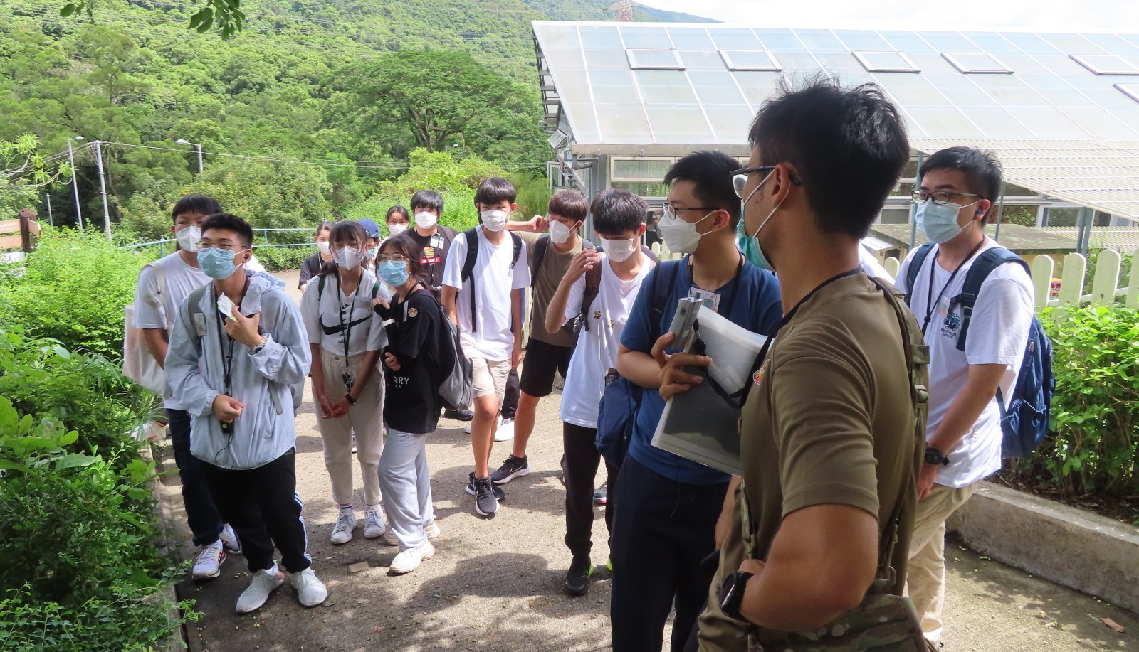
Kadoorie Farm and Botanic Garden
Established in 1956, the Kadoorie Farm and Botanic Garden (KFBG) site near Lam Tsuen, Tai Po, is one of Hong Kong's little known jewels. A wide variety of educational displays, sustainability features and wildlife rescue facilities complement the extensively landscaped gardens with their cobbled paths, pavilions, bridges, waterfalls and picnic spots. In addition to the many on-site courses, workshops and special events that have been developed for the education and upliftment of visitors.

Slide 12
JOINT THE GEOGRAPHY CLUB 2022-23
You are cordially invited to join the CLUB and
enjoy the activities organized for you!

