Slide 1
Business Studies Club
Teacher in-charge: Phoo Tai Wai
Lee Siu Fung

Slide 2
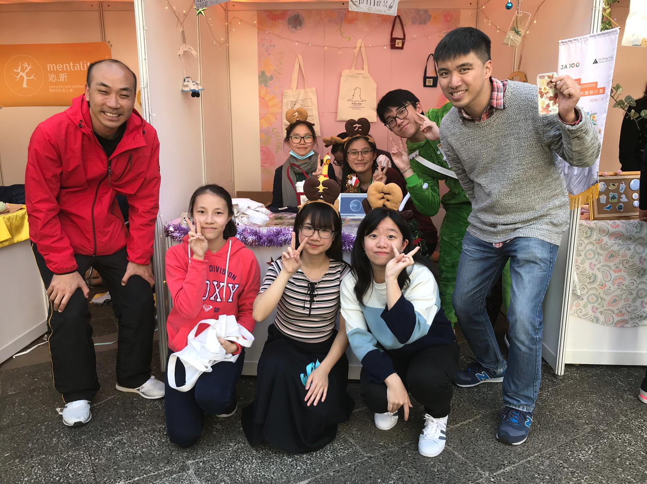
Objectives
Aroused student interest in business related subjects
Enable students to apply business subject knowledge learnt in lessons to reality
Develop students’ responsibility and commitment throughout the activity
Meeting frequency
Once a month

Slide 3
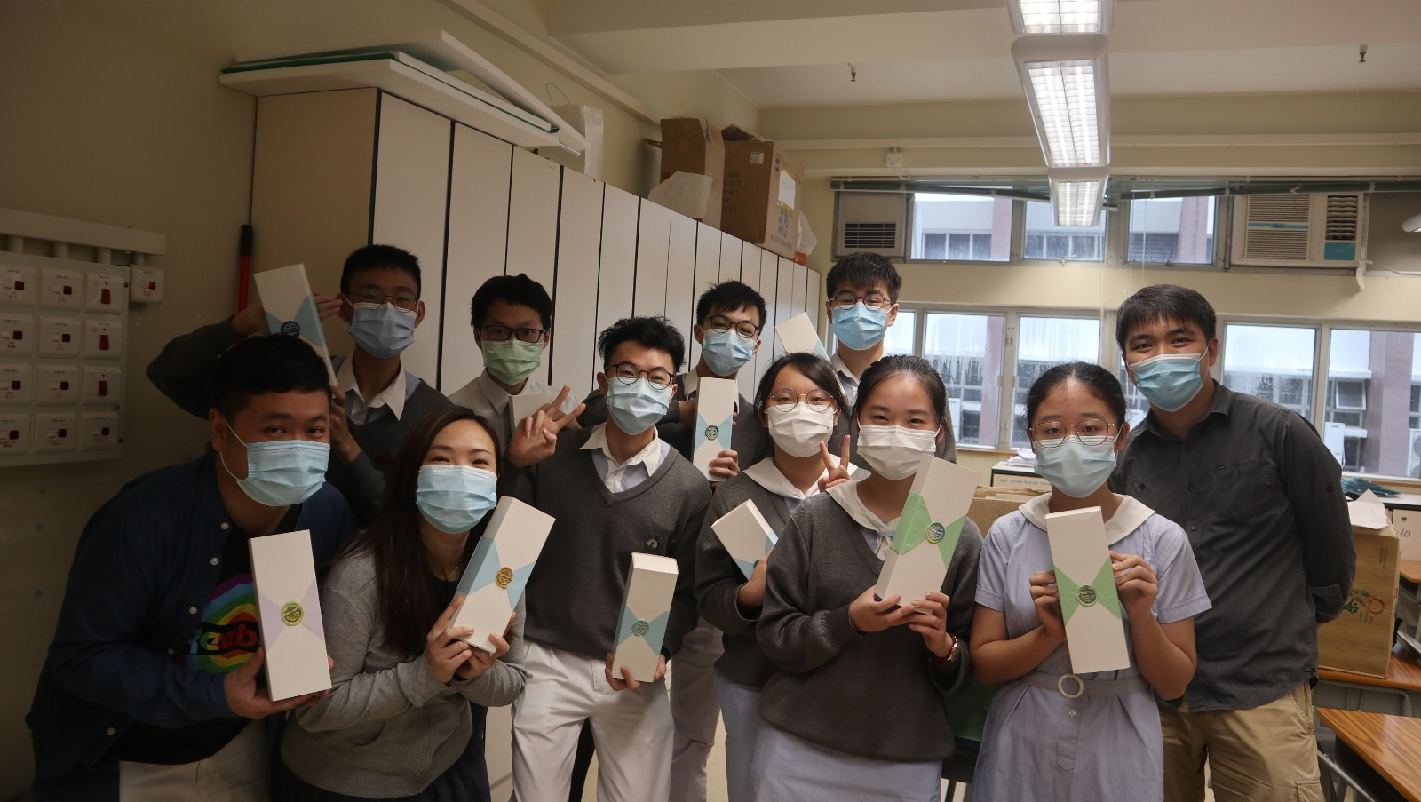
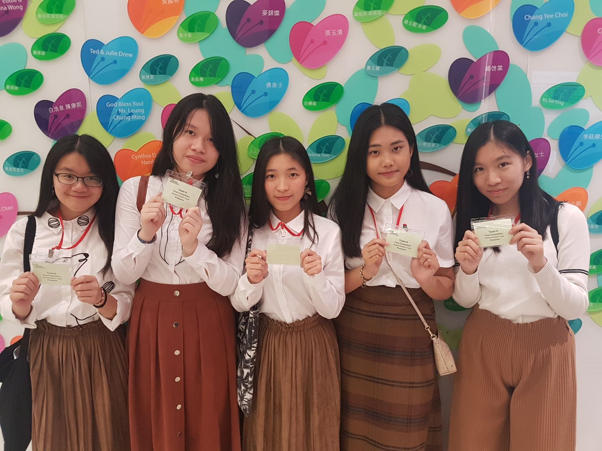
Proposed activities
JA Company Programmes
Board Game Competition (Monopoly, etc…….)
Business case study
Company Visit

