Slide 1
SCHOOL CHOIR
觀塘官立中學
學校合唱團
School Choir 2023-2024

Slide 2
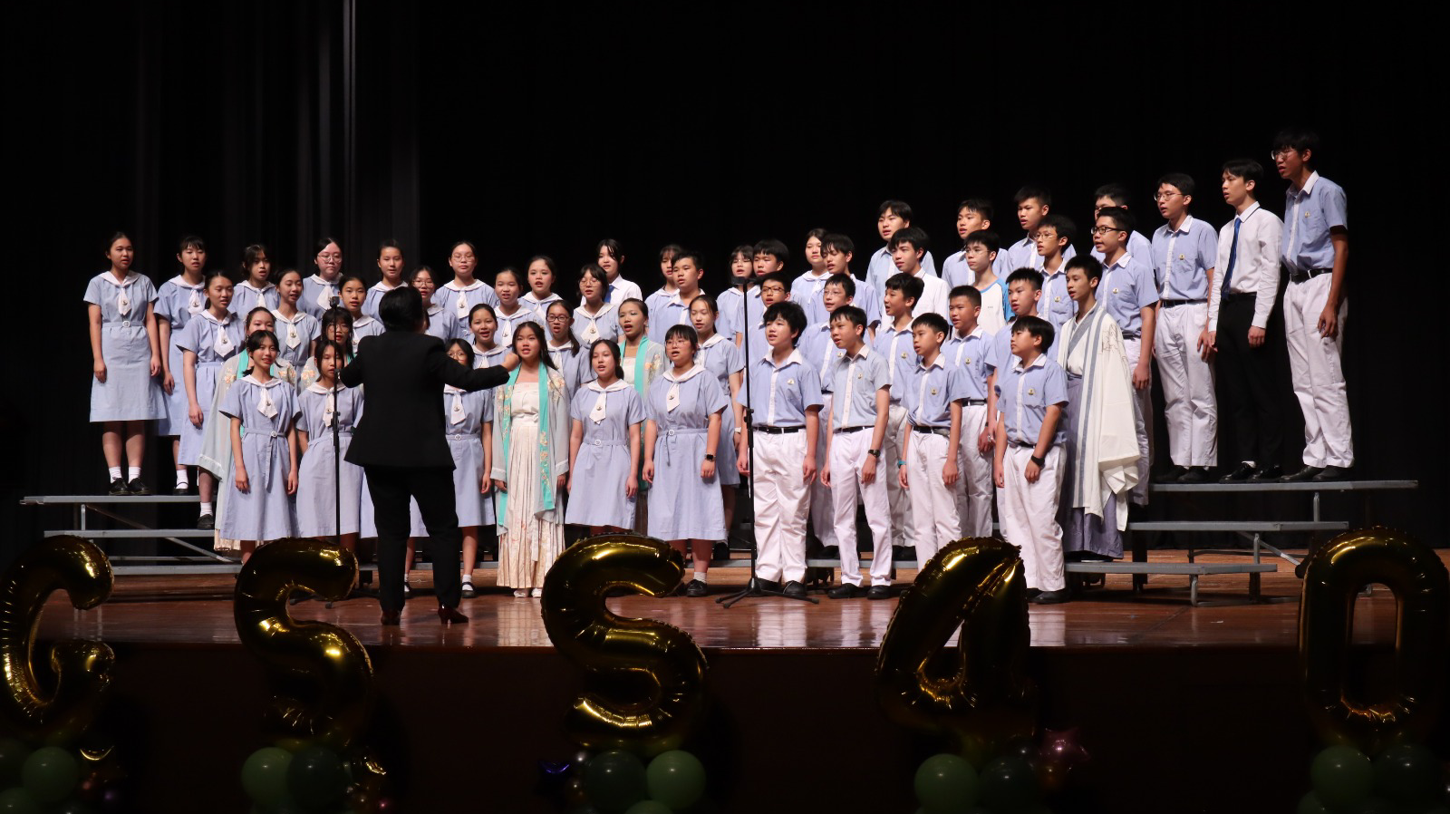
SCHOOL CHOIR
Alto
Soprano
Bass
Tenor

Slide 3
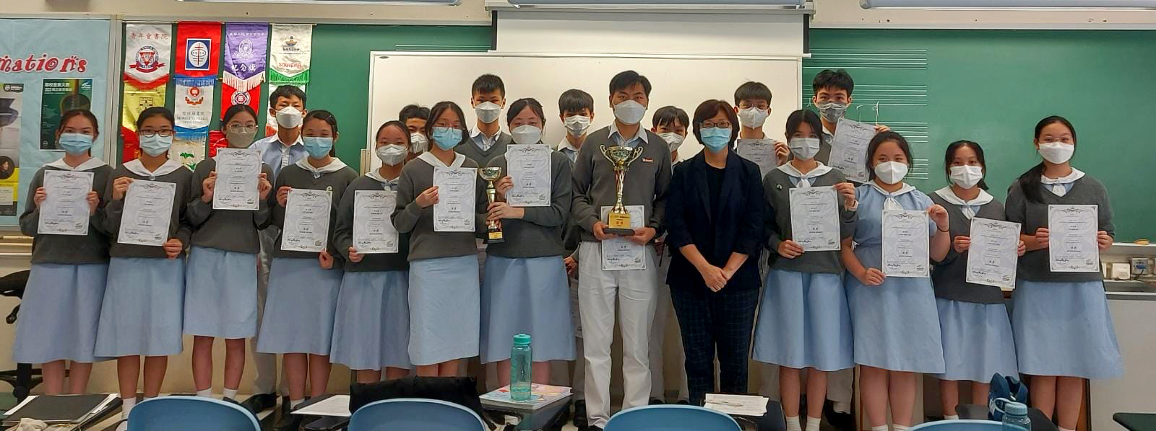
HONG KONG JOINT SCHOOL MUSIC COMPETITION 2022&2023
Secondary School Choir(Senior)—Silver Award
Secondary School Group Ensemble(Singing)— Silver Award

Slide 4
《你可知道》

Slide 5
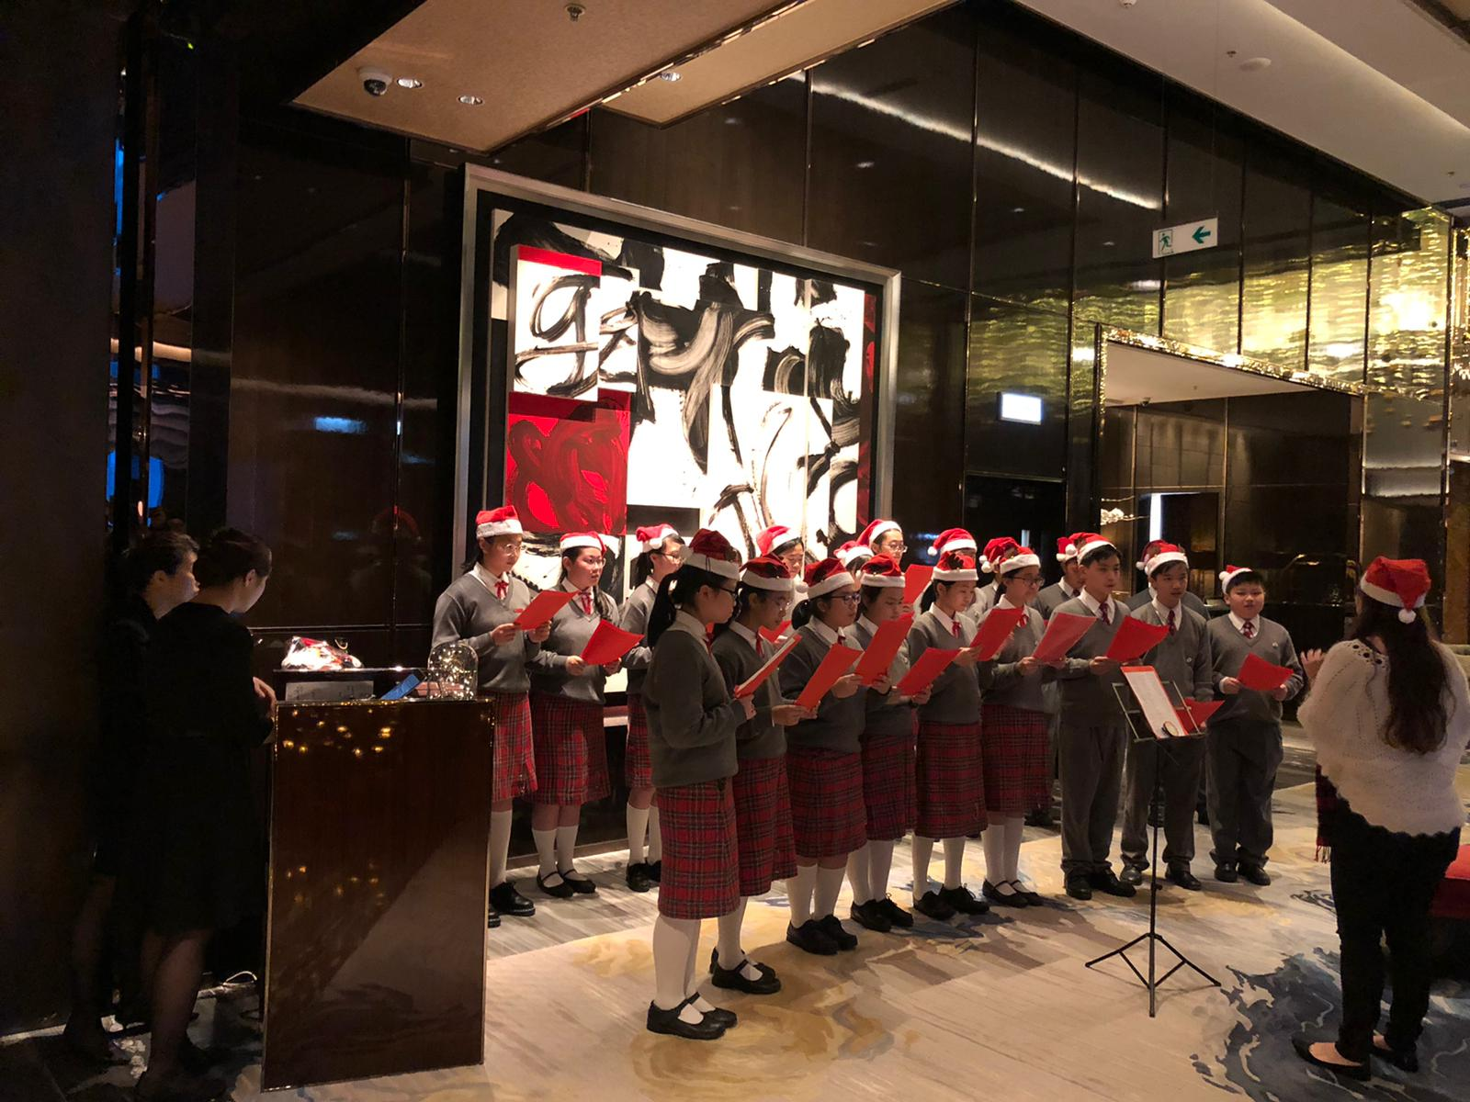
SCHOOL CHOIR CHRISTMAS PERFORMANCE

Slide 6
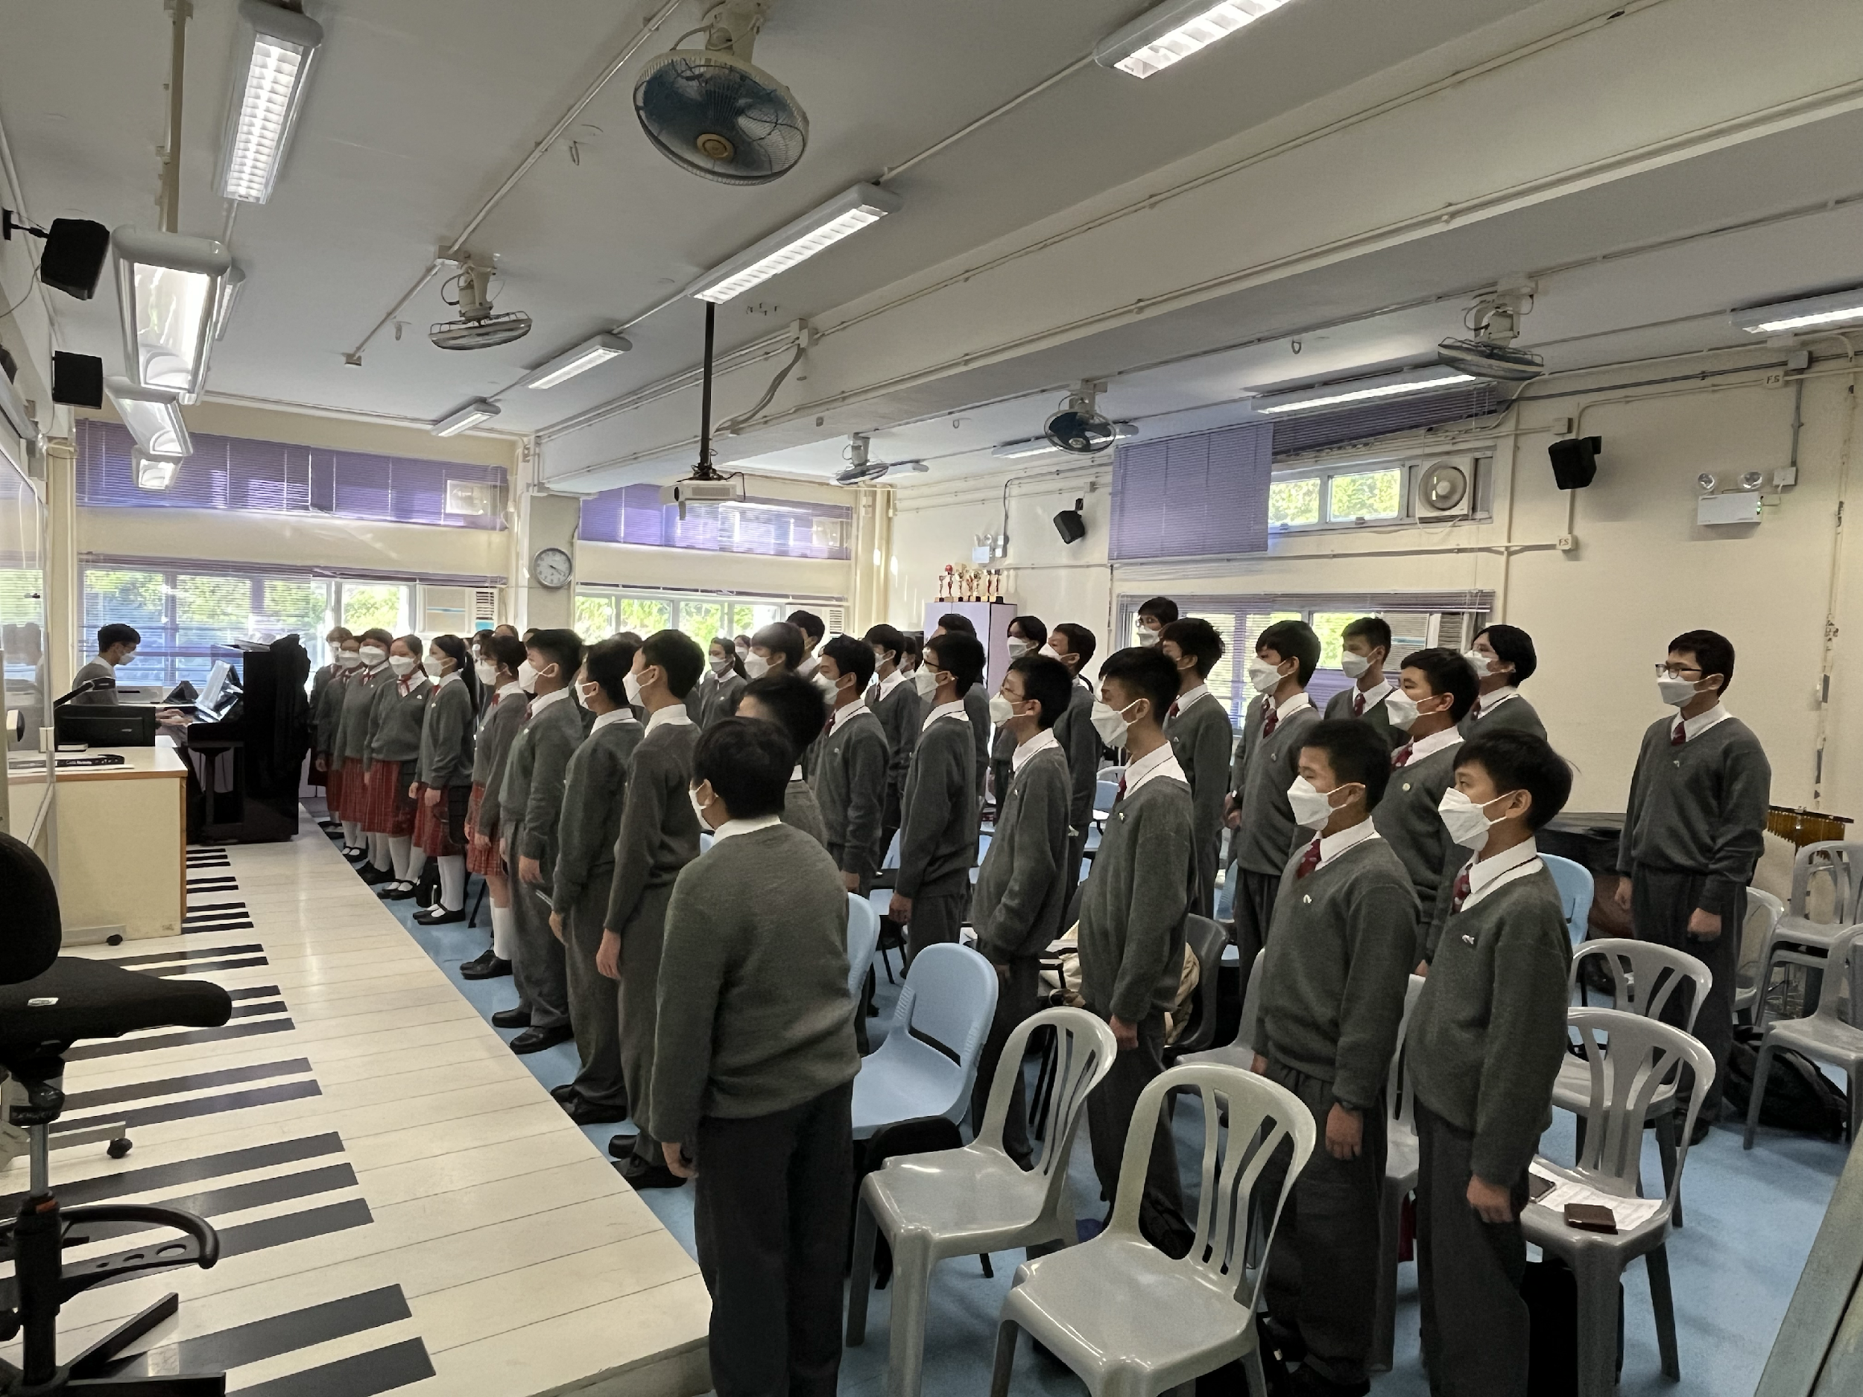
SCHOOL CHOIR
REGULAR PRACTICE

Slide 7
參加合唱團的好處
透過唱歌接觸不同音樂，增強同學對音樂的感知和審美能力
透過唱歌訓練情緒表達，有助提升說話溝通能力
能夠培養同學的團隊意識和合作精神
培養興趣以及建立自信心
透過呼吸和唱歌減壓

Slide 8
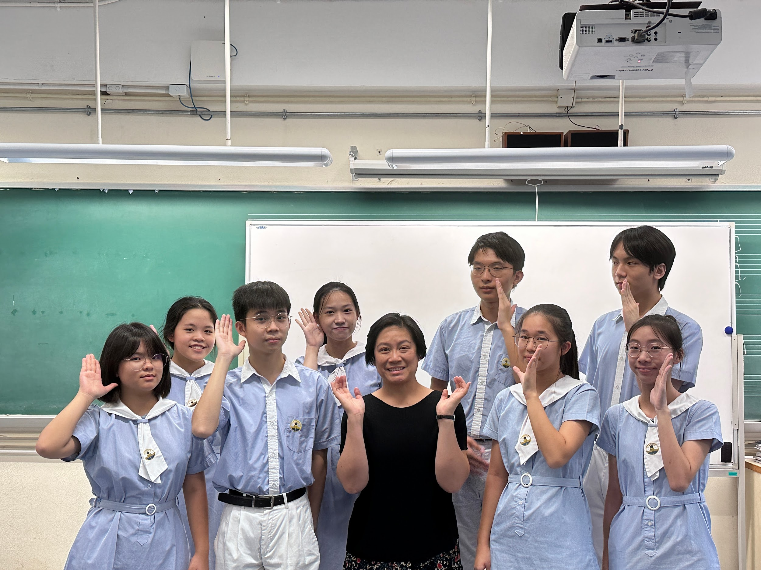
THE END!!

