Slide 1
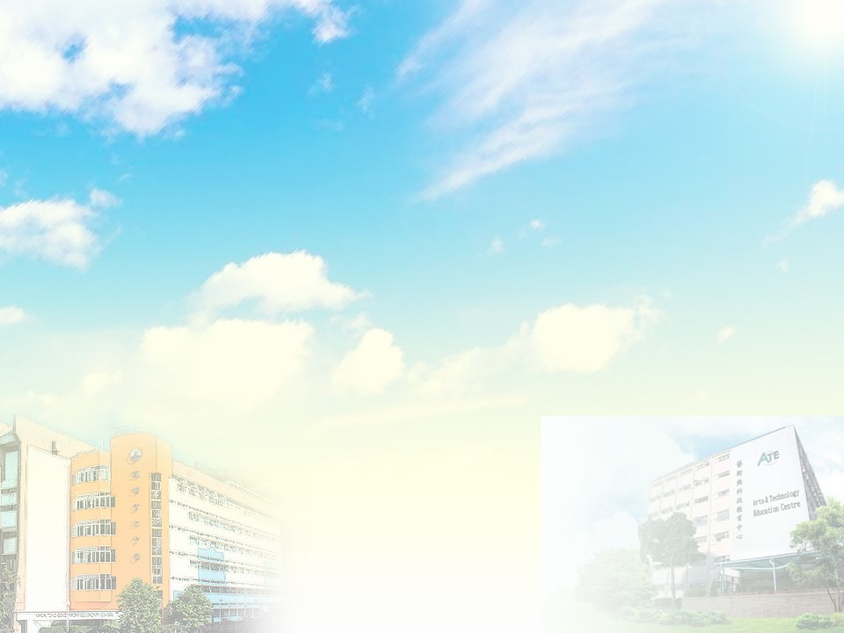
觀塘官立中學
與
藝術及科技教育中心
新高中音樂科

Slide 2
藝術及科技教育中心
Arts and Technology Education Centre
簡稱ATEC
位於樂富的官立中學，毋須繳交學費
提供多個新高中課程，包括音樂科
星期六上午或下午上課，每節3小時
不計補課，全年36節
每班人數約30人，本校每年約4-6位同學選修

Slide 3
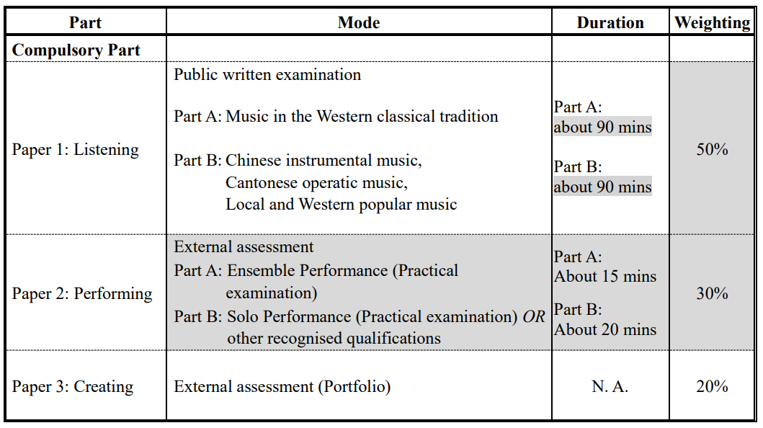
新高中音樂科

Slide 4
新高中音樂科
Paper 1: Listening (50%)
Candidates have to sit for a public written examination. The examination covers the following:
Part A: Music in the Western classical tradition (24%)
Part B:
Chinese instrumental music (12%)
Cantonese operatic music (6%)
Local and Western popular music (8%)

Slide 5
新高中音樂科
Paper 2: Performing (30%)
Part A : Ensemble Performance (15%)
two or more pieces in an instrumental or vocal ensemble in contrasting styles,
5 to 10 minutes(12%)
an oral presentation (3%) lasting for 3 to 5 minutes to explain their understanding and interpretation of the music performed.

Slide 6
Part B: Solo Performance (15%)
Candidates may use any instruments, including voice, for this externally-assessed practical examination.
two or more solo pieces in contrasting styles in a continuous performance (13%),
8 to 15 minutes,
viva voce (2%) lasting for 3 to 5 minutes to explain their understanding and interpretation of the music performed.

Slide 7
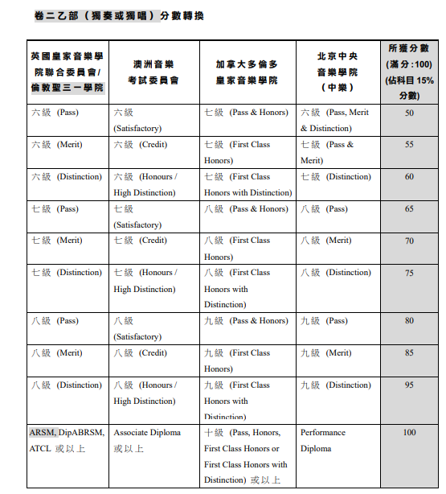

Slide 8
新高中音樂科
Paper 3: Creating (20%)
Audio recordings and scores of two original compositions (16%) based on composition briefs.
A reflective report (4%) ranging from 400 to 600 words.

