Slide 1
Debating Club

Slide 2
English debate | Chinese debate
Teachers: Ms Lui Mei Kei (English Debate) Ms Kopman Diane Ruebina (English Debate) | Teachers: Ms Chu Bo Yin (Chinese Debate) Ms Chan Wun Ling (Chinese Debate)
Club meeting day:
Wednesday
(Twice a month)
Club meeting time:
4:00pm-5:00pm

Slide 3
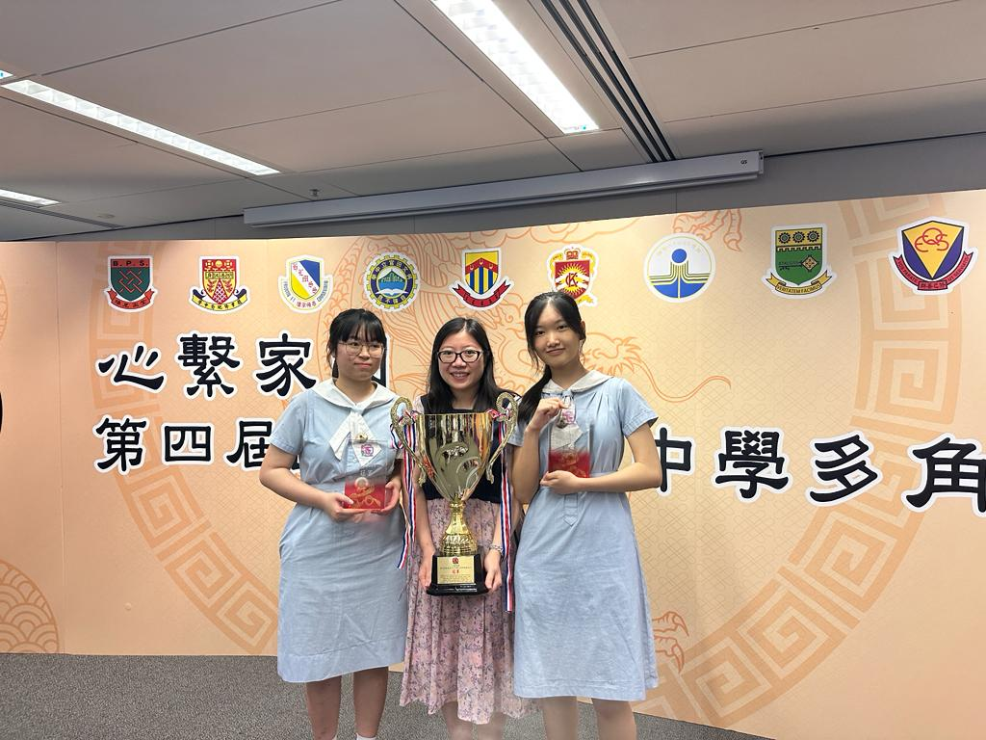
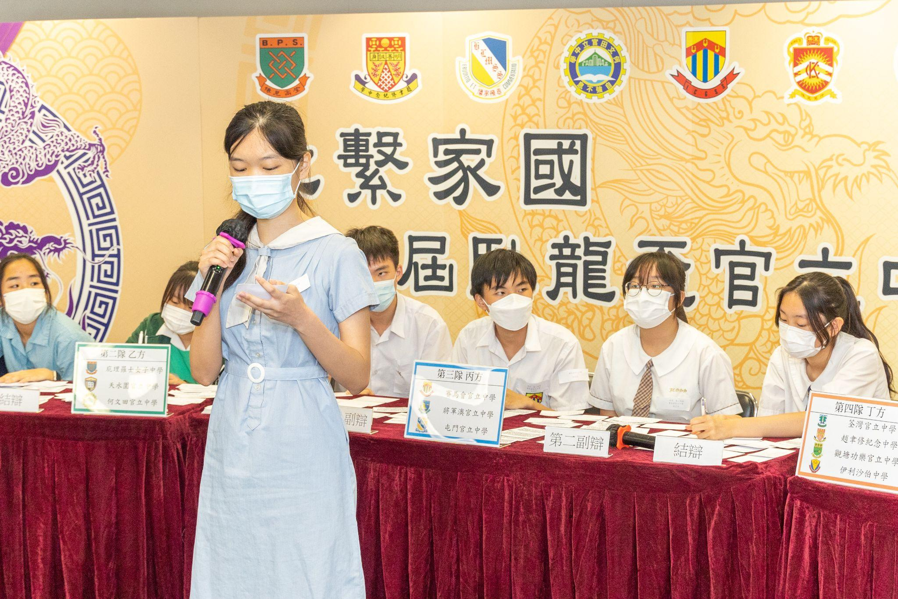
第二屆及第四屆
臥龍盃官立中學多角辯論賽
冠軍

