Slide 1
Debating Club

Slide 2

English debate | Chinese debate
Teachers: Ms Lui Mei Kei Ms Poon Siu Pik | Teachers: Ms Chan Wun Ling Mr Hui Wai Yam
Club meeting day:
Wednesday
(Twice a month)
Club meeting time:
4:00pm-5:00pm

Slide 3
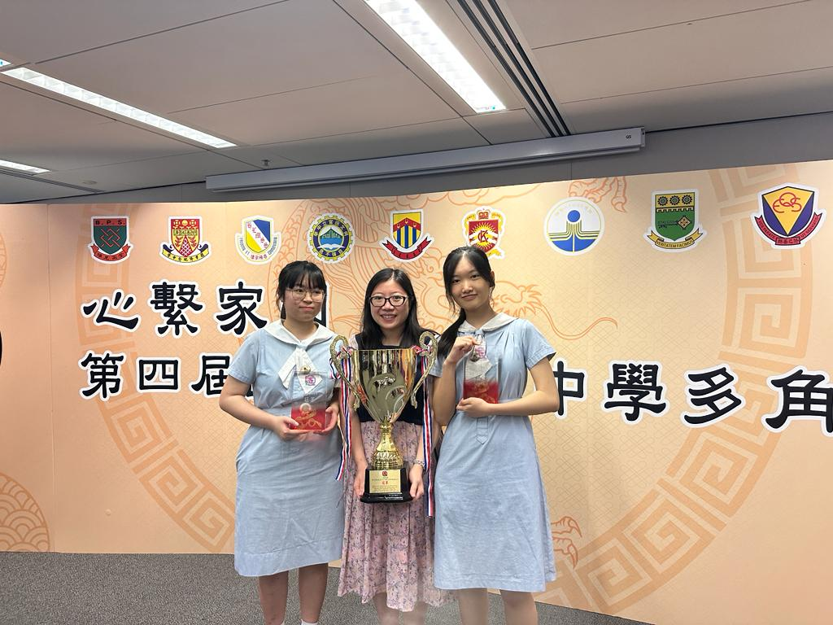
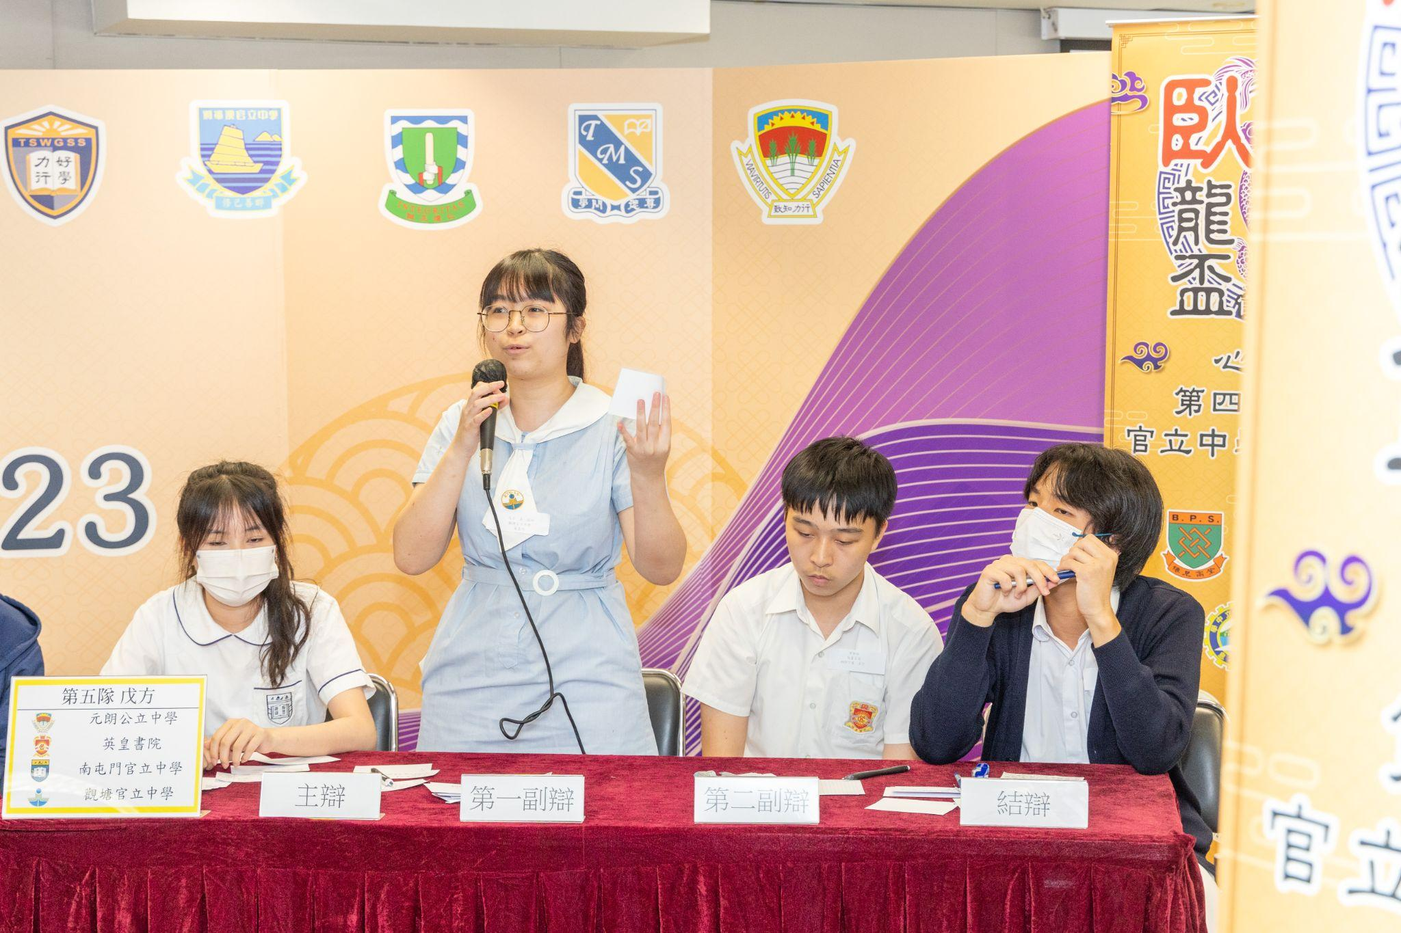
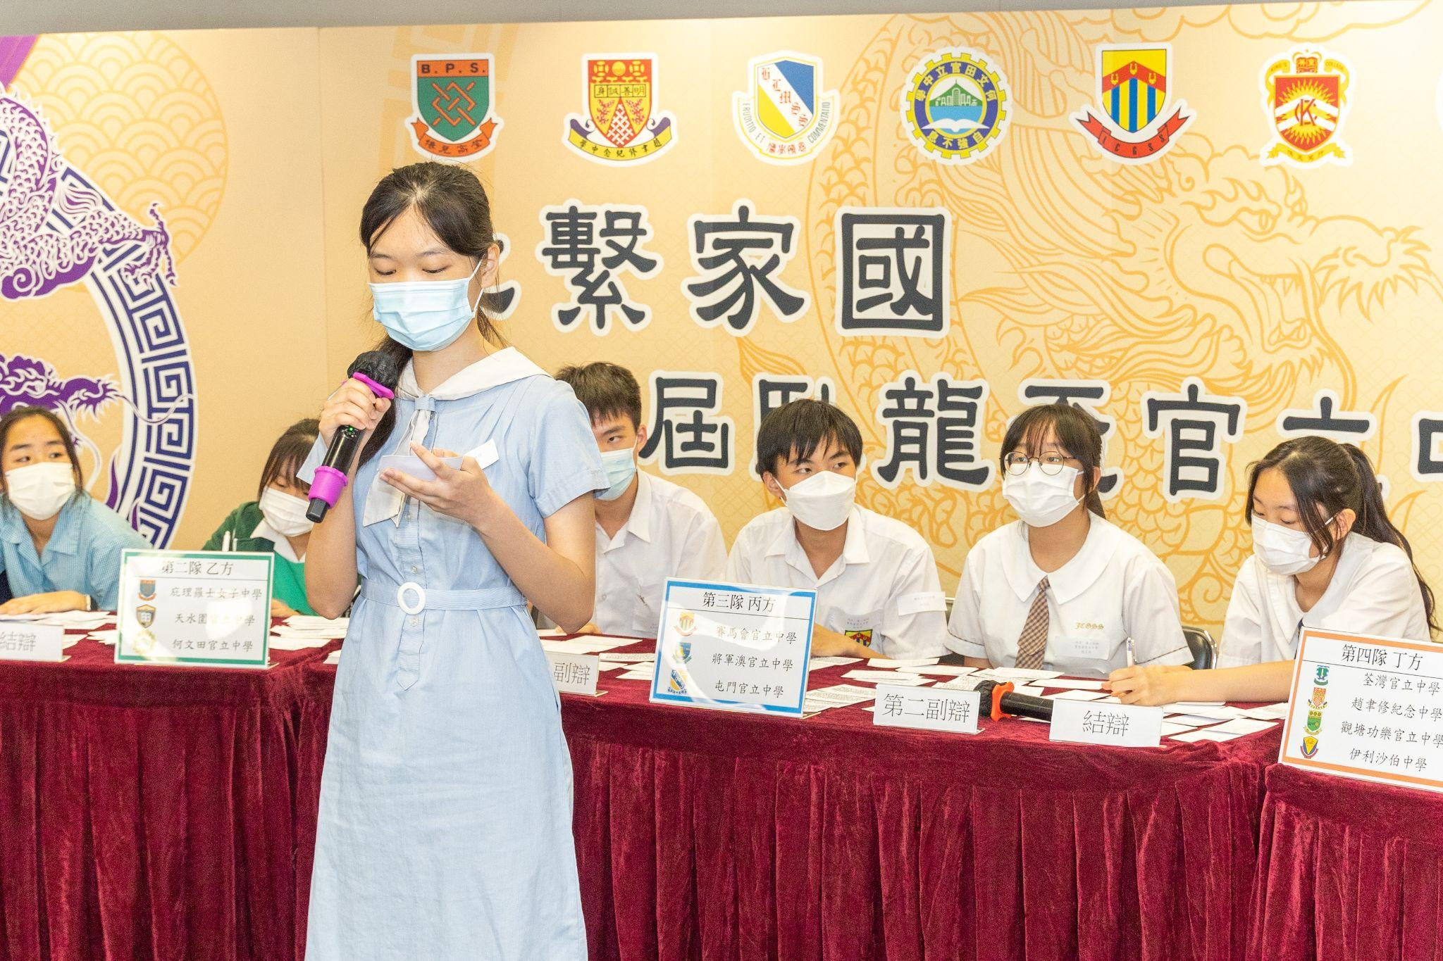
第二屆、第四屆、第五屆
臥龍盃官立中學多角辯論賽
冠軍

