Slide 1


SCHOOL CHOIR
觀塘官立中學
學校合唱團
School Choir 2024-2025

Slide 2
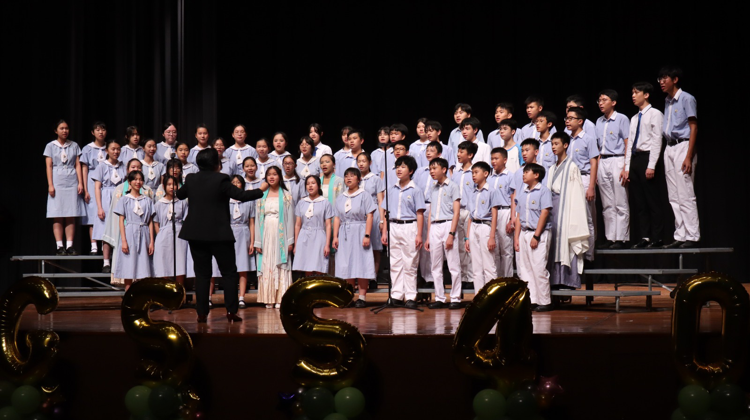


SCHOOL CHOIR
Alto
Soprano
Bass
Tenor

Slide 3
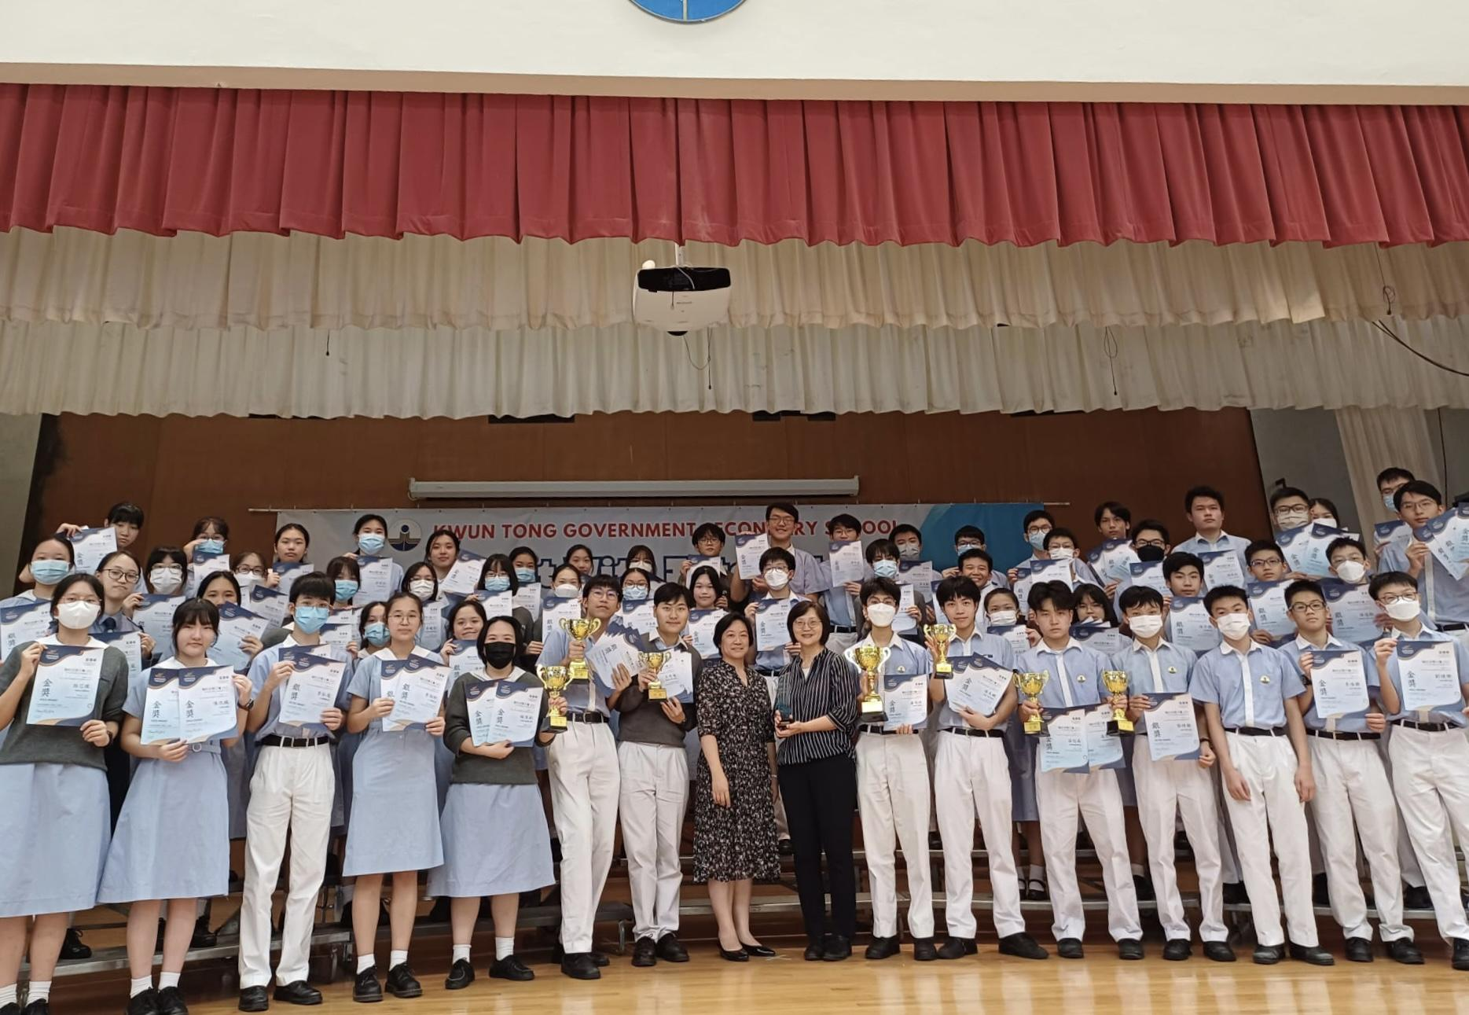
HONG KONG JOINT SCHOOL MUSIC COMPETITION 2023-2024
Secondary School Choir(Senior)—Bronze Award
Secondary School Group Ensemble(Singing)— Silver Award

Slide 4
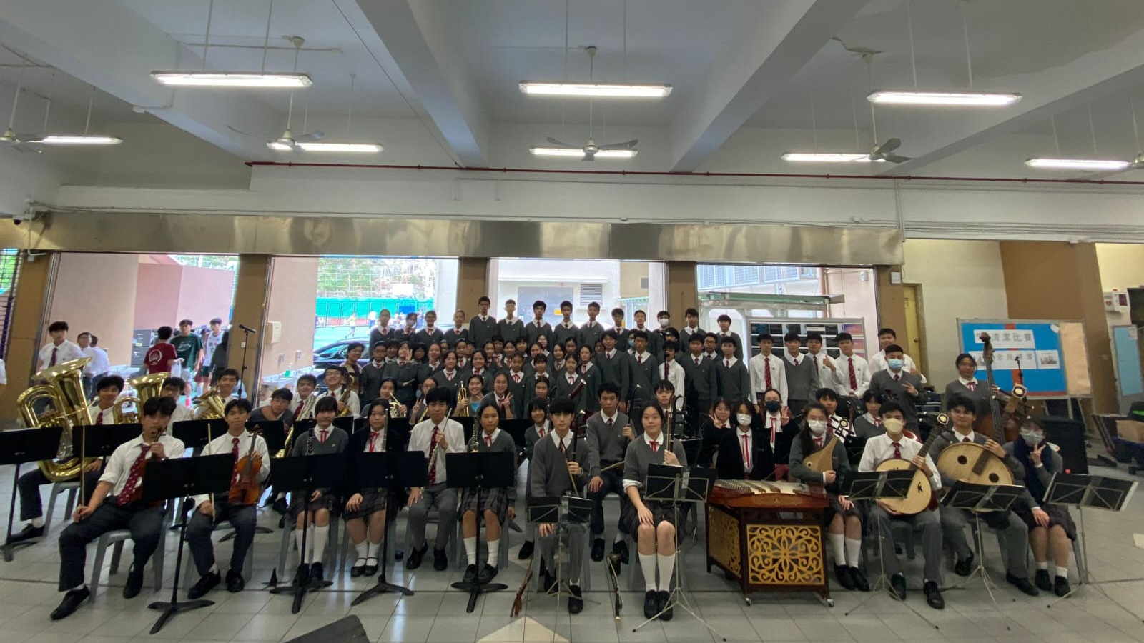
Christmas concert

Slide 5
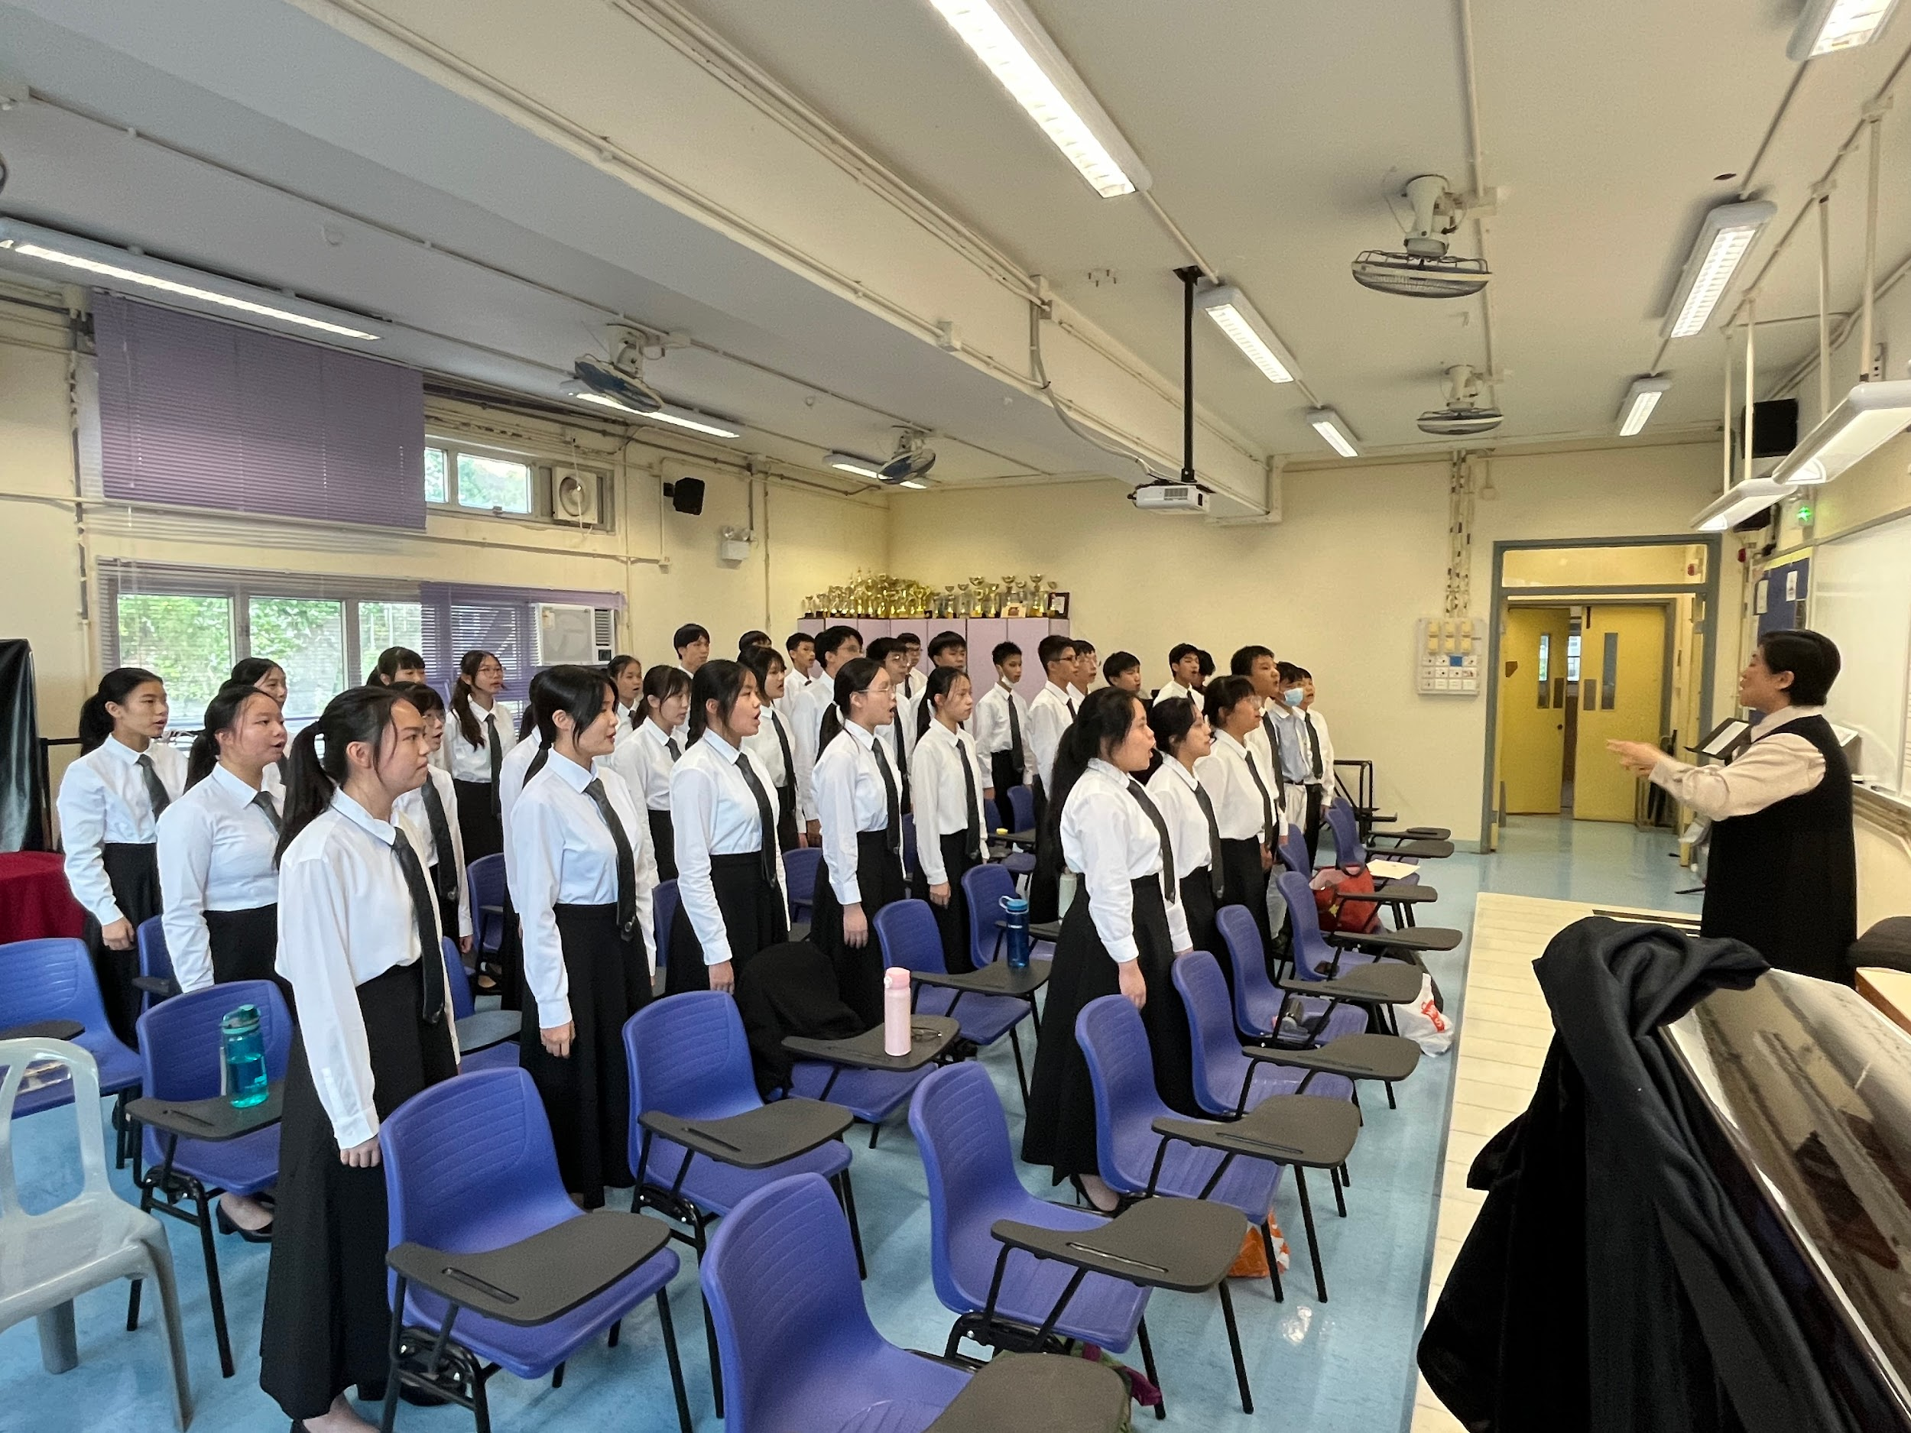
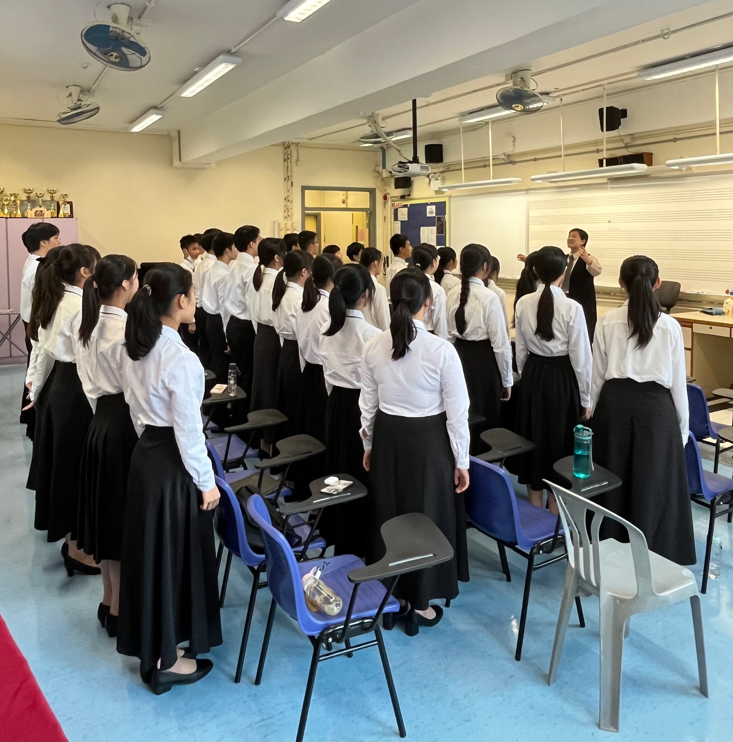
SCHOOL CHOIR
PRACTICE BEFORE SPEECH DAY

Slide 6
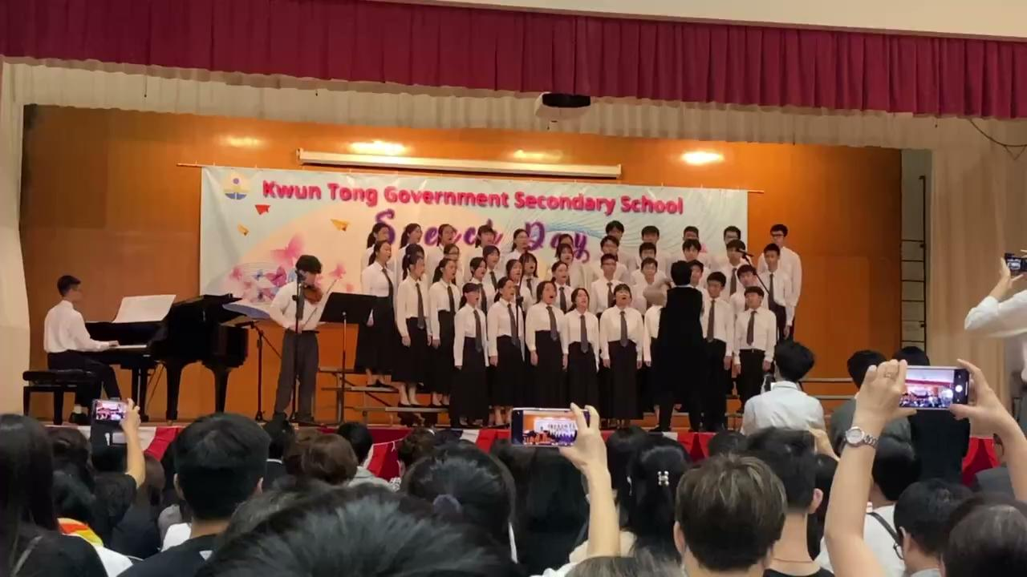
40th Speech Day:《Perhaps Love》

Slide 7
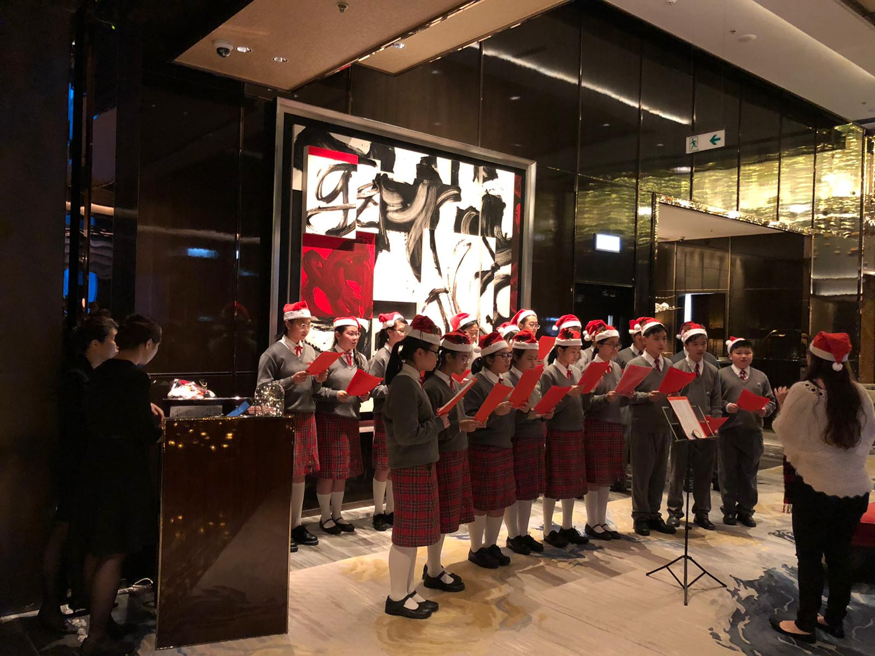
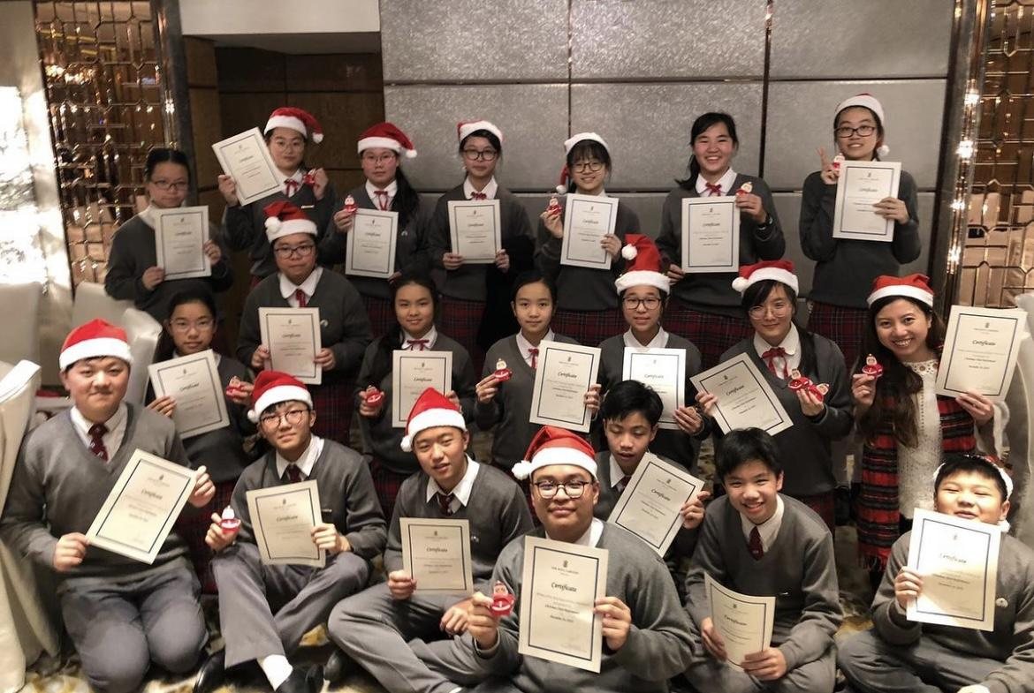
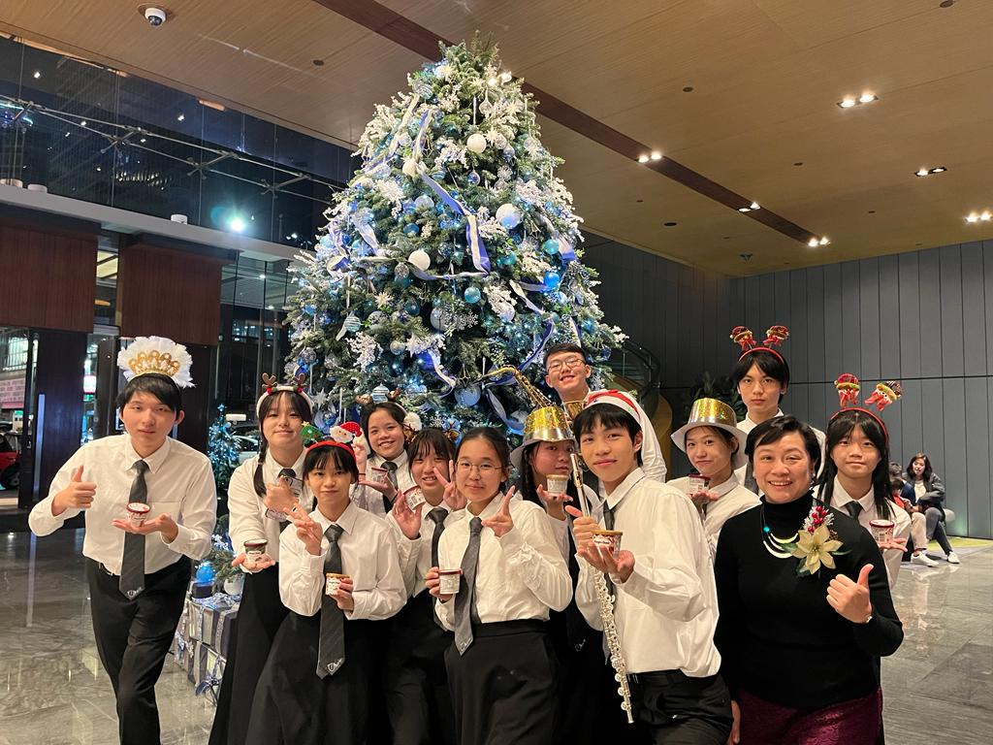
SCHOOL CHOIR
CHRISTMAS PERFORMANCE

Slide 8
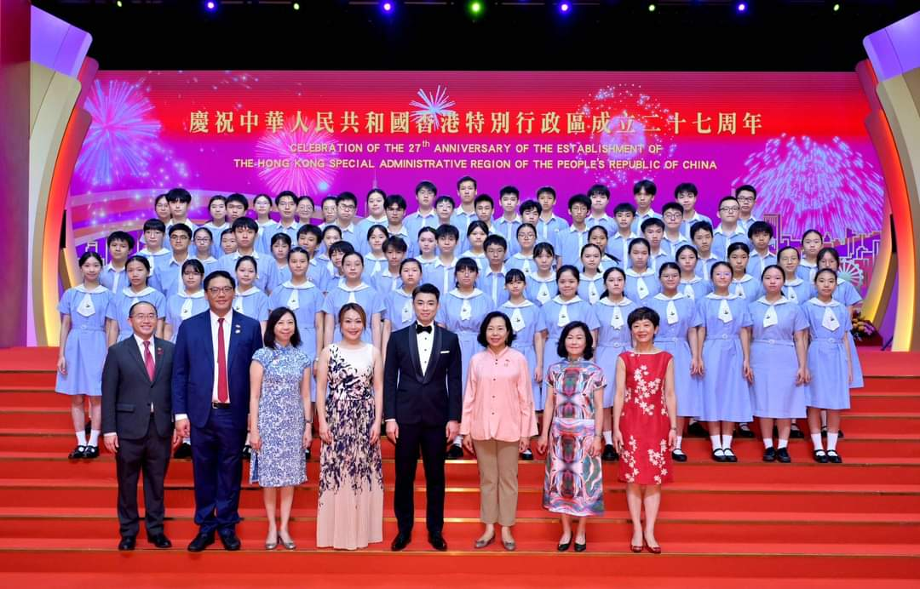
SCHOOL CHOIR
香港回归纪念日

Slide 9

參加合唱團的好處
透過唱歌接觸不同音樂，增強同學對音樂的感知和審美能力
透過唱歌訓練情緒表達，有助提升說話溝通能力
能夠培養同學的團隊意識和合作精神
培養興趣以及建立自信心
透過呼吸和唱歌減壓

Slide 10
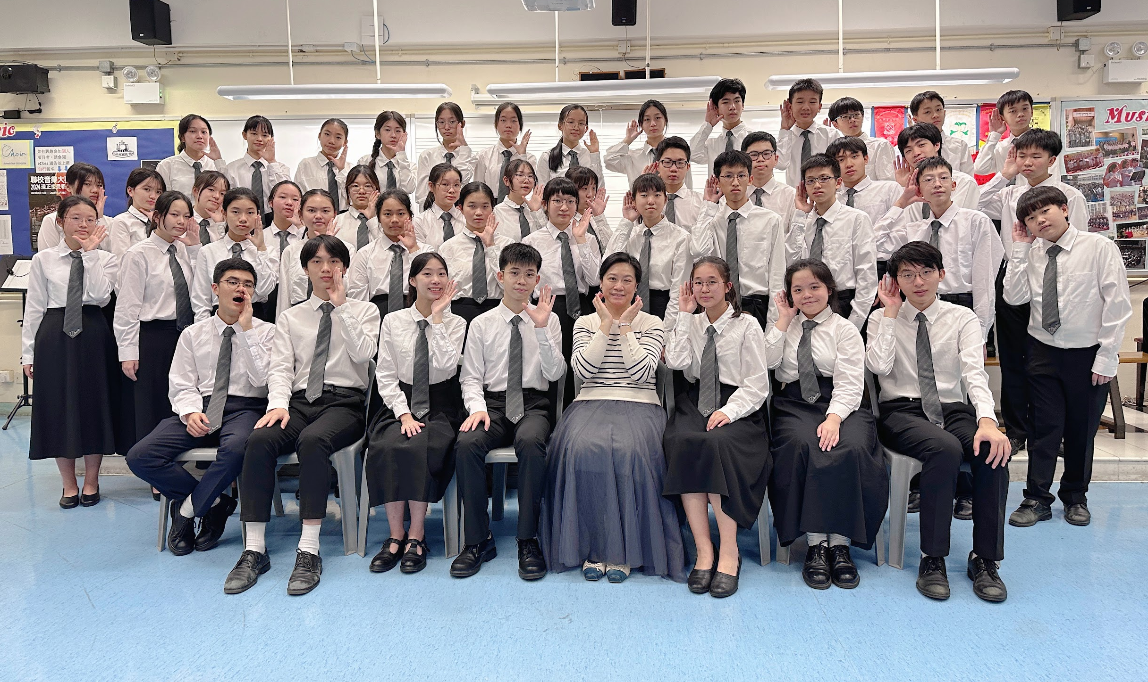
The End!!

