Slide 1
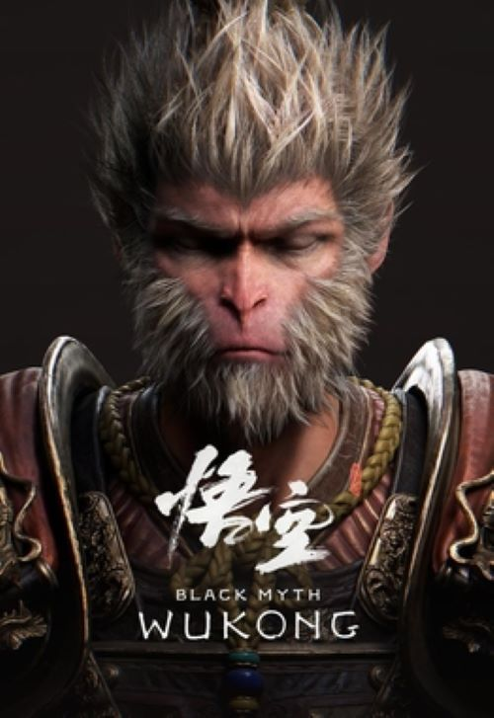
Audio Visual Information Technology Club
2024 - 2025

Slide 2
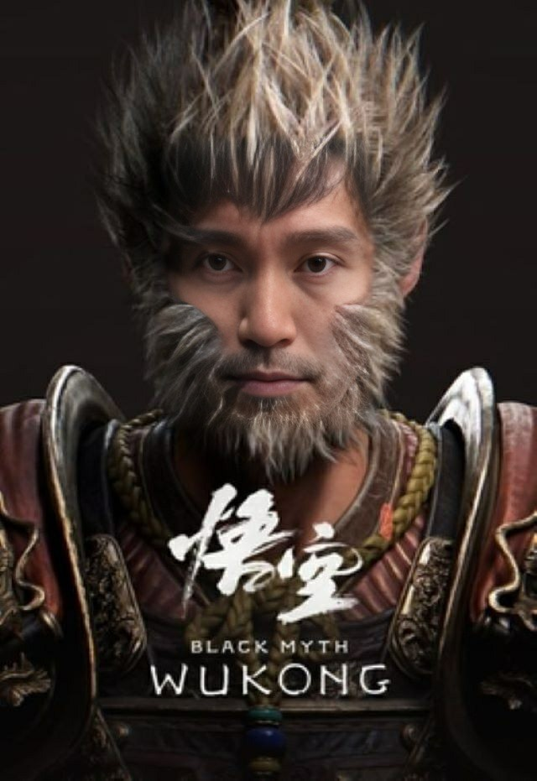
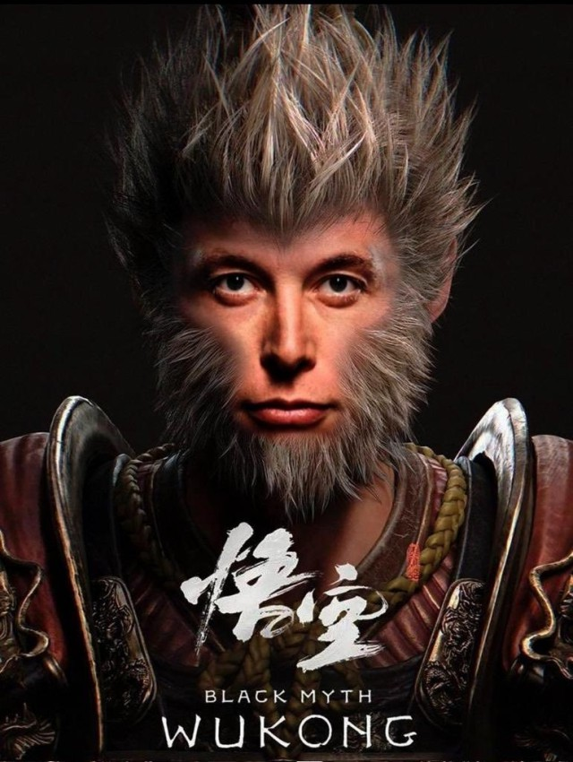
Guess who they are

Slide 3
Monkey King | Elon Musk | Stephen Chow
A.I softwares can generate these pictures with a click of a mouse

Slide 4
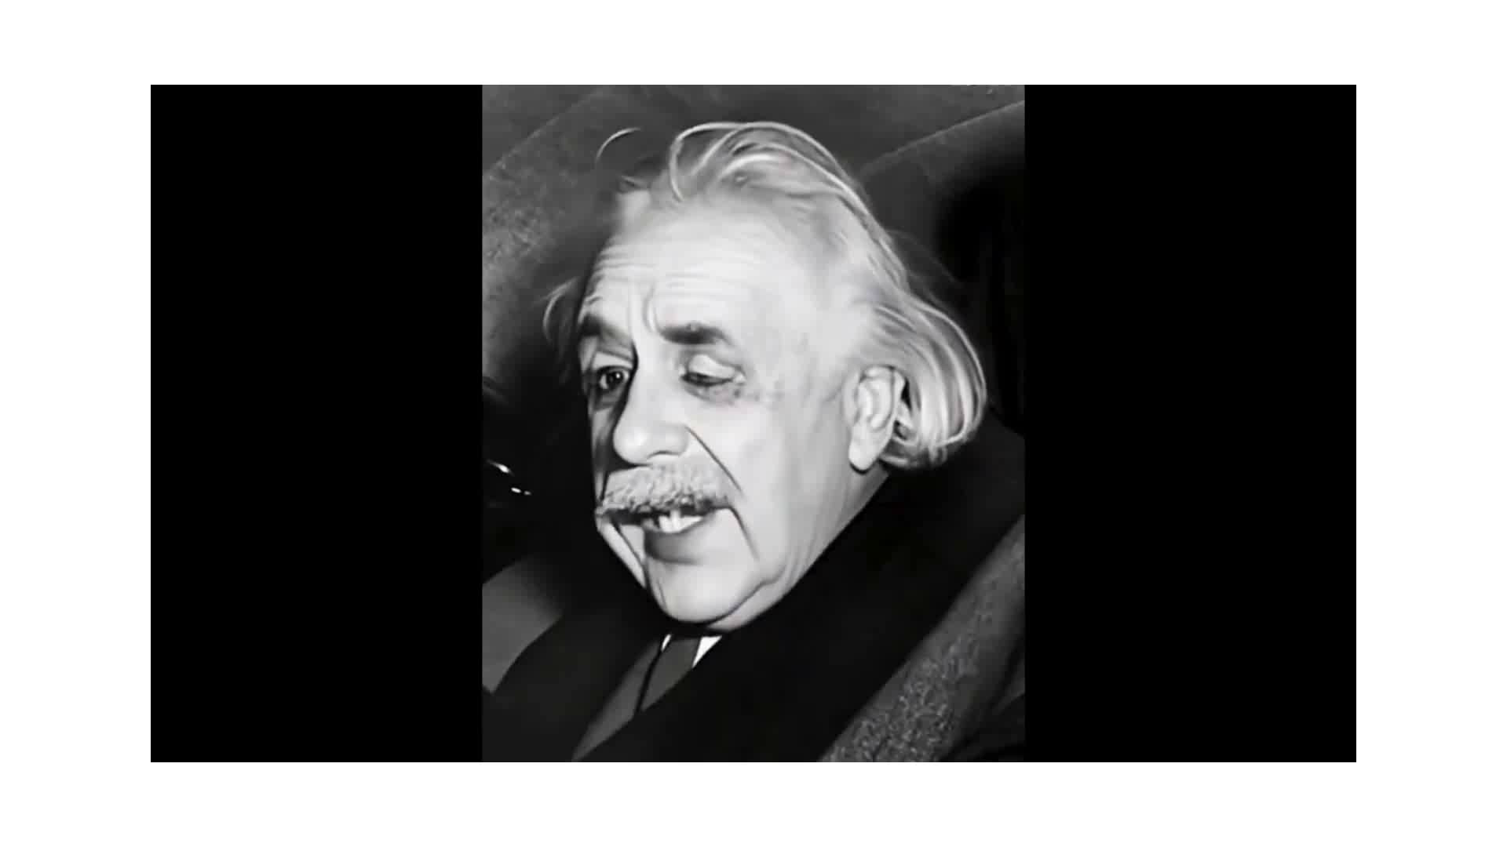
How easy to turn something in motion
Just one click

Slide 5
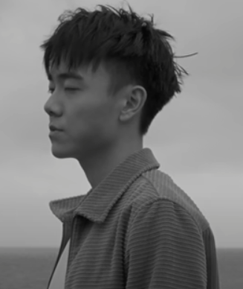
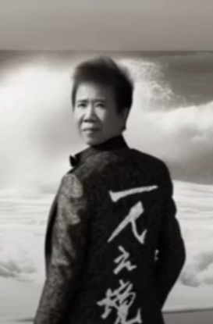
Don't you want to be a popular A.I singer?
林家謙
尹光

Slide 6
A.I (Audio and Video Softwares)
These softwares can turn you into an incrediable creator
Many memorable images can bring back to live
Master all these free online A.I generated audio and video softwares in a snap of a finger
Bring you up-to-date of A.I technologies in the cyber world

Slide 7
Come and Join (All are welcome)
Audio Visual Information Technology club (Mr. Alberto)
Meeting venue : Computer room (2nd floor)
Meeting Date / Time : Day 7 / Lunch Time (13:25 - 14:05)
Meeting Frequency : Once a month

