Slide 1
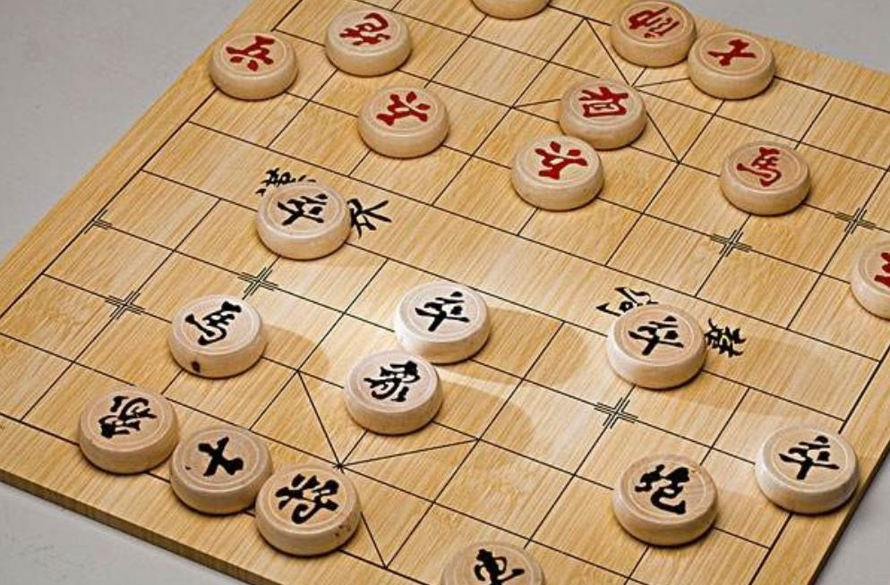
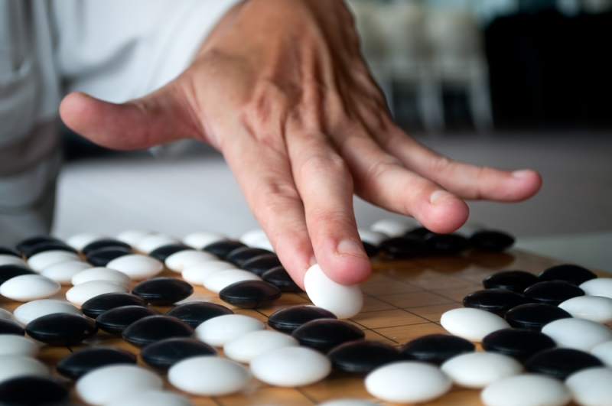

Chess club 棋藝學會
Club i/c:
Mr. Mak Chin Ho (6/F Staff Room)

Slide 2
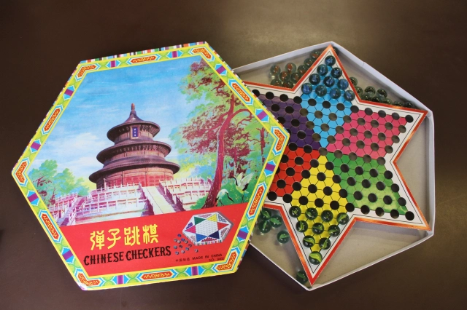
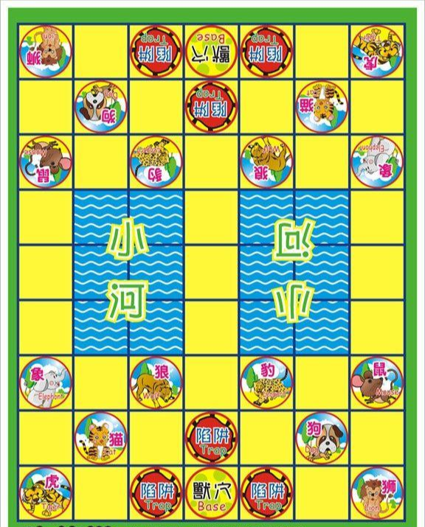
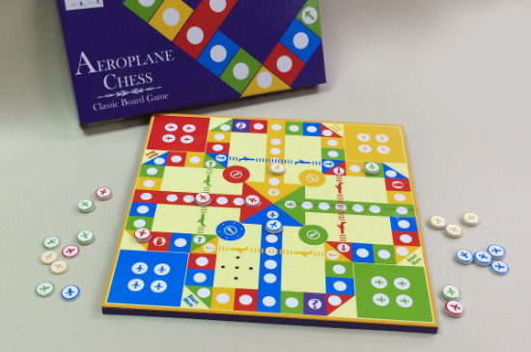
圍棋
象棋
飛行棋
波子棋...
Meeting time:
4:00-4:40pm (Friday)
Once a month

