Slide 1
Gardening Club 2023-24
Gardening is considered by many people to be a relaxing activity.

Slide 2
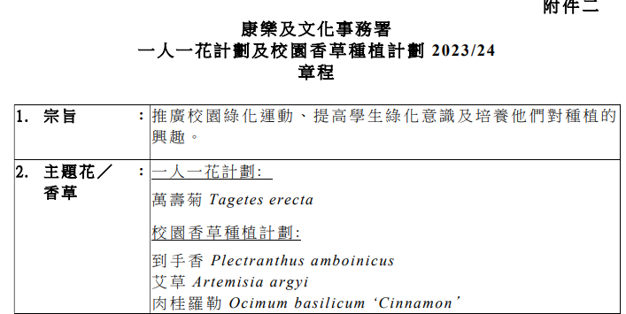
Two pots per class gardening scheme 「一班兩花」種植計劃
Co-organized with LCSD

Slide 3
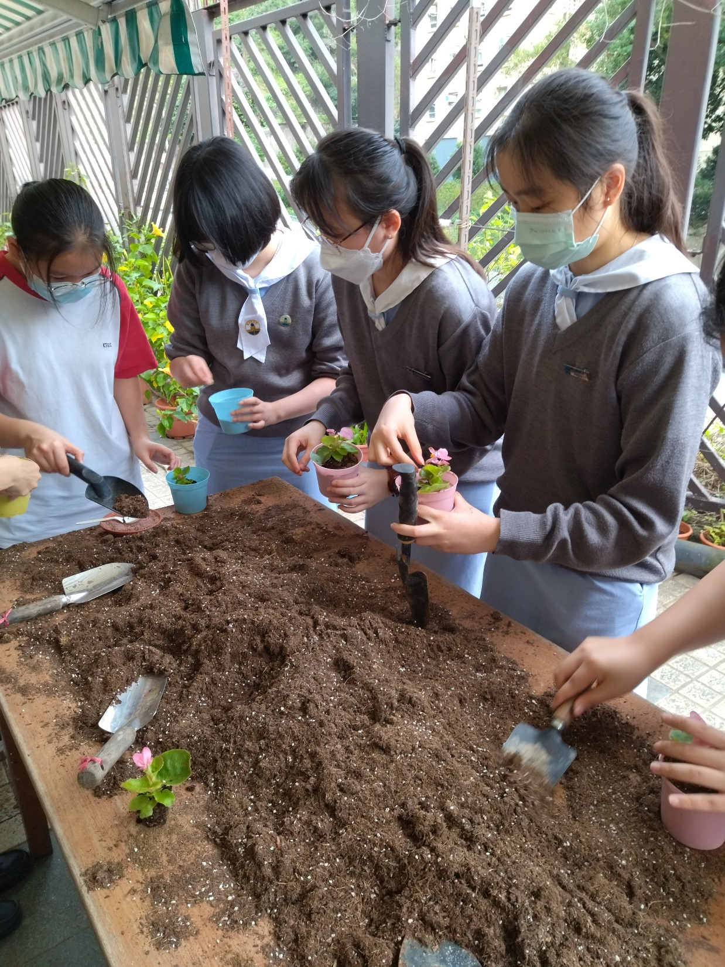
Two pots per class gardening scheme 「一班兩花」種植計劃 2022-2023 回顧

Slide 4
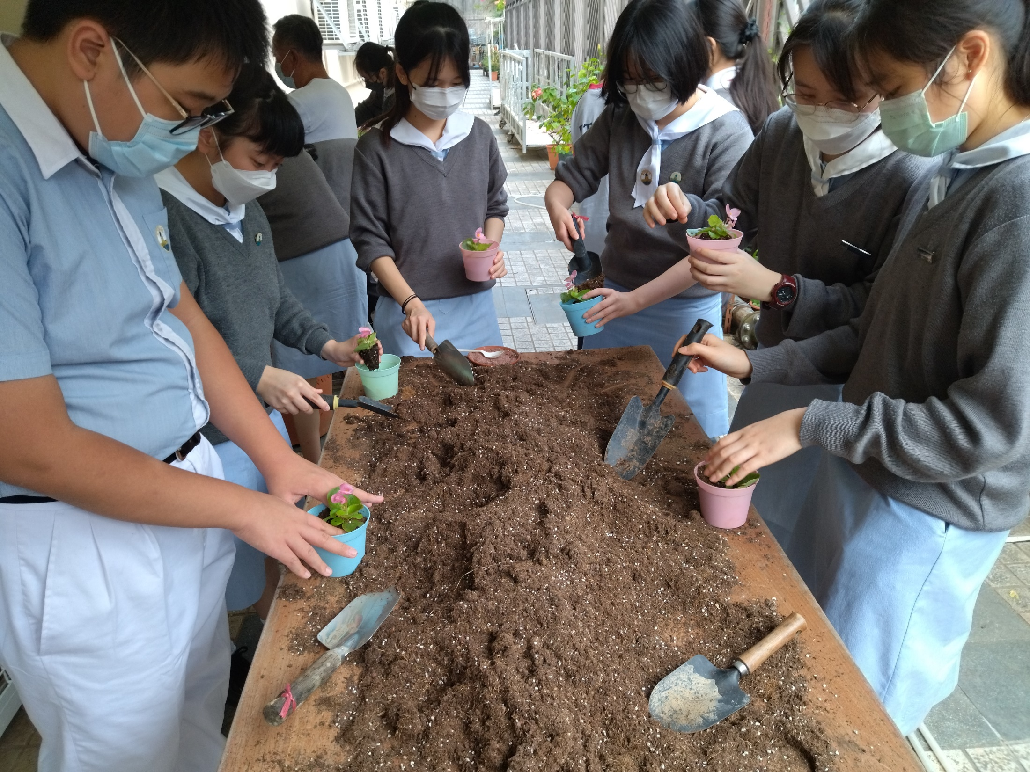

Slide 5
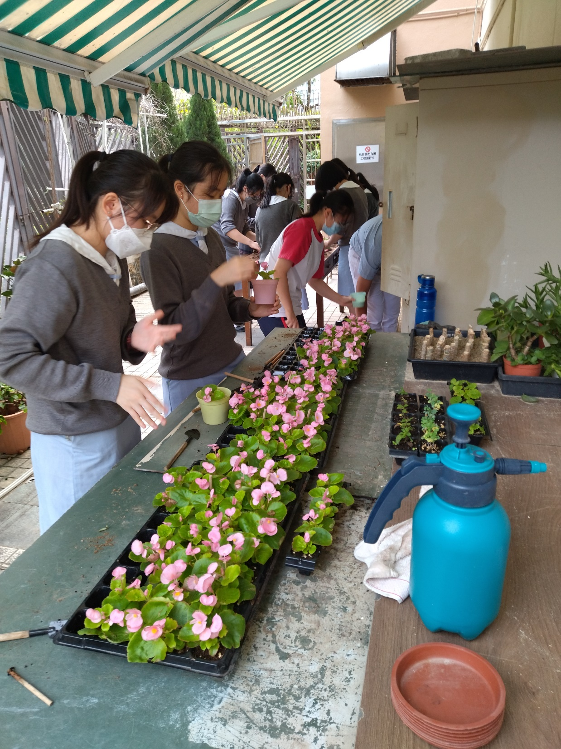

Slide 6
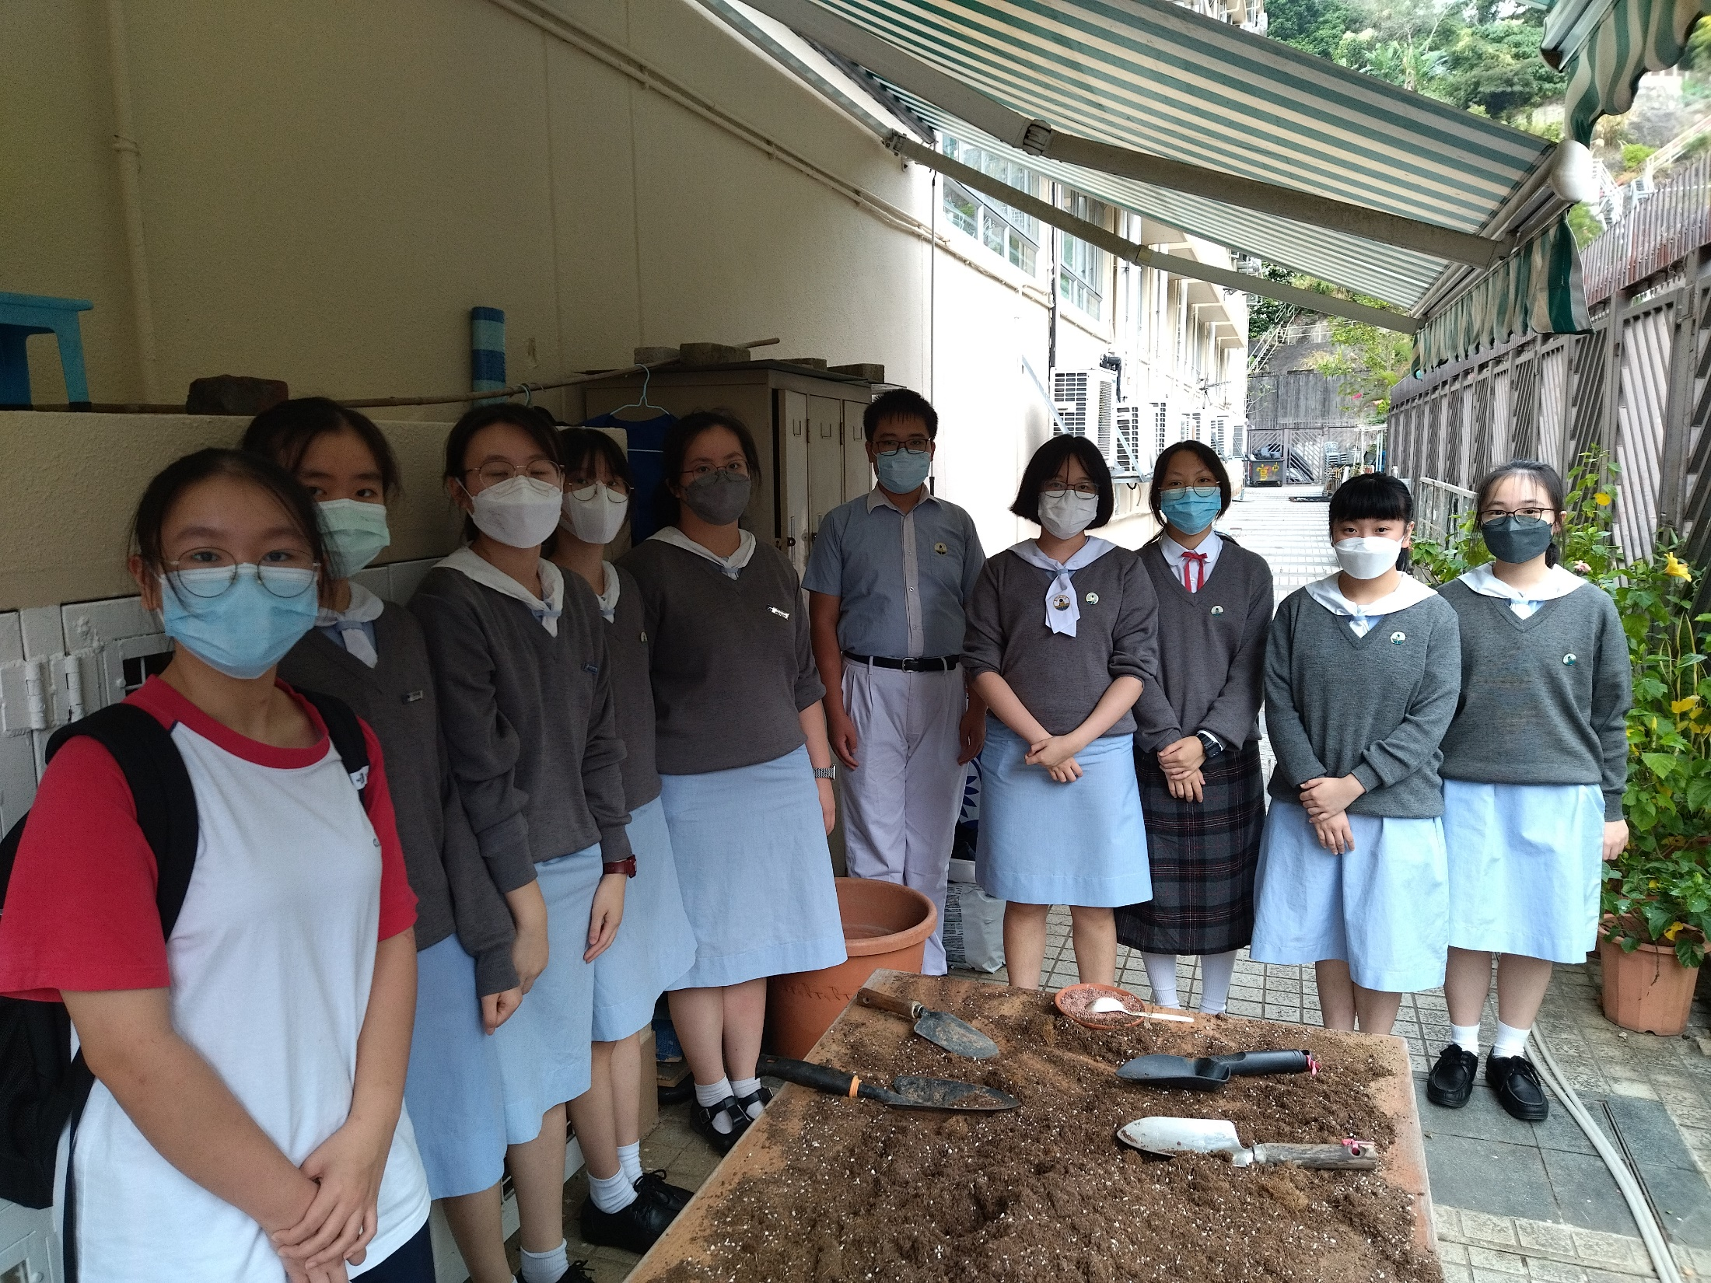

Slide 7
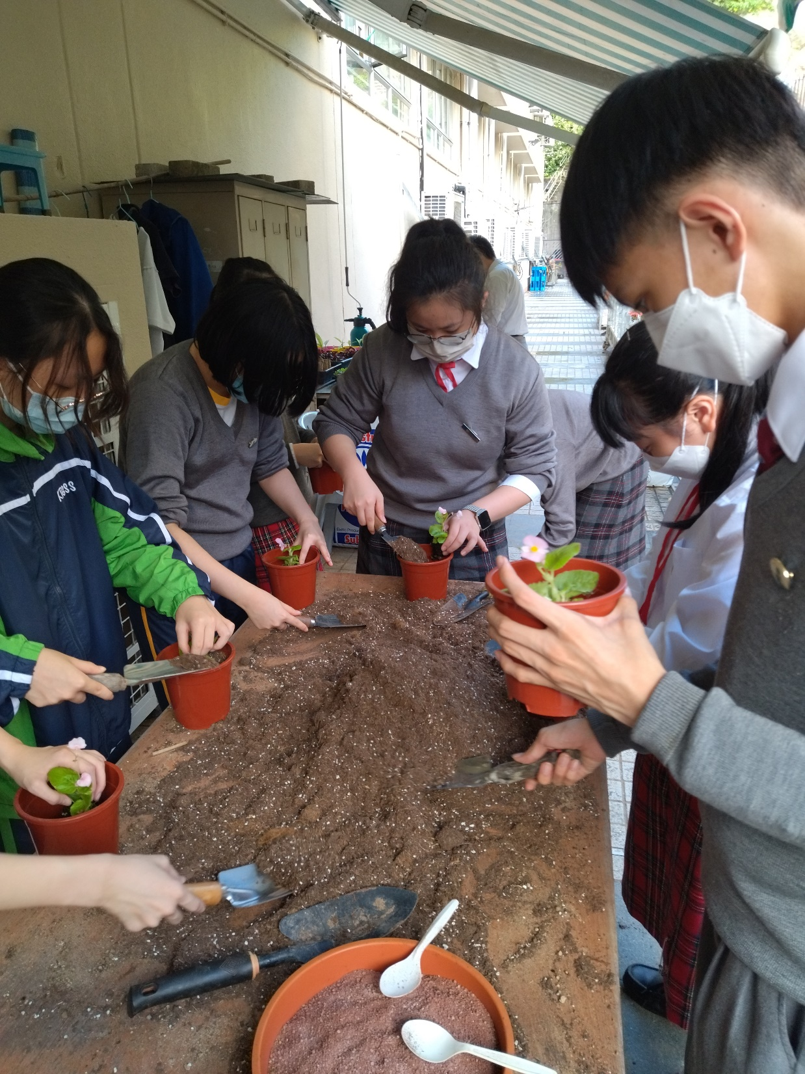

Slide 8
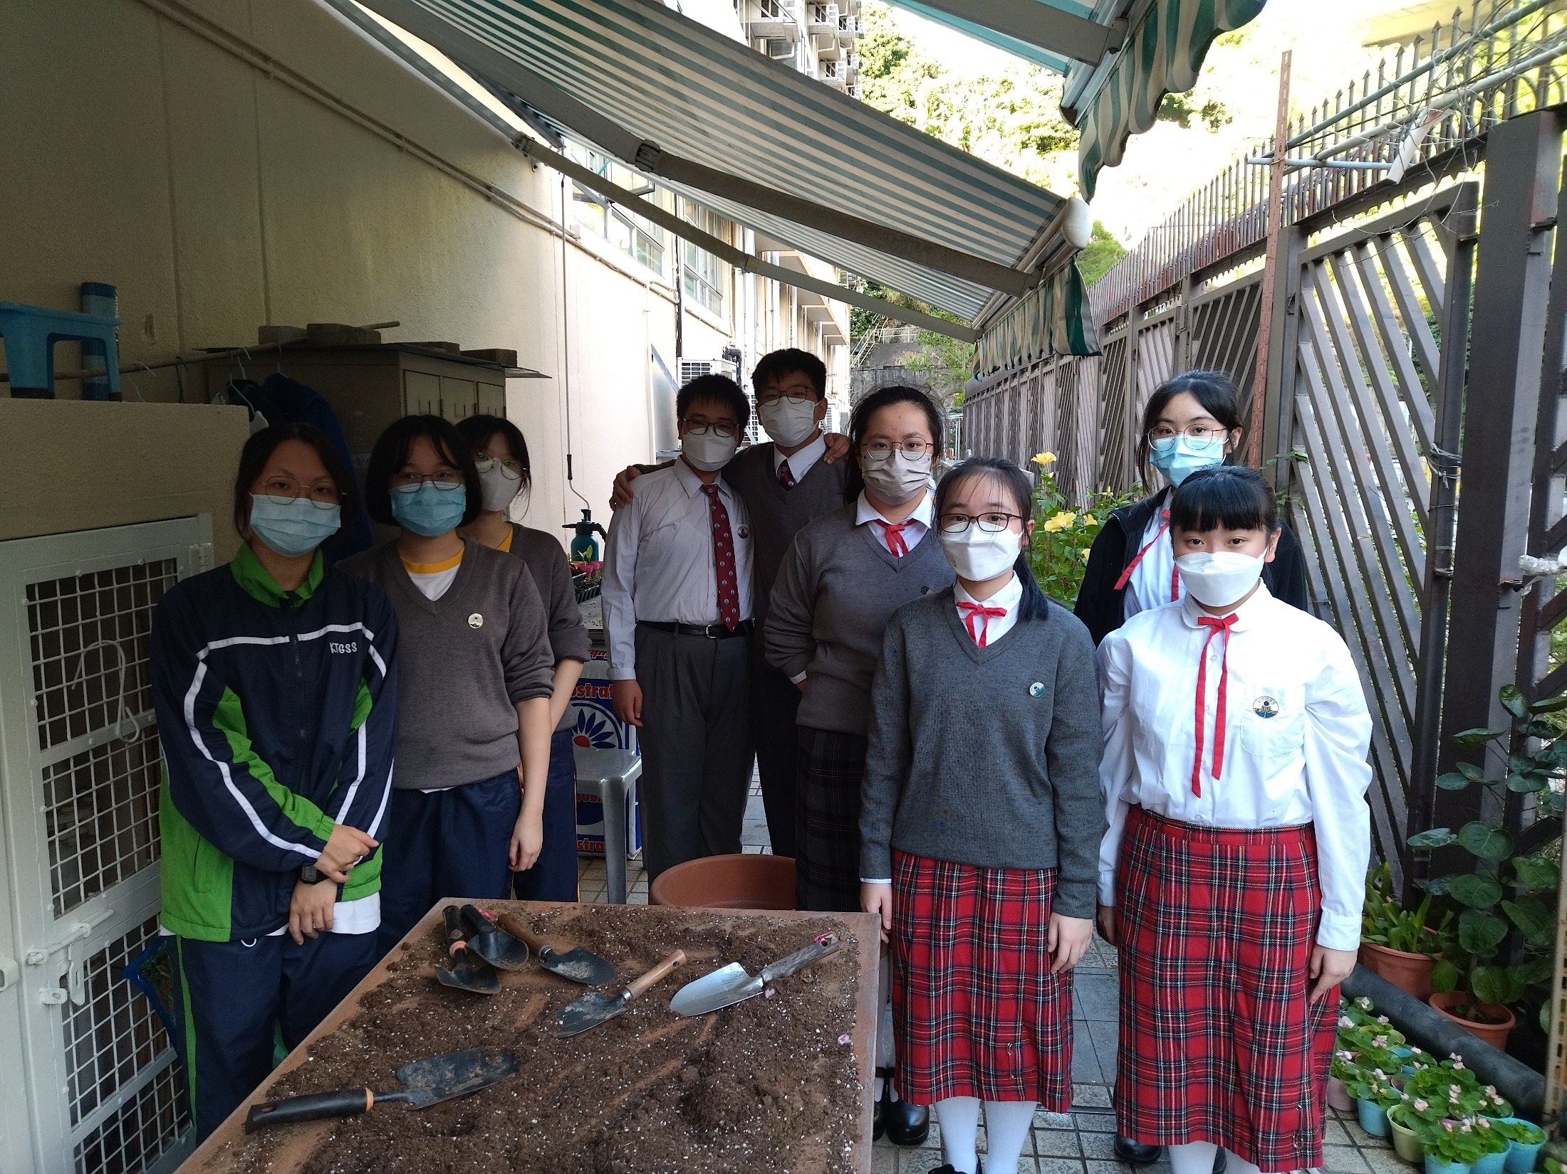

Slide 9
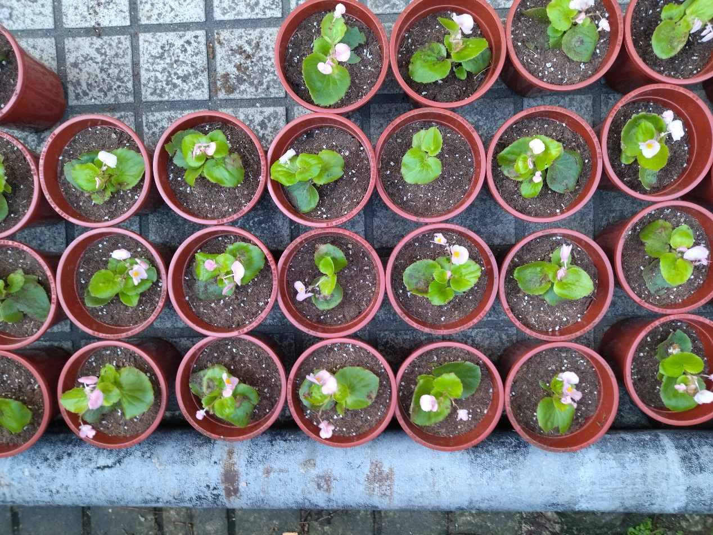
Two pots per class gardening scheme 「一班兩花」種植計劃 2022-2023 回顧
Photo on first term

Slide 10
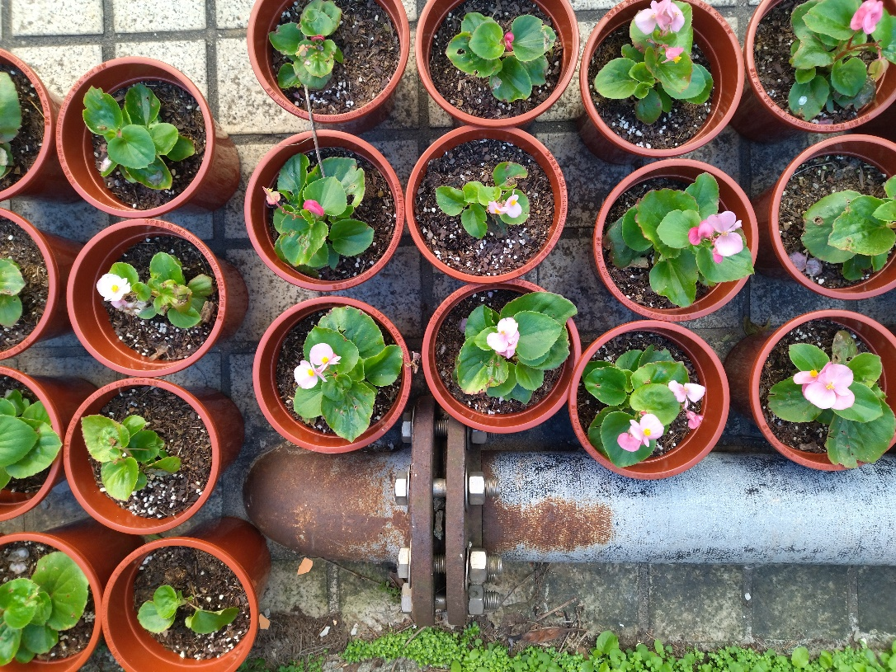
Two pots per class gardening scheme 「一班兩花」種植計劃 2022-2023 回顧
Photo on second term

Slide 11
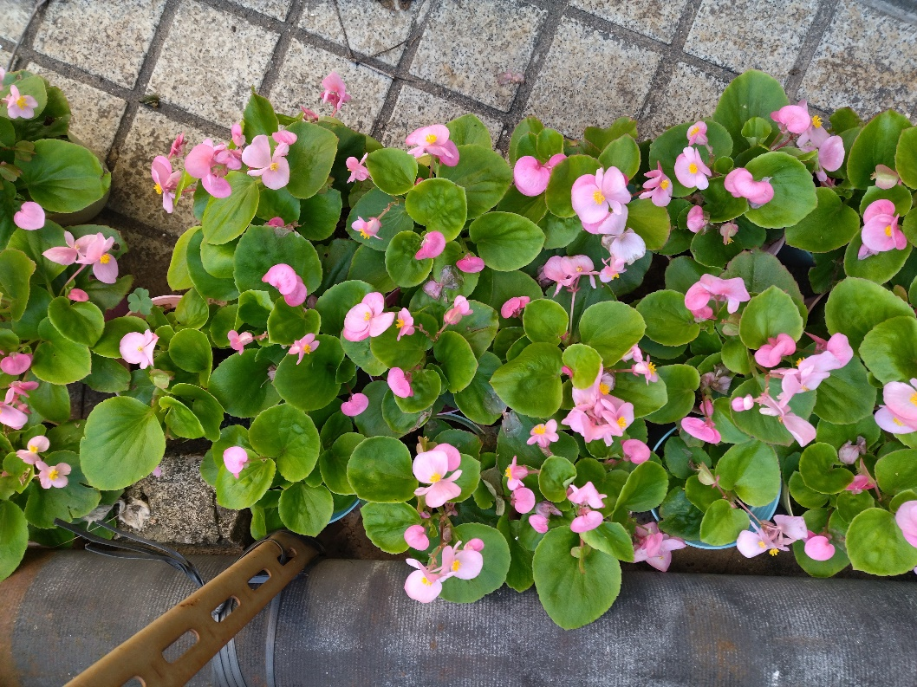
Two pots per class gardening scheme 「一班兩花」種植計劃 2022-2023 回顧
Photo on second term

