Slide 1
Gardening Club 2024-25
Gardening is considered by many people to be a relaxing activity.

Slide 2
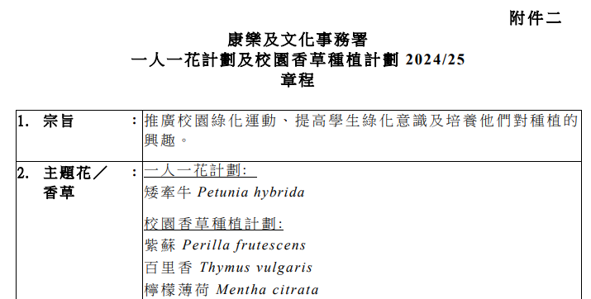
Two pots per class gardening scheme
「一班兩花」種植計劃
Co-organized with LCSD

Slide 3
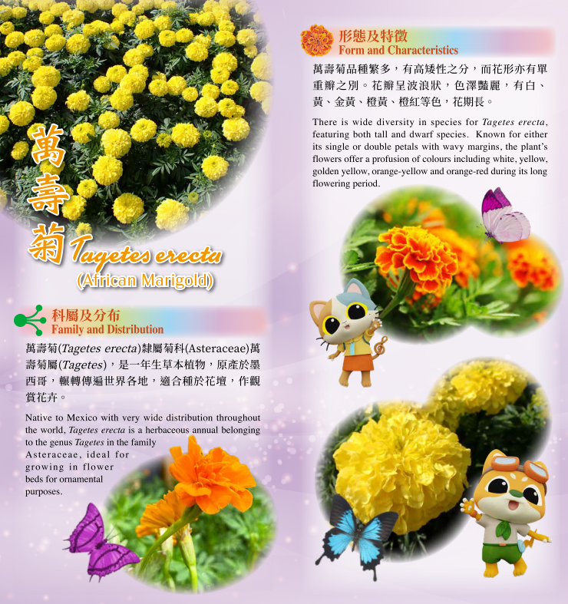
Two pots per class gardening scheme
「一班兩花」種植計劃 2023-2024 回顧

Slide 4

YouTube link
https://www.youtube.com/watch?v=OPEQH8hzEYs

Slide 5
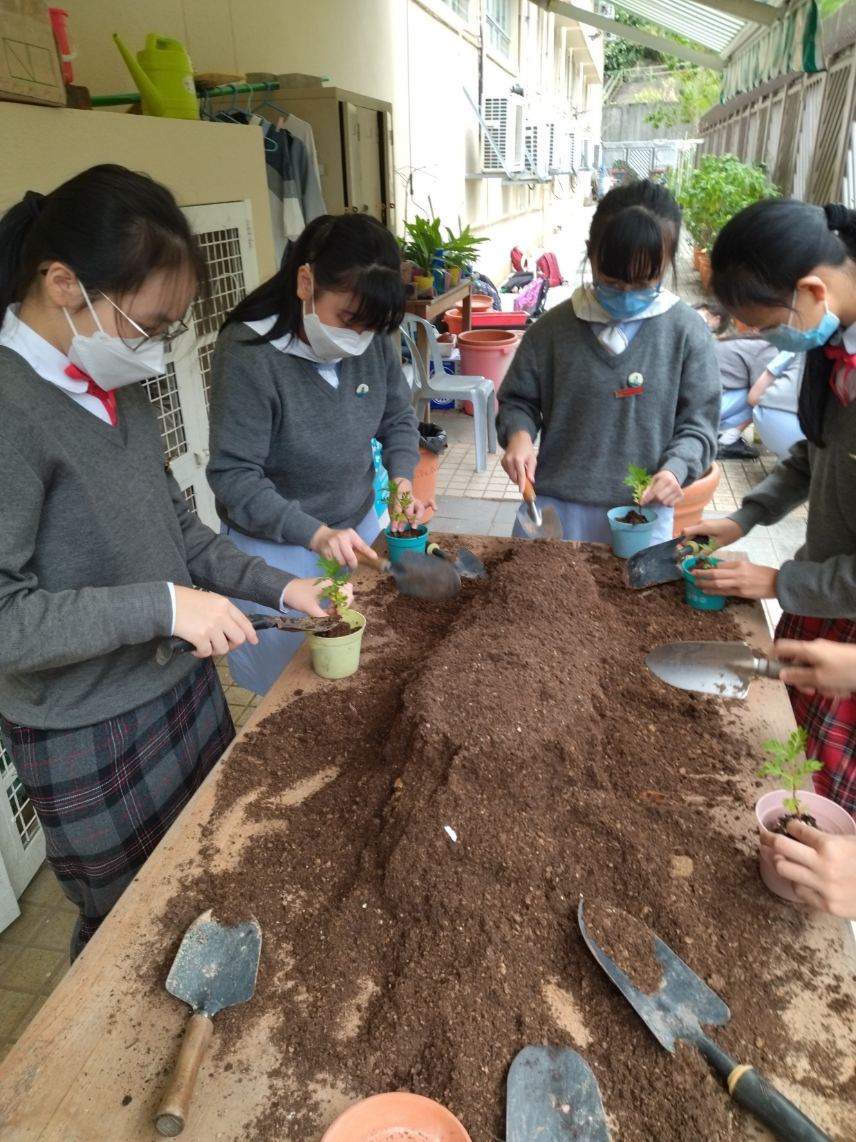

Slide 6
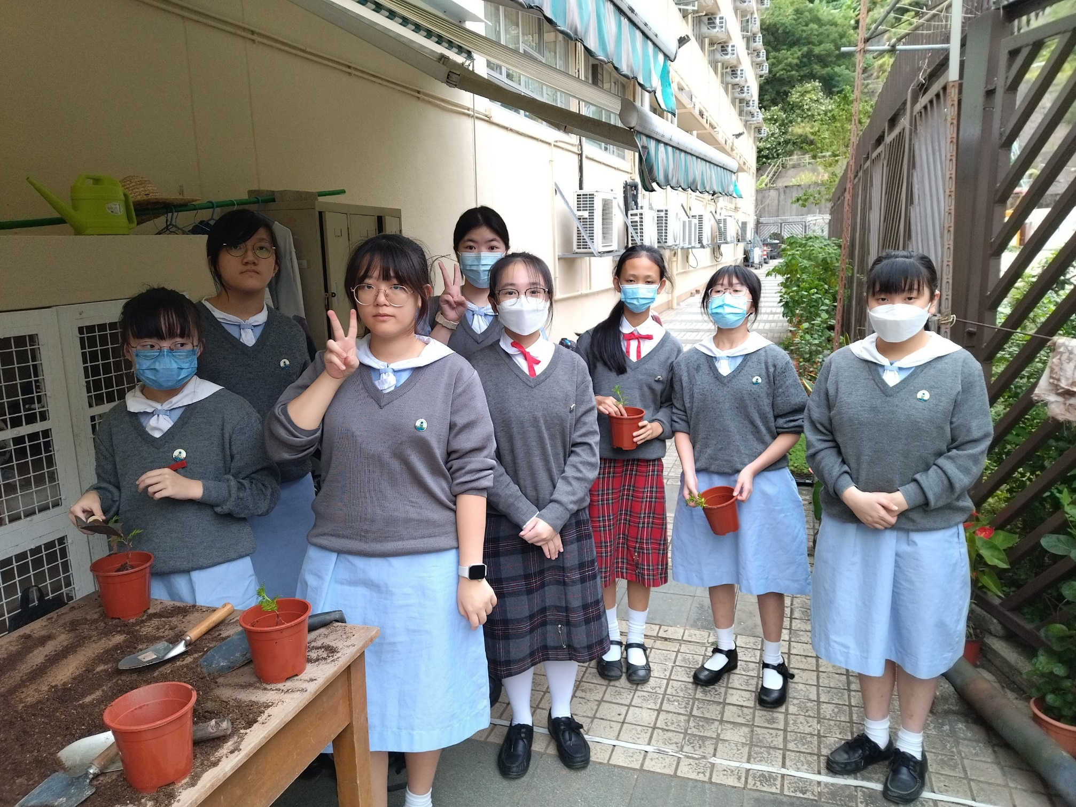

Slide 7
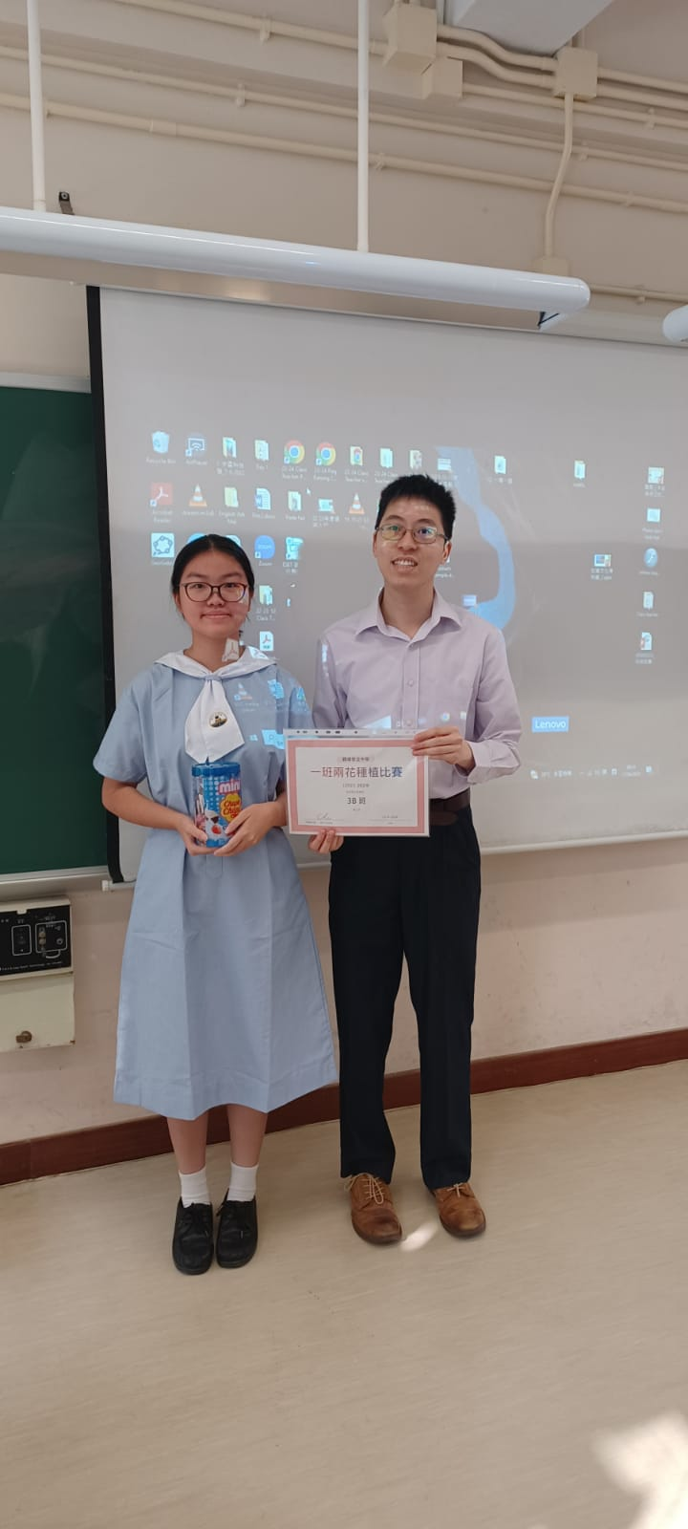

Slide 8
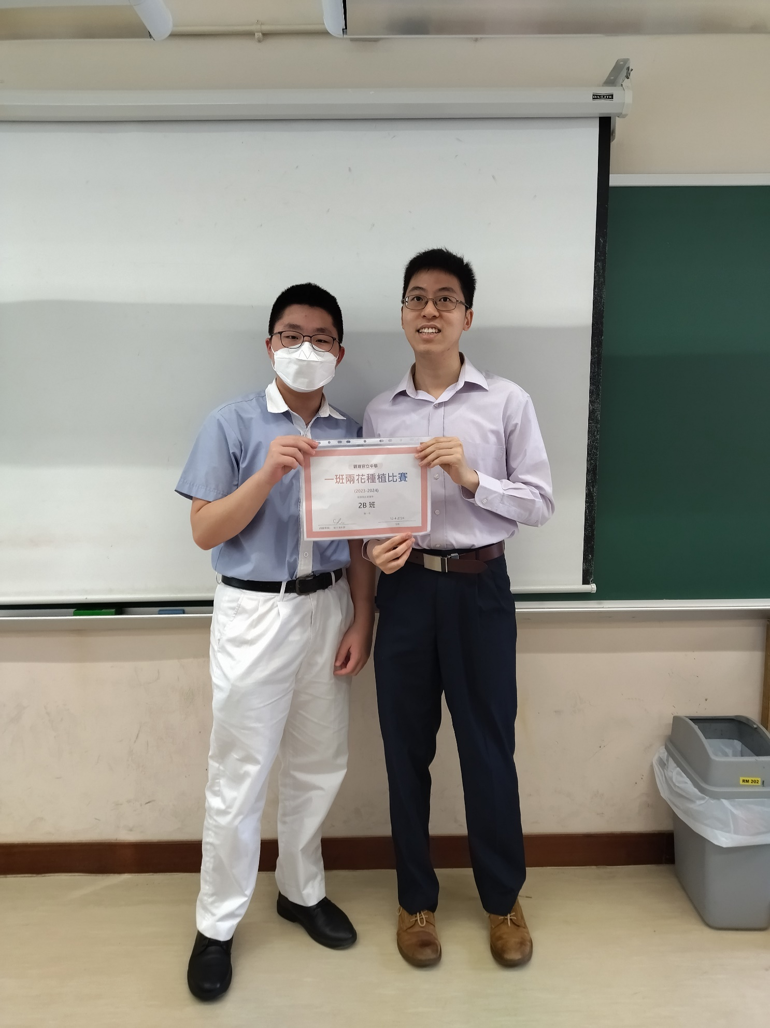

Slide 9
