Slide 1
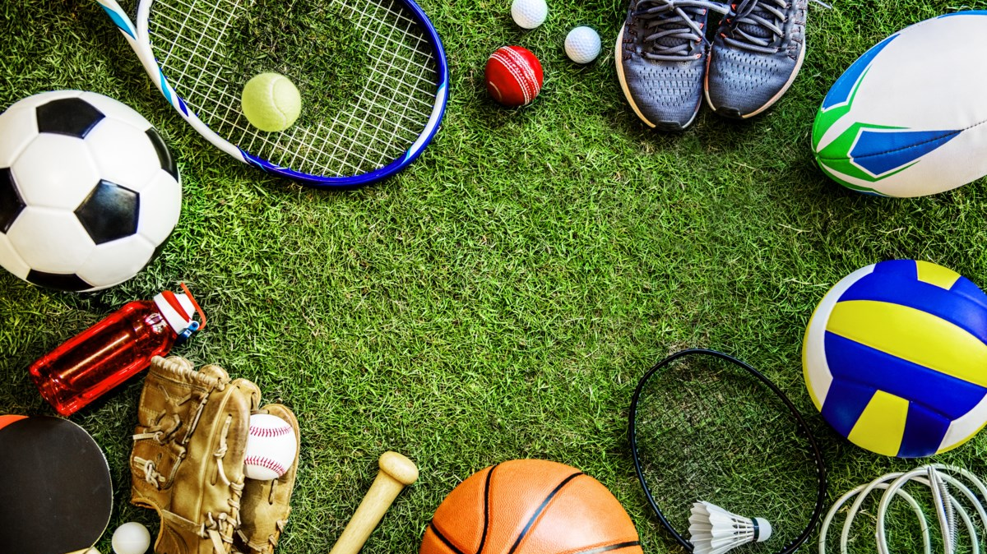
Sports ECA of KTGSS

Slide 2
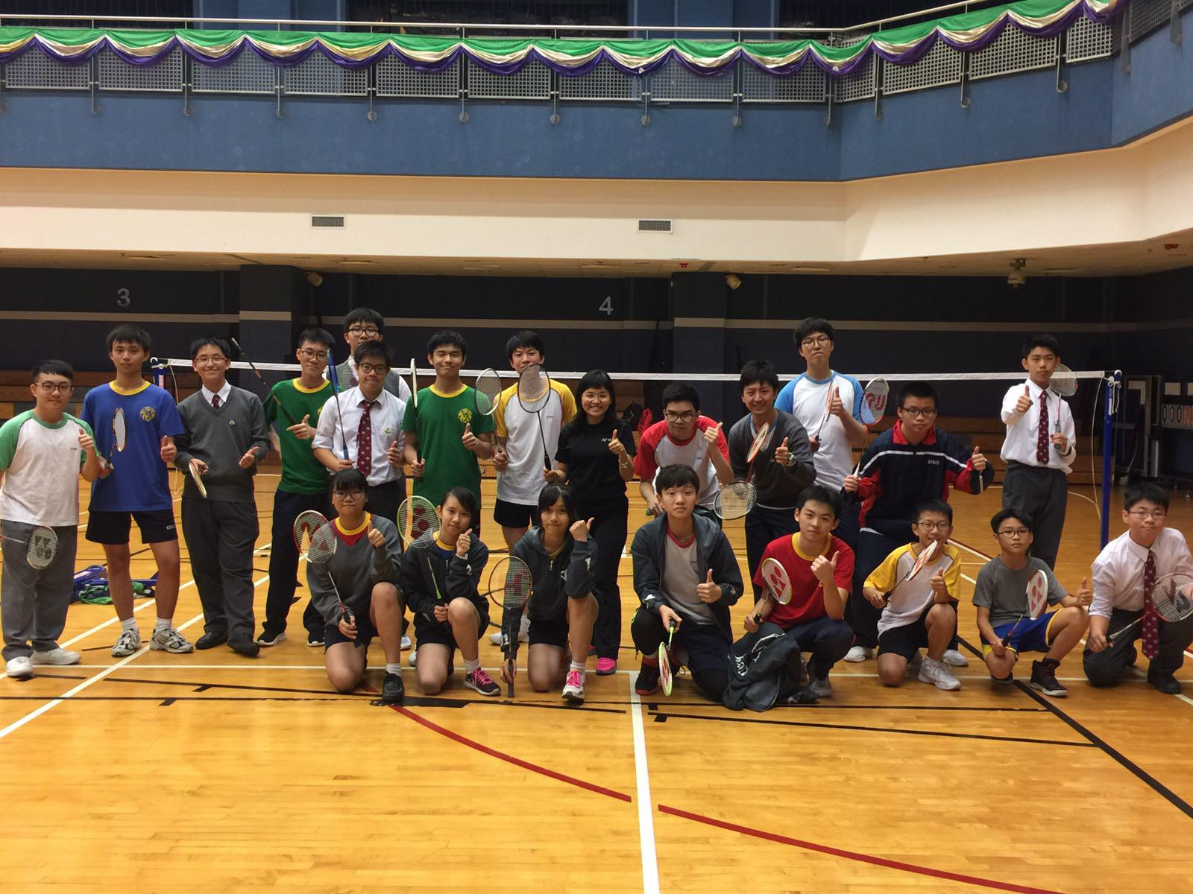
Badminton Club & Team
Ms Lui Pui Ha

Slide 3
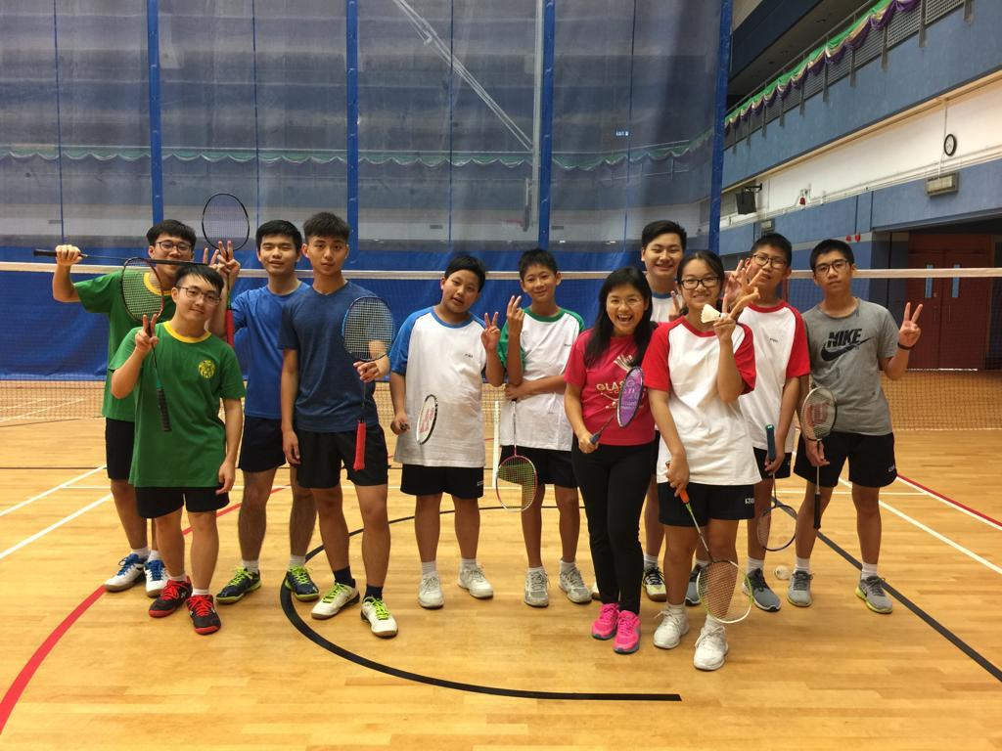
Badminton Club & Team
Ms Lui Pui Ha

Slide 4
Badminton Club & Team
Ms Lui Pui Ha
Max. no. of members: 16
Meeting day : Wednesday
Meeting time : 4-6pm
Meeting venue: School hall/Shun Lee Sports Center
Meeting frequency : Once a week
Remarks : Please wear sports uniform and bring your badminton racket

Slide 5
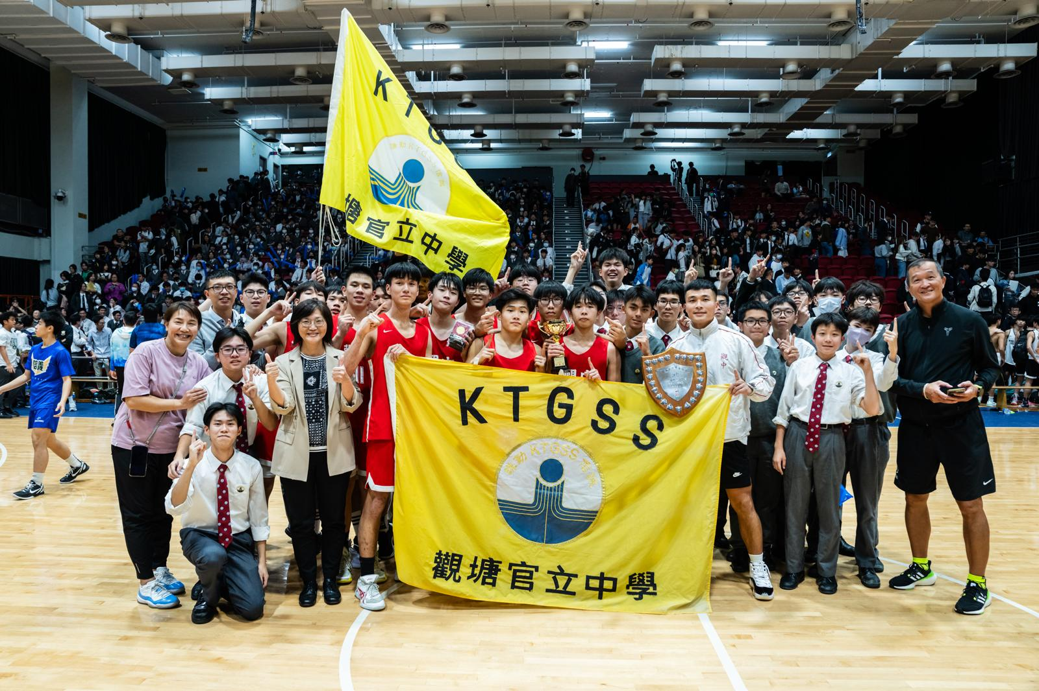
Basketball Club & Team
Mr Yau Shing Kit

Slide 6
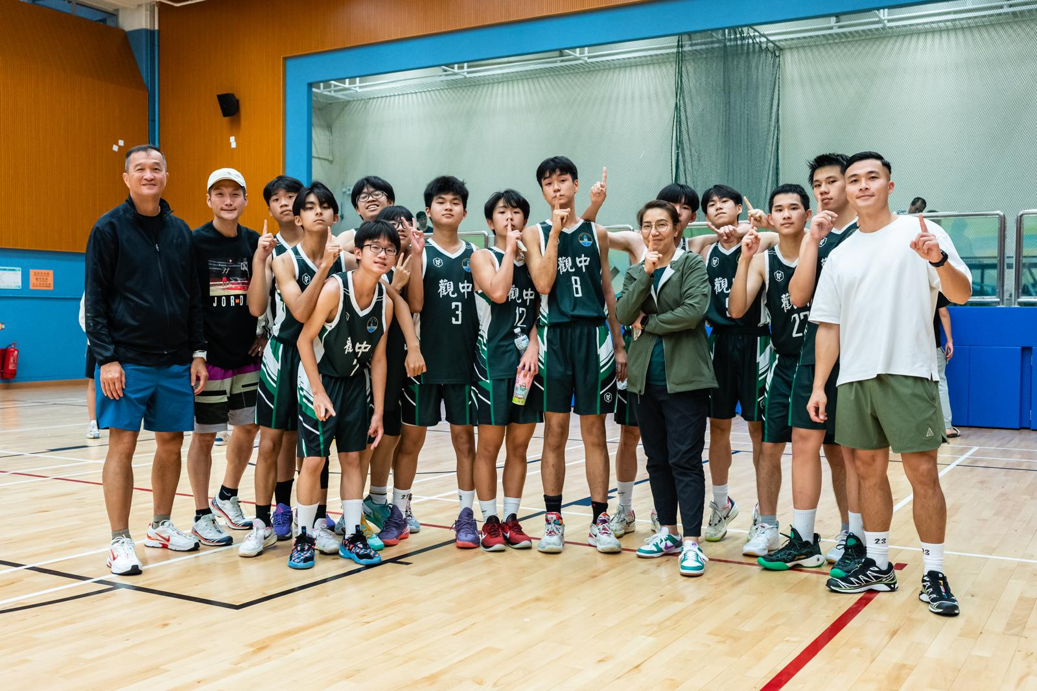
Basketball Club & Team
Mr Yau Shing Kit

Slide 7
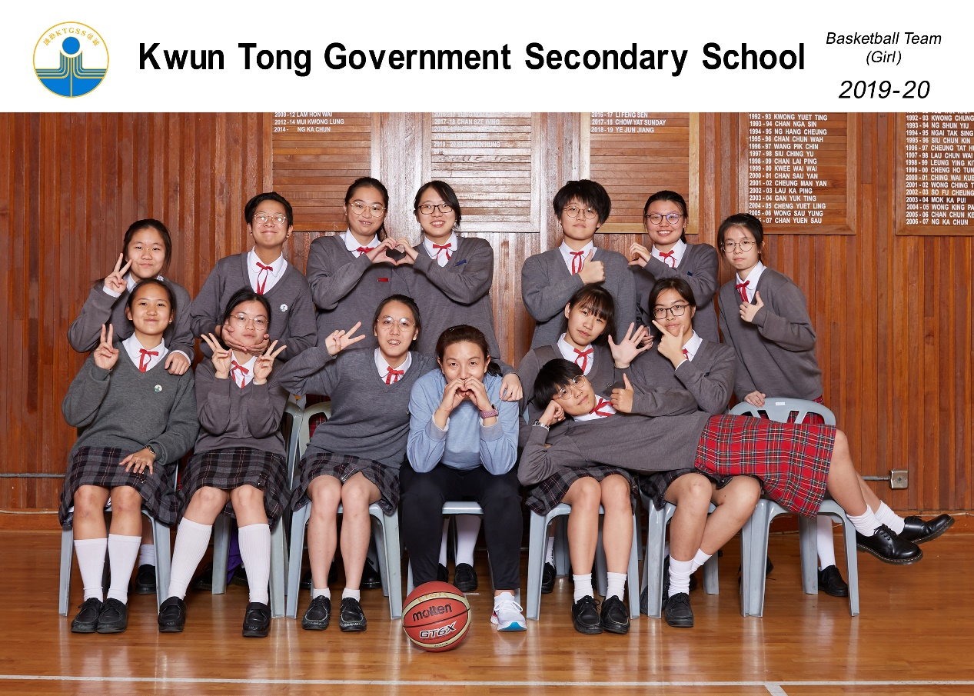
Basketball Team (Girls)
Ms Leung Fung Ying

Slide 8
Basketball Club & Team
Mr Yau Shing Kit
Max. no. of members: 50
Meeting/Training day : Tuesday/Thursday (Girls)
Wednesday/Thursday (Boys)
Meeting time : 4-6pm
Meeting frequency : Twice a week

Slide 9
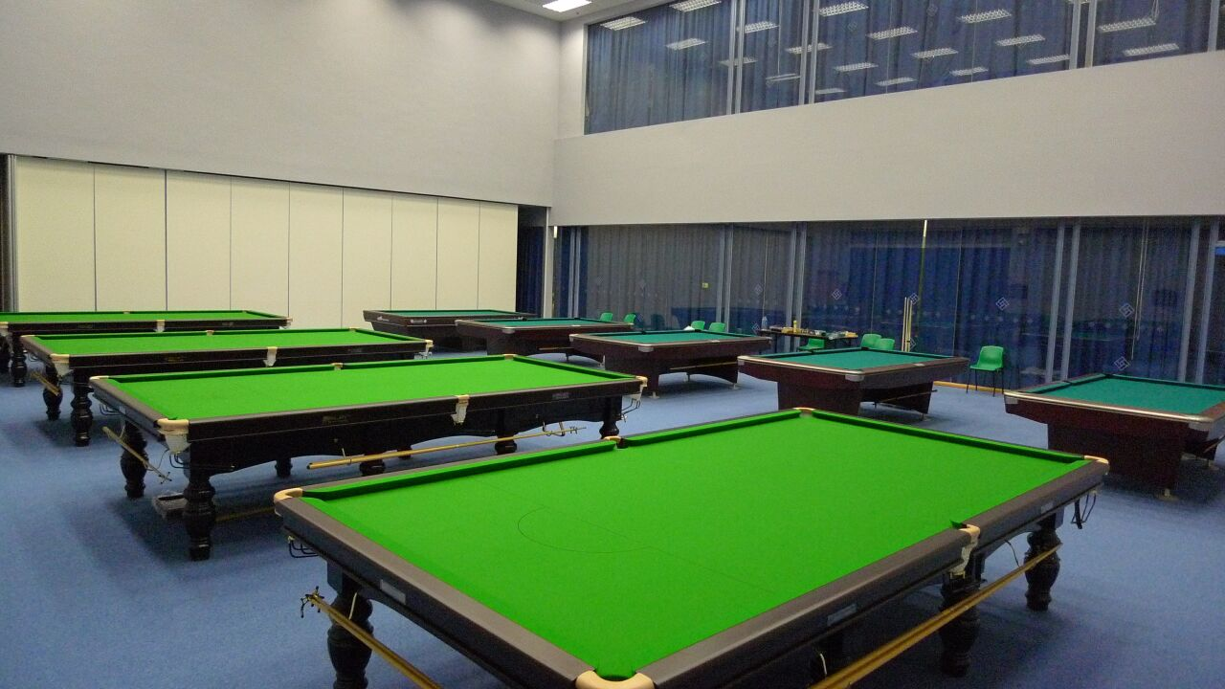
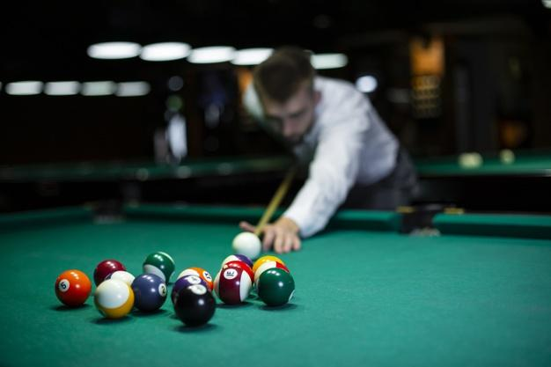
Billiard Club
Ms. Leung Fung Ying

Slide 10
Billiard Club
Ms. Leung FungYing
Max. no. of members: 20
Meeting day : Wednesday
Meeting time : 4-6pm
Remarks : @Shun Lee Sports Centre

Slide 11
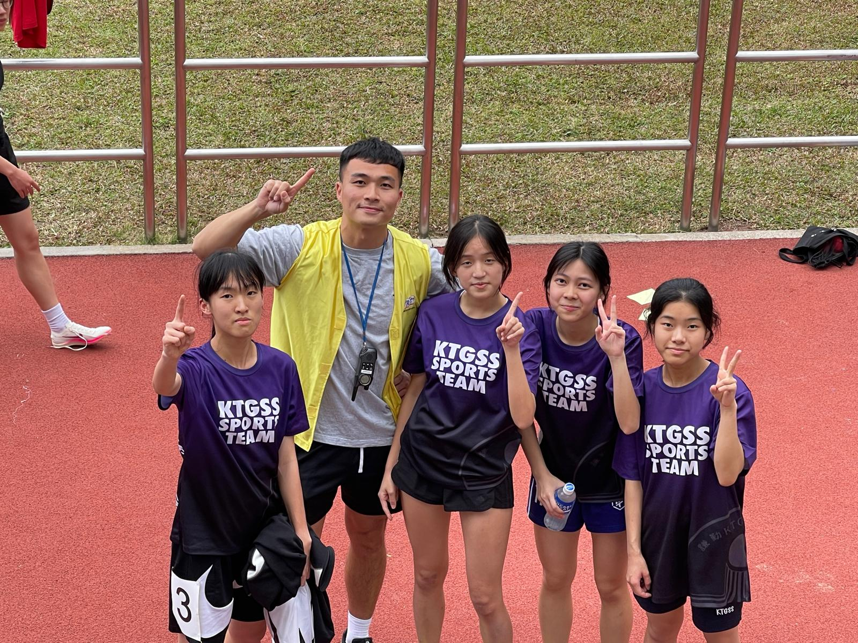
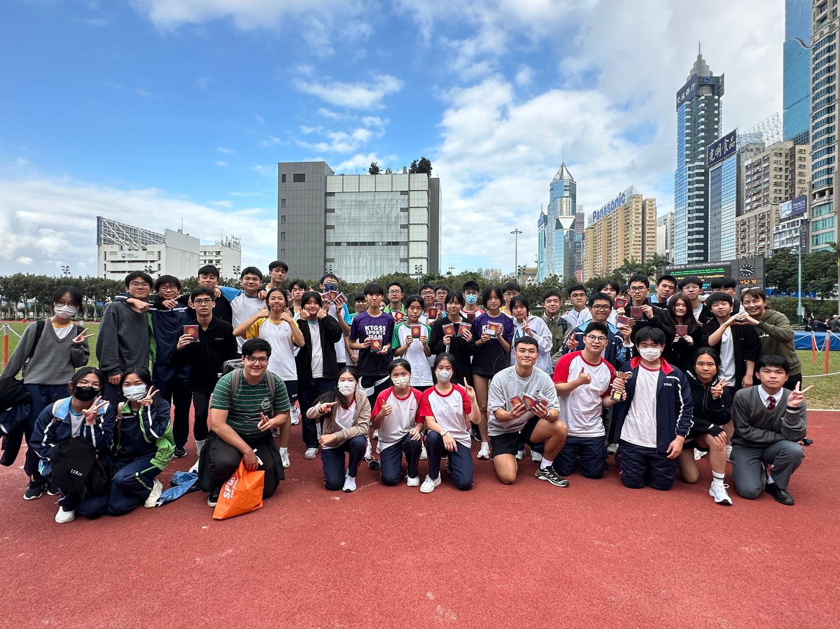
Cross Country Club/Team
Mr Yau Shing Kit

Slide 12
Cross country Club/Team
Mr Yau Shing Kit
Max. no. of members: 20
Meeting day : Friday
Meeting time : 4-5pm
Meeting frequency : Once a week

Slide 13
Football Club &
Team
Mr Yau Shing Kit
Meeting/Training time : Wednesday
Venue: Shun Lee Sports Centre/ School Playground

Slide 14
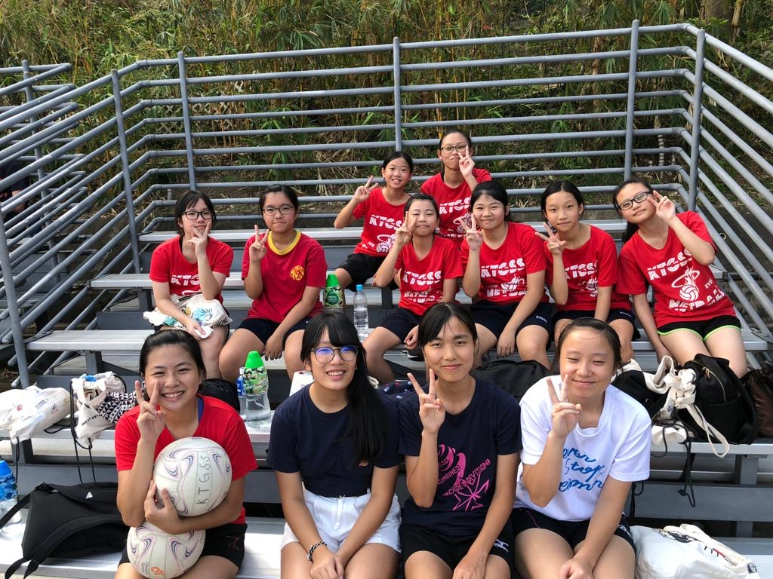
Netball Club & Team
Ms Leung Fung Ying

Slide 15
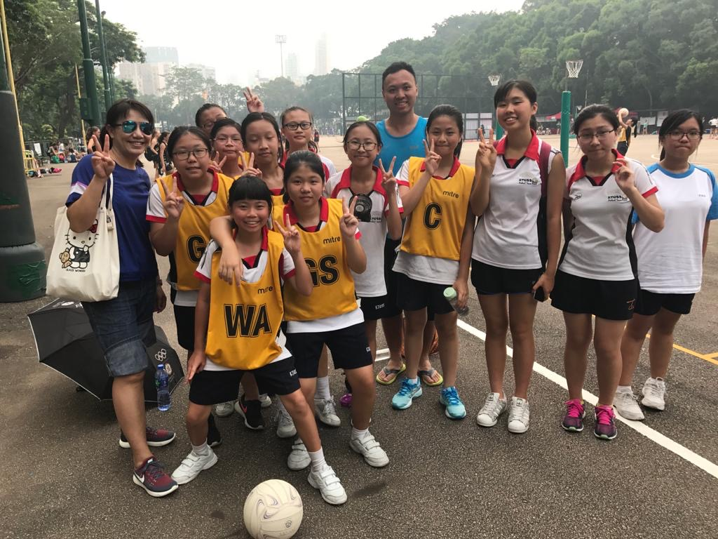
Netball Club & Team
Ms Leung Fung Ying

Slide 16
Netball Club & Team
Ms Leung Fung Ying
Max. no. of members: 36
Meeting day : Saturday
Meeting time : 9-11am
Meeting frequency : Once a week

Slide 17
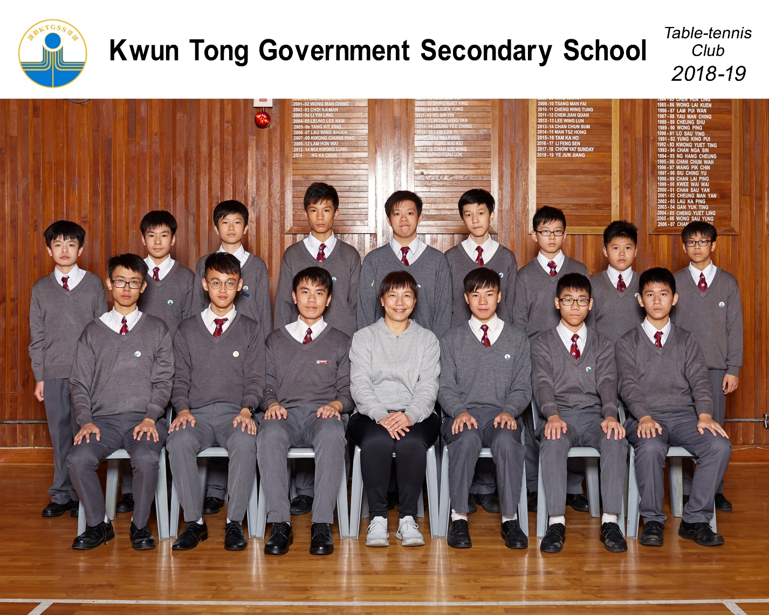
Table Tennis Club & Team
Ms Leung Fung Ying

Slide 18
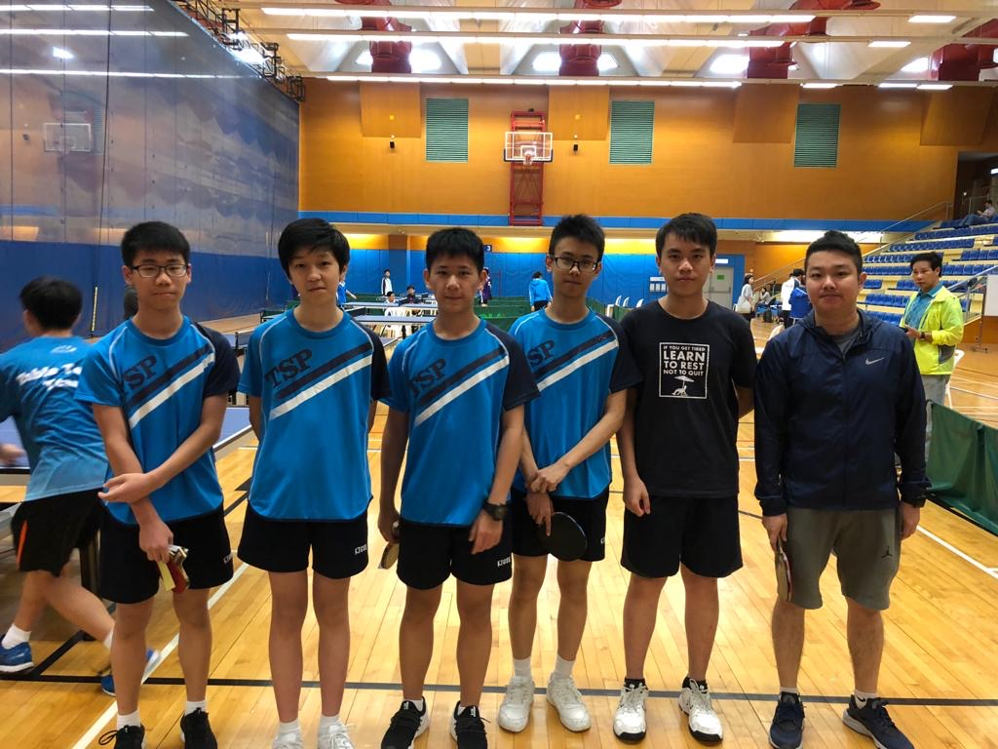
Table Tennis Club & Team
Ms Leung Fung Ying

Slide 19
Table Tennis Club & Team
Ms Leung Fung Ying
Max. no. of members: 36
Meeting day : Wednesday
Meeting time : 4-6pm
Meeting frequency : Once a week

Slide 20
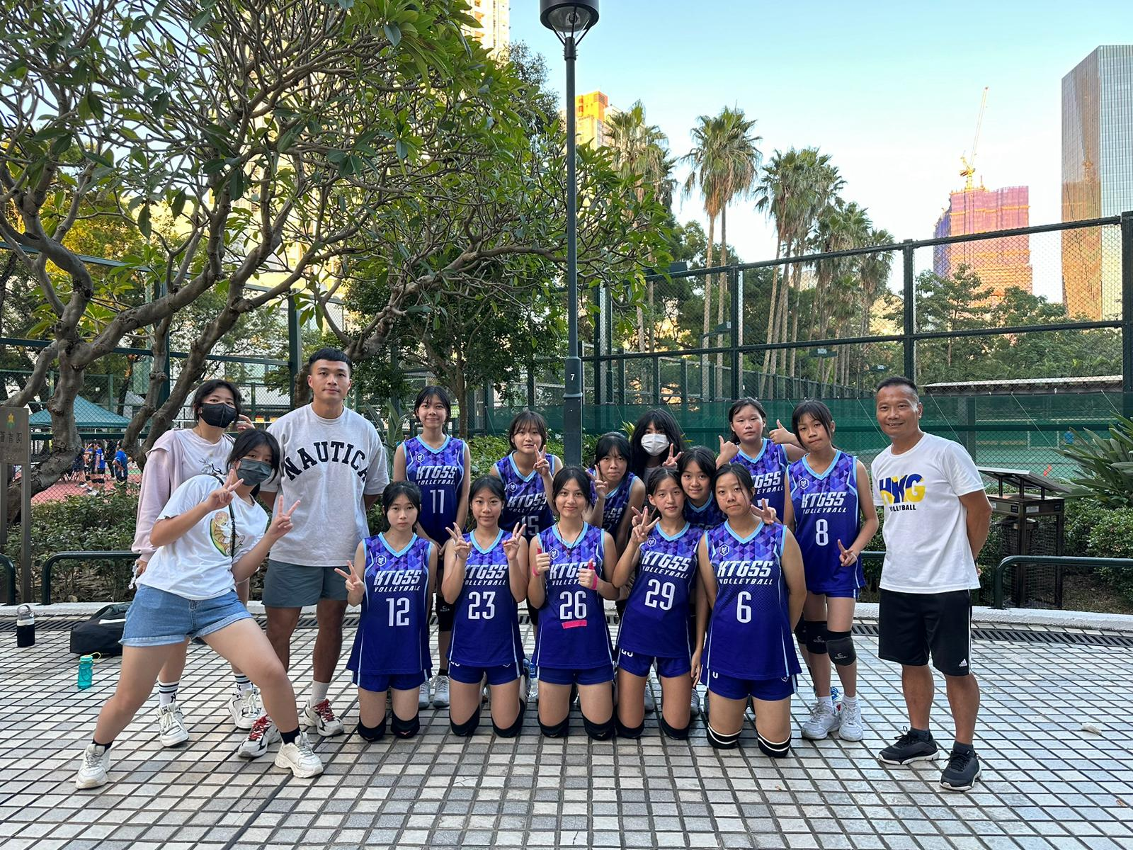
Volleyball Club &
Team
Mr Yau Shing Kit

Slide 21
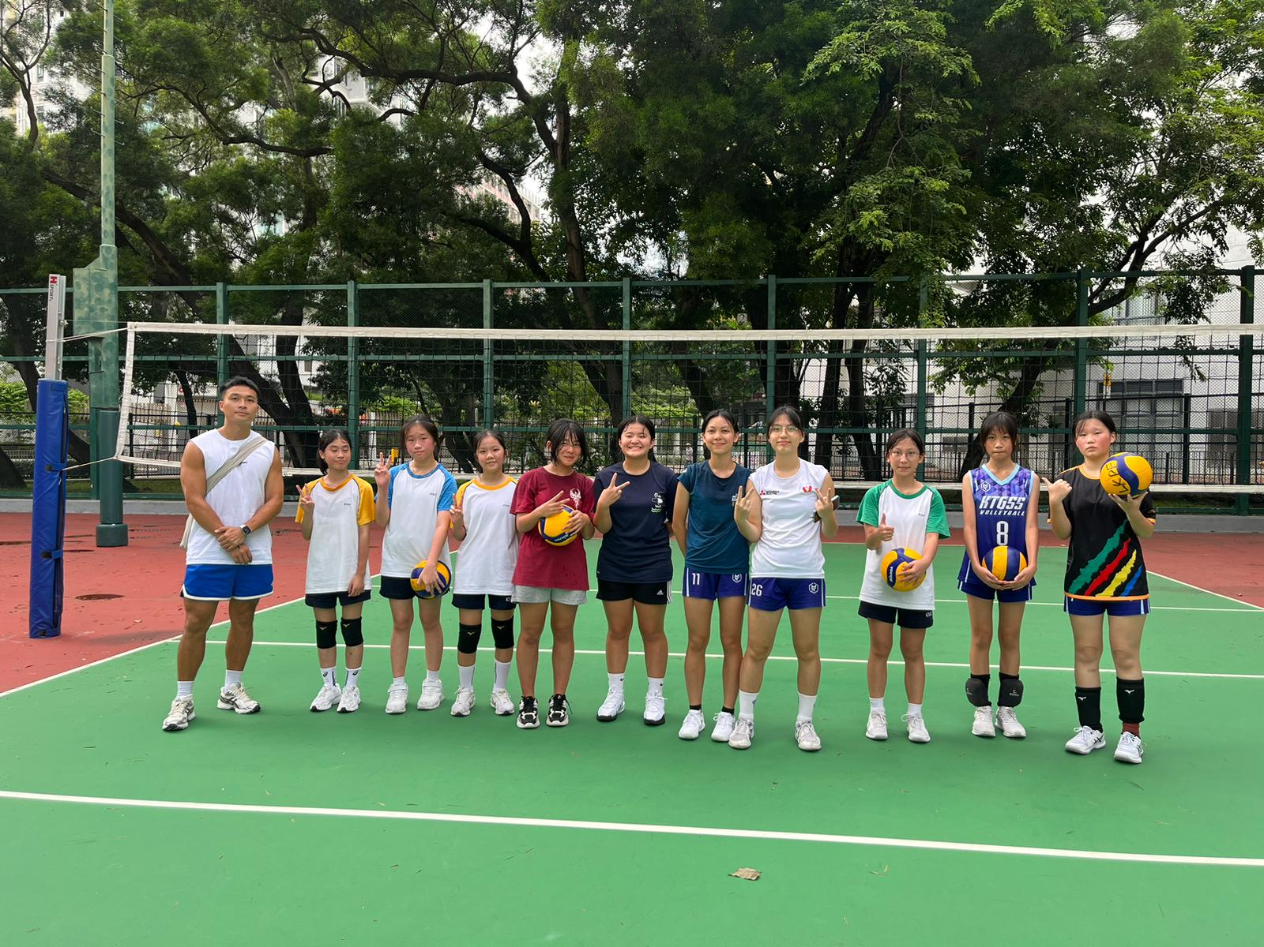
Volleyball Club &
Team
Mr Yau Shing Kit

Slide 22
Volleyball Club &
Team
Mr Yau Shing Kit
Max. no. of members: 40
Meeting/Training day : Tuesday/Friday
Meeting time : 4-6pm
Meeting frequency : Twice a week

Slide 23
Other Sports Team
Athletics Team : Mr Yau Shing Kit
Swimming Team : Ms Leung Fung Ying
Rhythmic Gym Team : Ms Leung Fung Ying
Remarks: Students have good performance will be invited to join school team to participate in inter-school competition.

