Slide 1
History Club 2024-2025
Objectives:
1. To arouse students' interest in studying History through organizing activities
2. To Promote students' awareness of national identity and appreciate different culture and races of the world.
3. To train the committee members to organize activities for the club members and other students

Slide 2
Proposed meeting schedule and activities
-- The meetings will be held on an irregular basis
-- All students are welcomed.
Date | Topic | Teacher / student in charge
September | Board declaration
September | Introduction and planning
September | Sharing from Museum Ambassador
September to May | Cross Curricular Activities with Chinese History and Life and Technology
October | Local Study Tour
December | Information Day for S3 Students
April | Local Study Tour

Slide 3
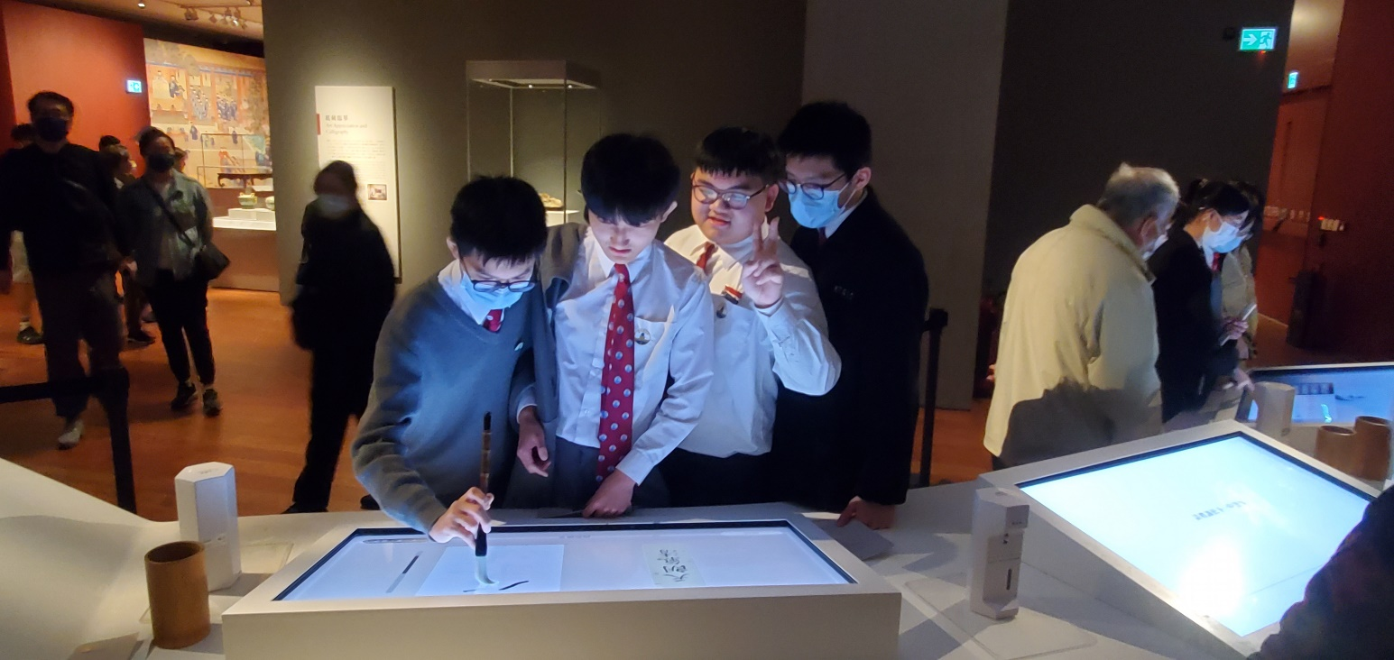
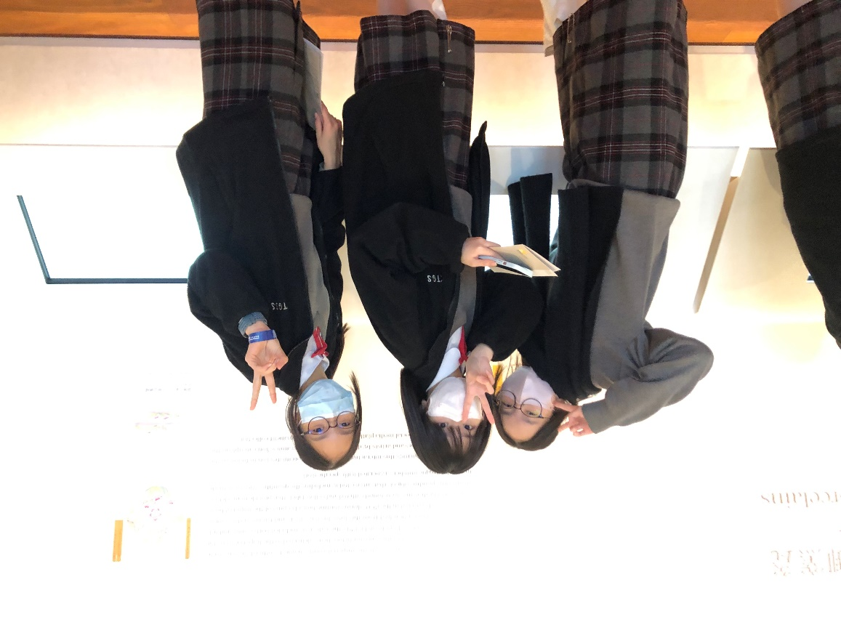
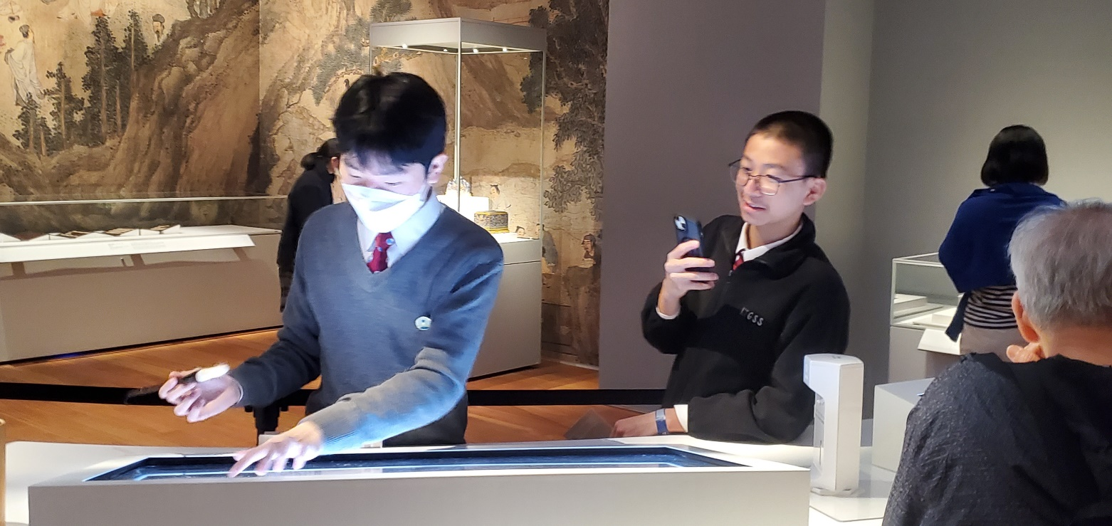
A Visit to Palace Museum

Slide 4
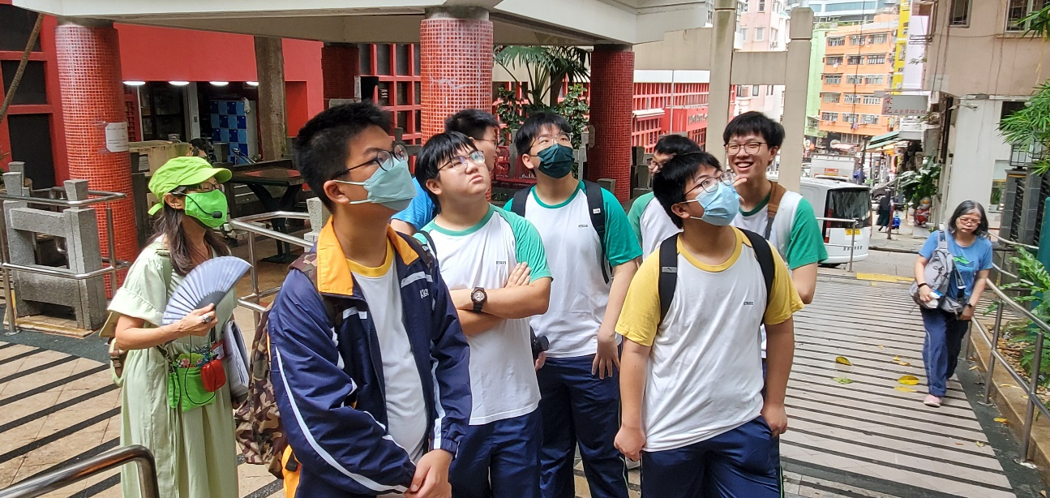
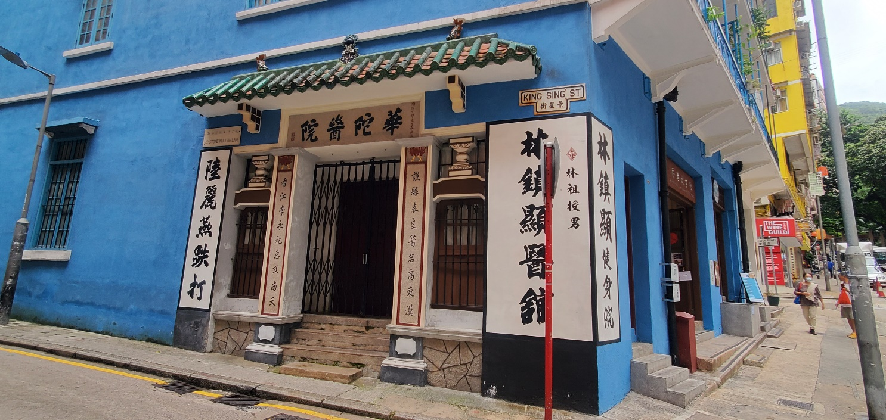
Local Study Tour to Wan Chai

Slide 5
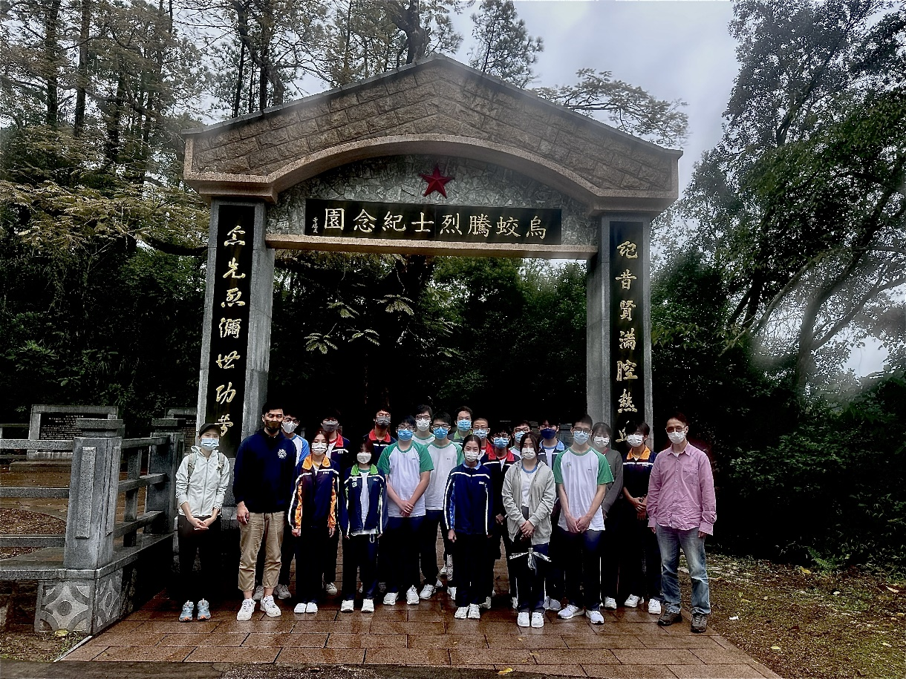
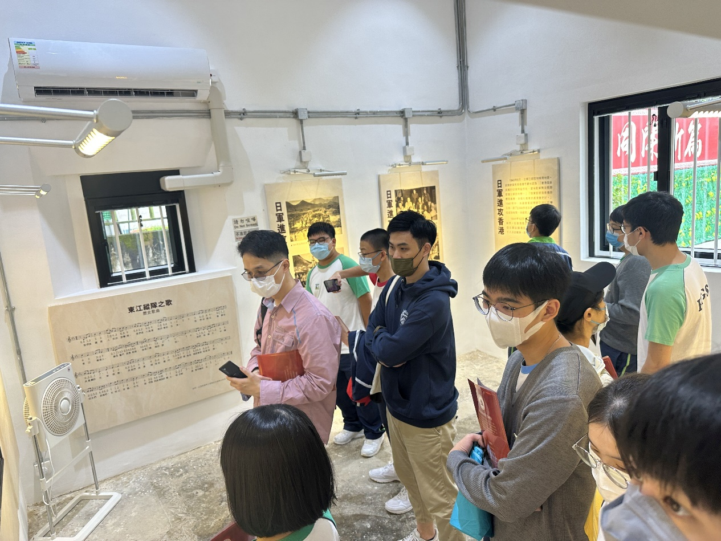
Local Study Tour to Sha Tou Kok

