Slide 1
Science club
2023-2024

Slide 2
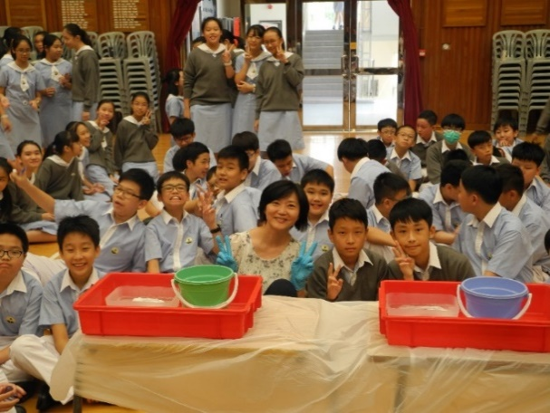
What’s special about the Science Club?
Monthly meeting
Through joining our club, students may
→ Design experiments and games based on scientific knowledge, with the assistance
of teachers and committee members; and
→ Take part in the organization of the Science For All using what they have learnt in
Science lessons and club meetings.
Lunchtime entertainment will be held in the hall irregularly during lunch time
and all students are welcomed
→ Demonstrations of various experiments
→ Game booths

Slide 3
Turning coins into silver and gold in 2022-23

Slide 4
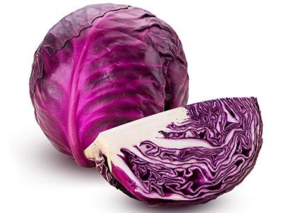
Red cabbage indicator in 2022-23

Slide 5
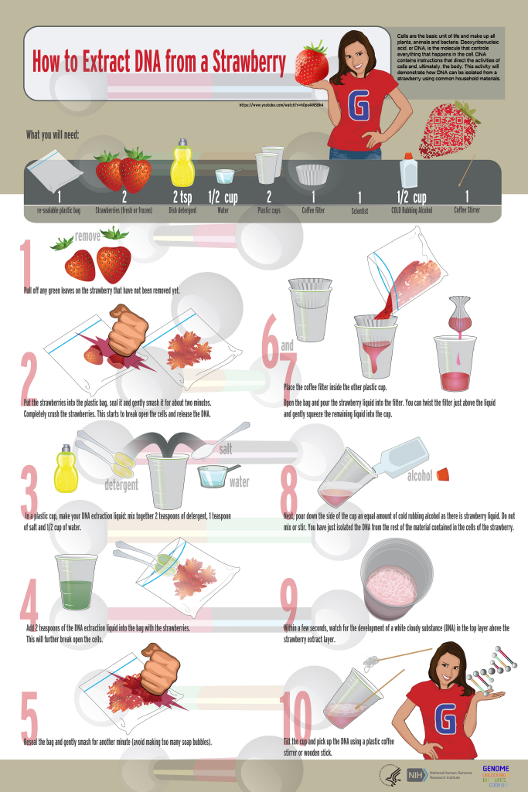
Simple extraction of DNA from food in 2022-23

Slide 6
Simple extraction of DNA from food in 2022-23

