Slide 1
Science club
2024-2025

Slide 2
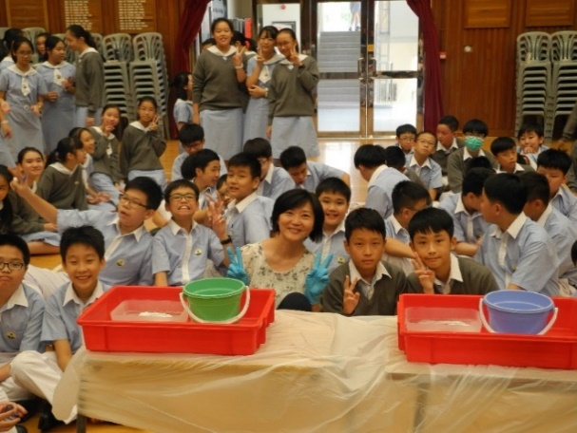
What’s special about the Science Club?
Monthly meeting
Through joining our club, students may
→ Design experiments and games based on scientific knowledge, with the assistance
of teachers and committee members; and
→ Take part in the organization of the Science For All using what they have learnt in
Science lessons and club meetings.
Lunchtime entertainment will be held in the hall irregularly during lunch time
and all students are welcomed
→ Demonstrations of various experiments
→ Game booths

Slide 3
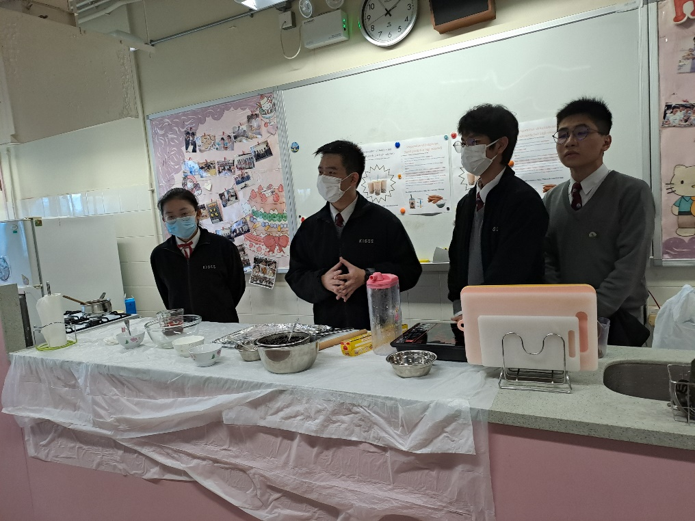

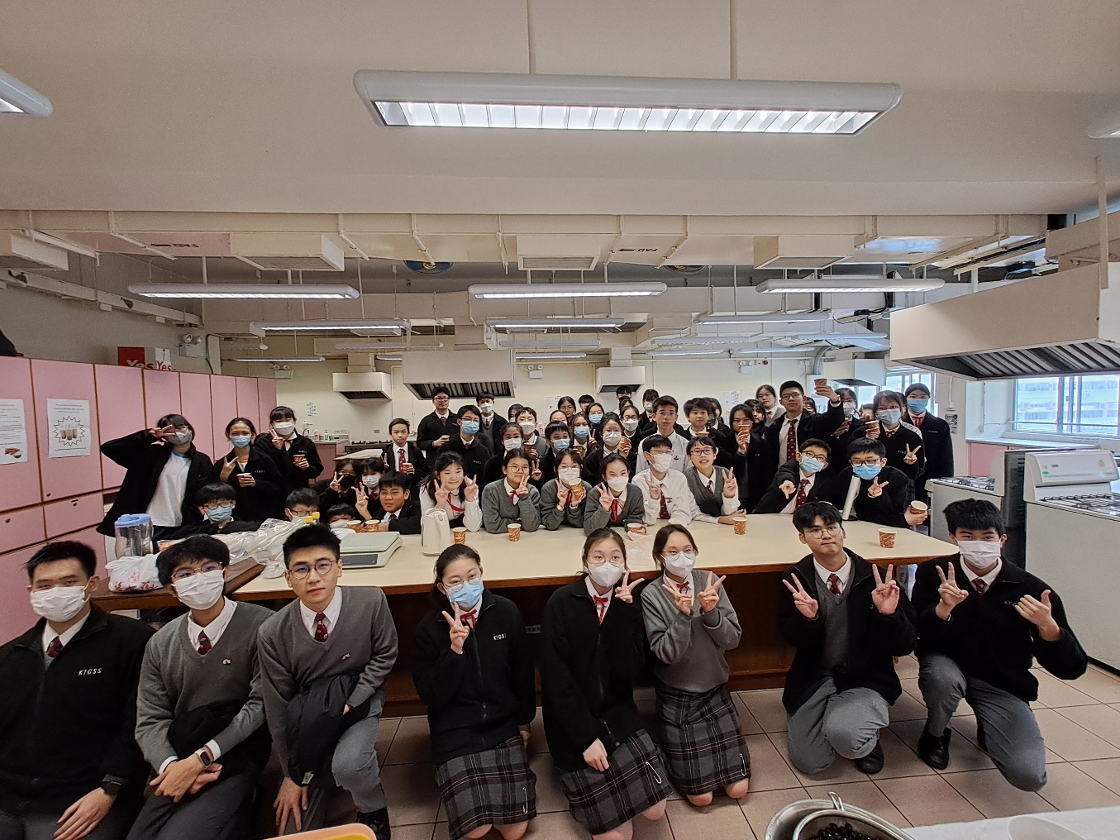
Preparation of bubble tea

Slide 4

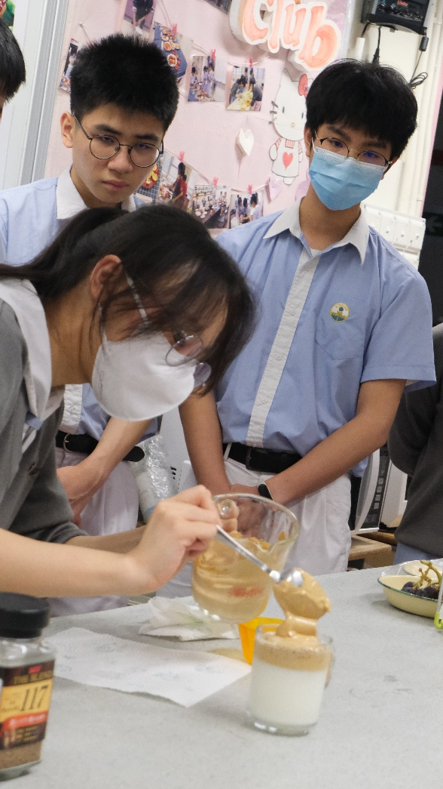
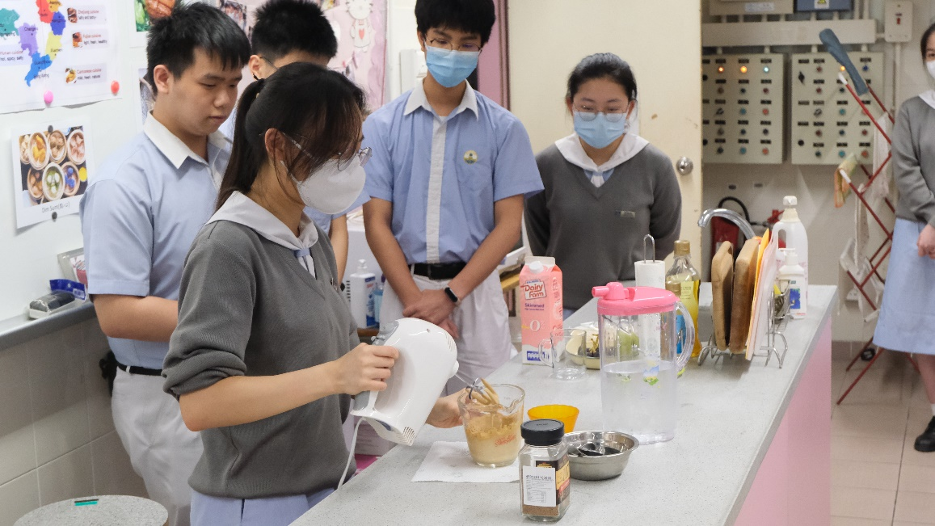
400 Coffee

Slide 5

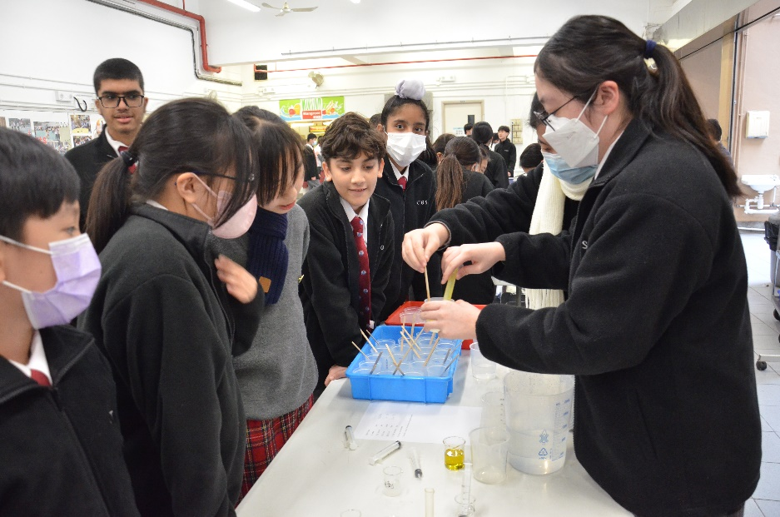
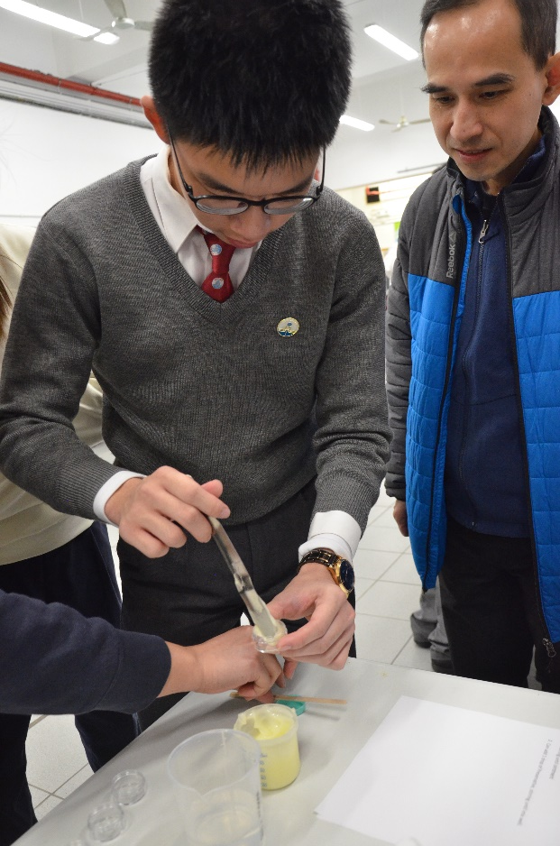
Preparation of Hand Cream

Slide 6
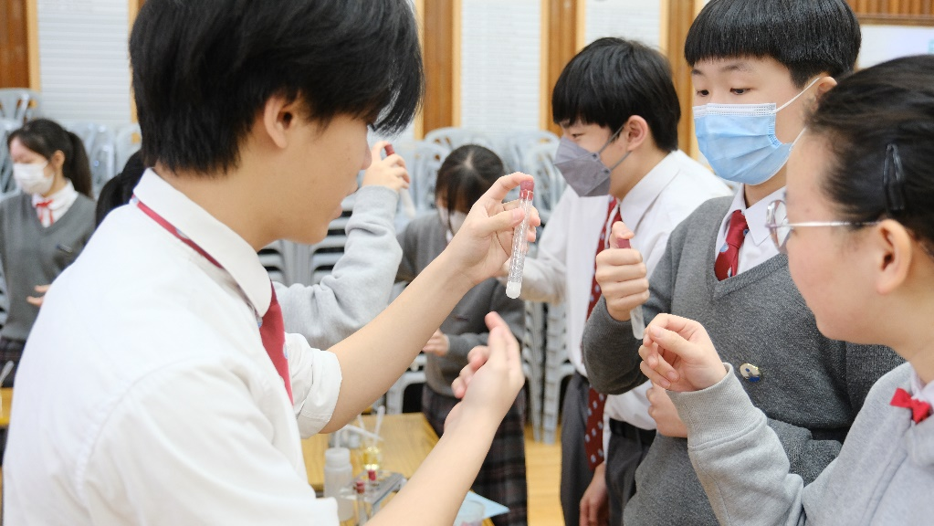
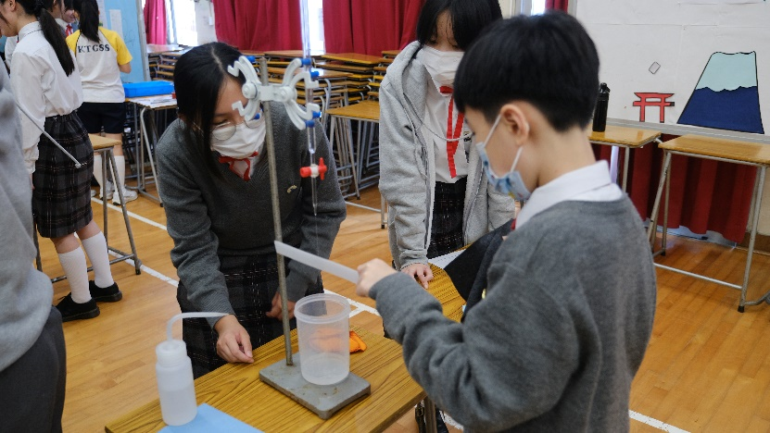
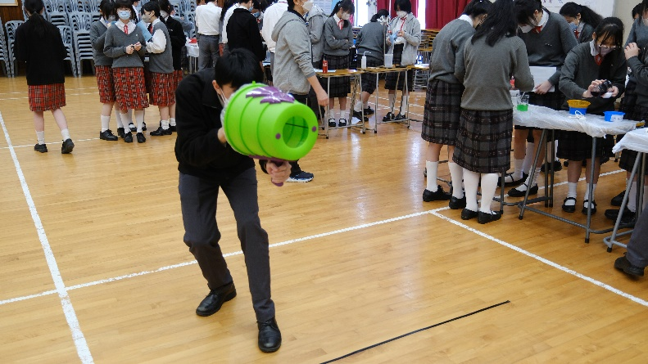
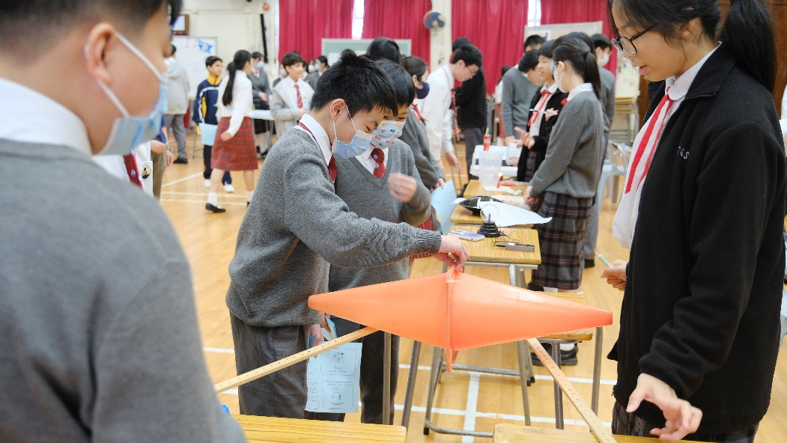
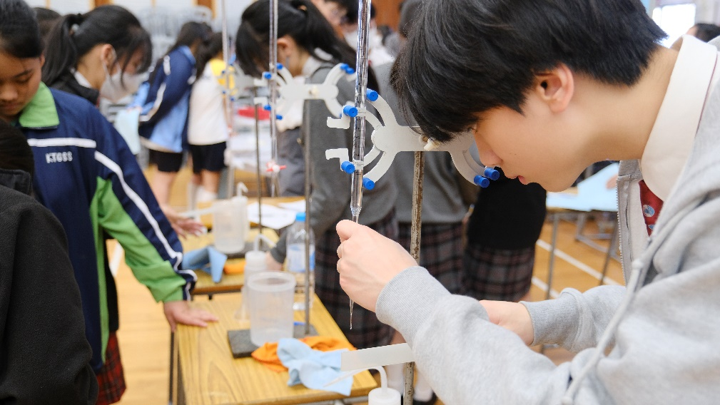
Science for All Workshop

Slide 7
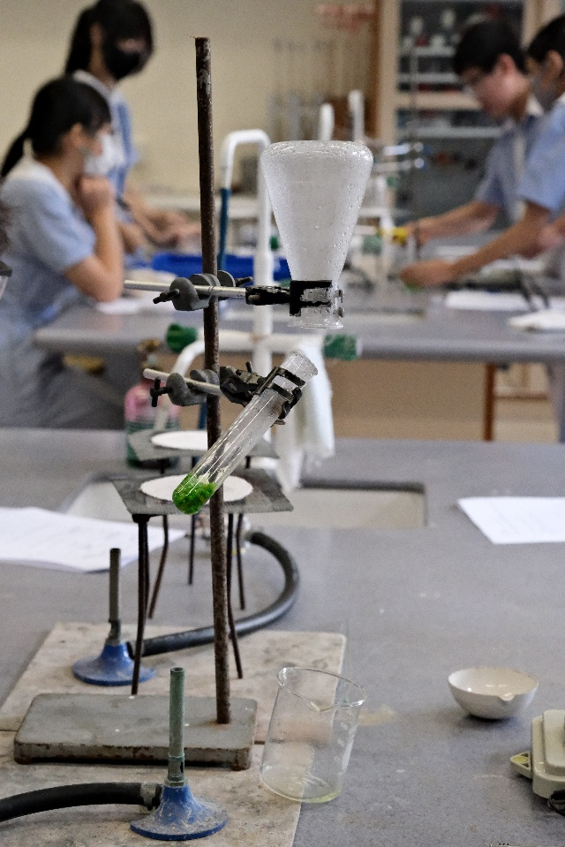

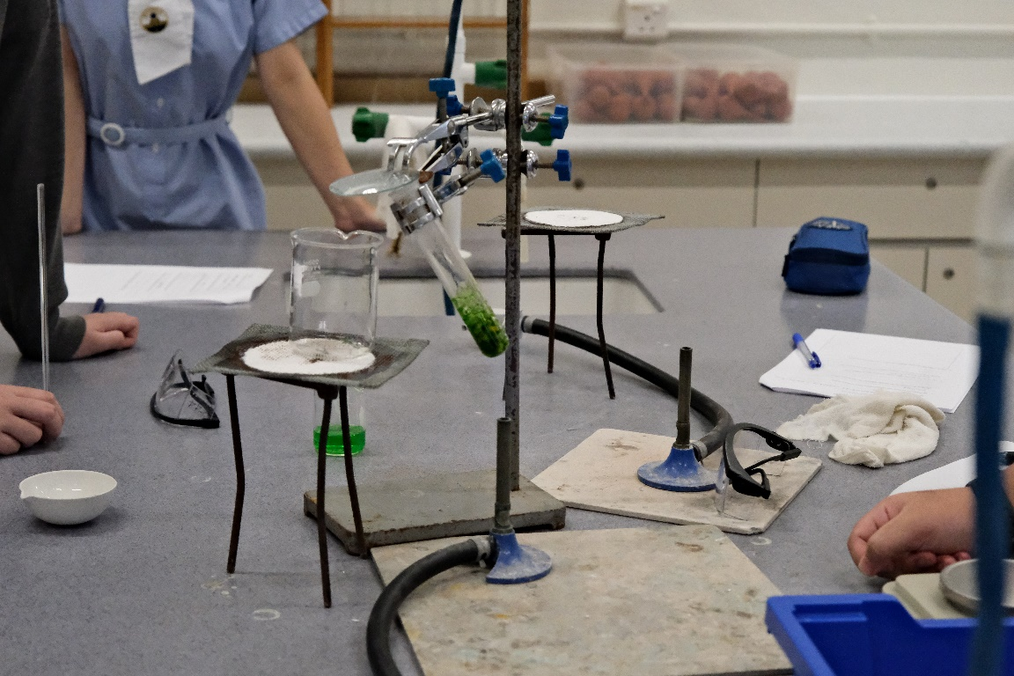
Distillation of Essential Oil from Daily Substances

Slide 8
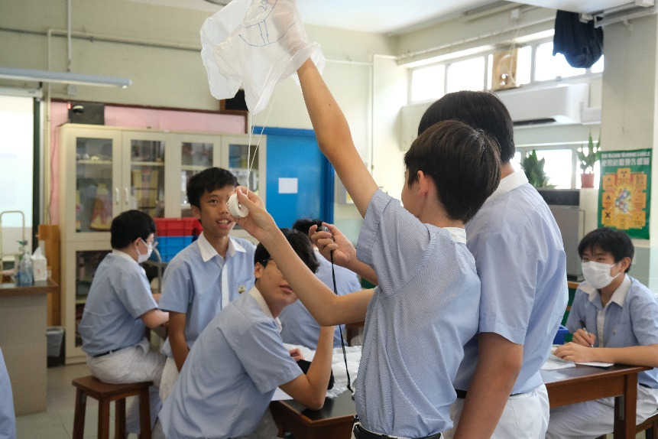

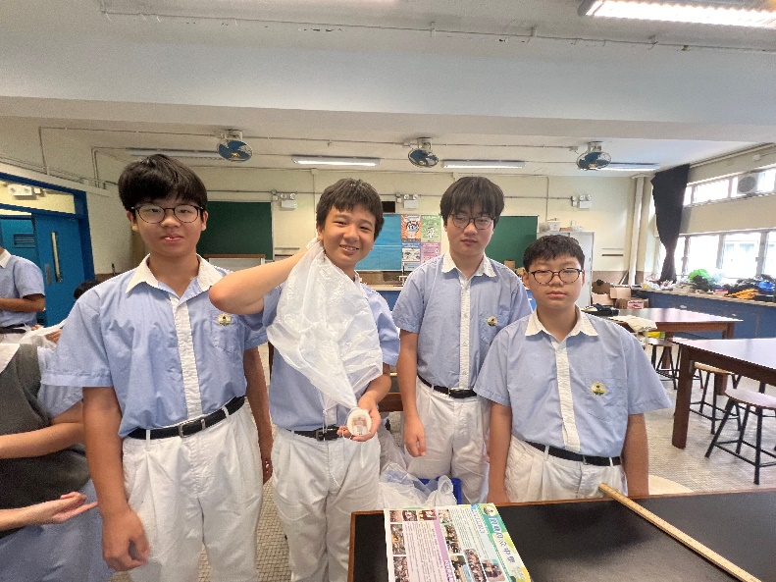
Designing a perfect parachute

Slide 9
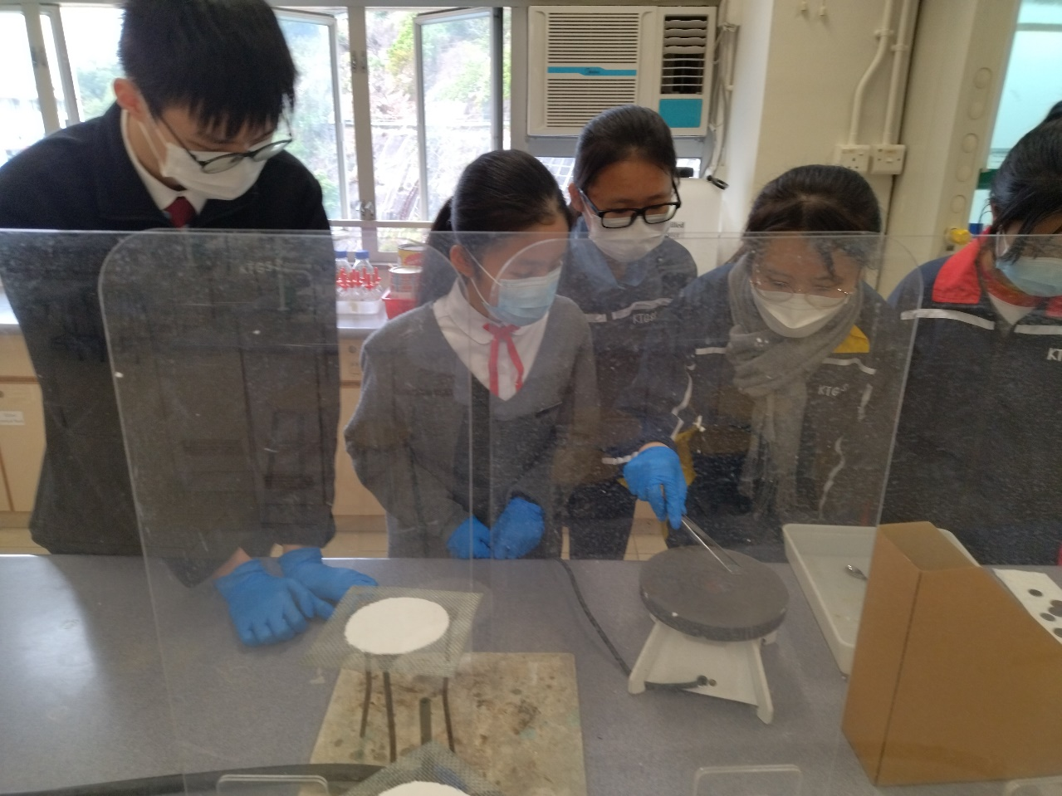
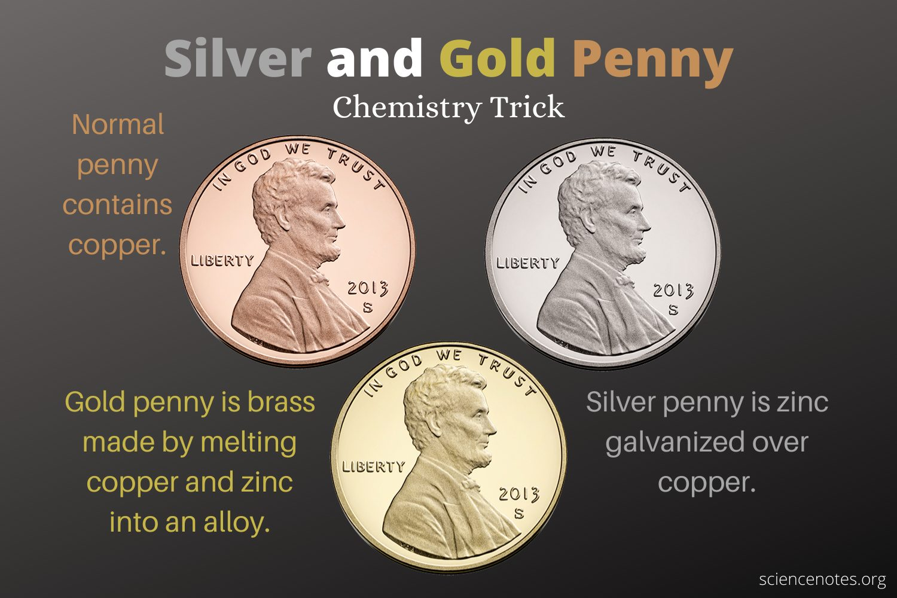
Turning coins into silver and gold

Slide 10
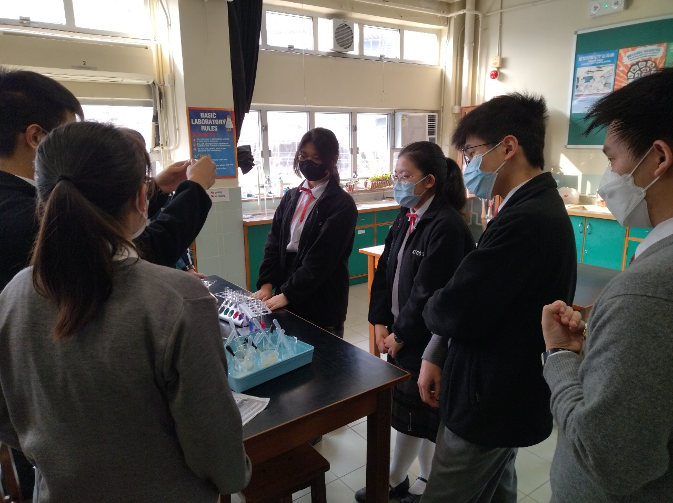
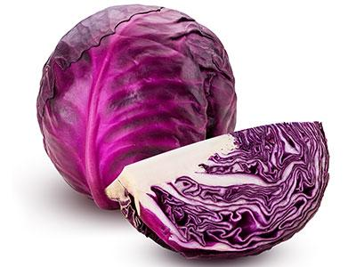
Red cabbage indicator

Slide 11
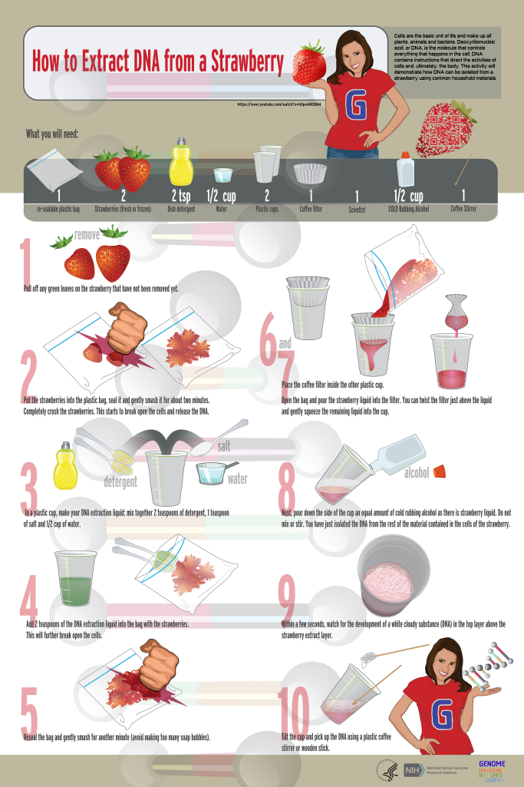
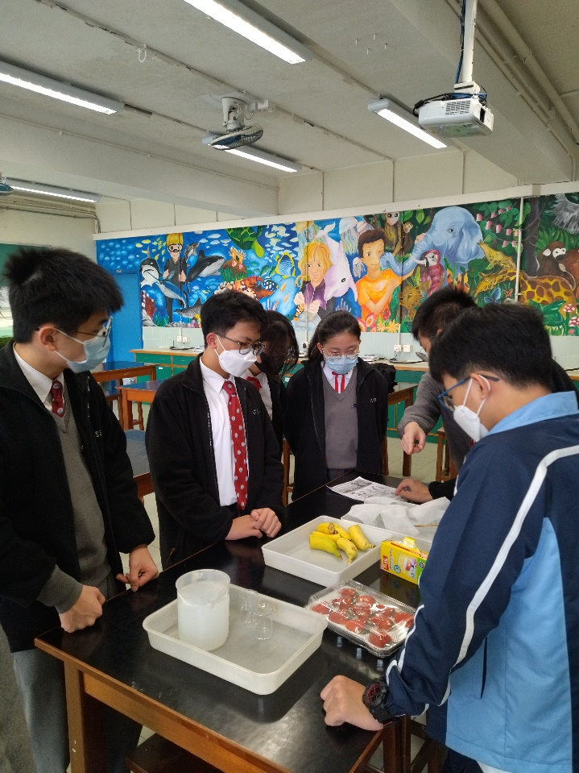
Simple extraction of DNA from food in 2022-23

Slide 12
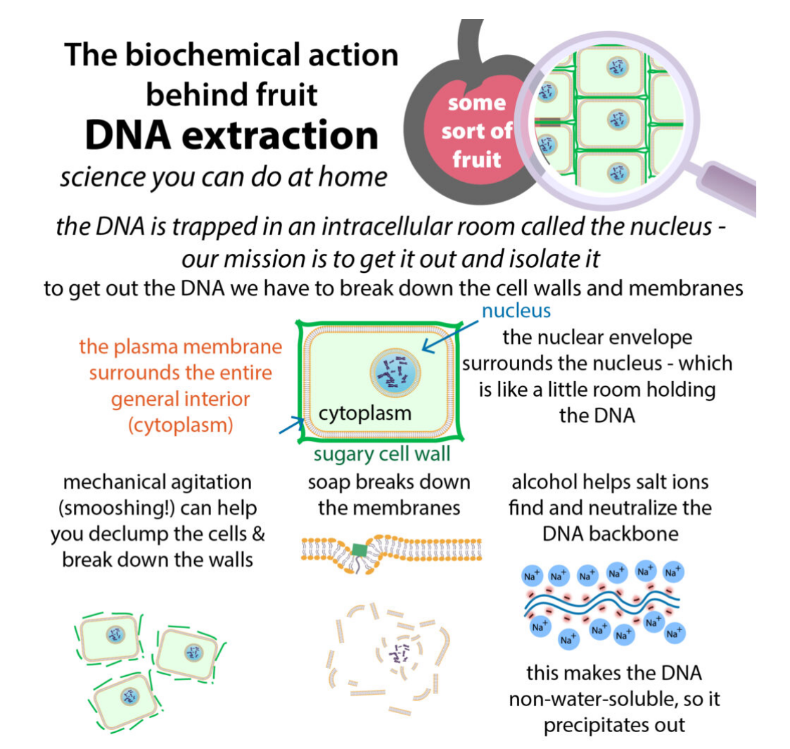
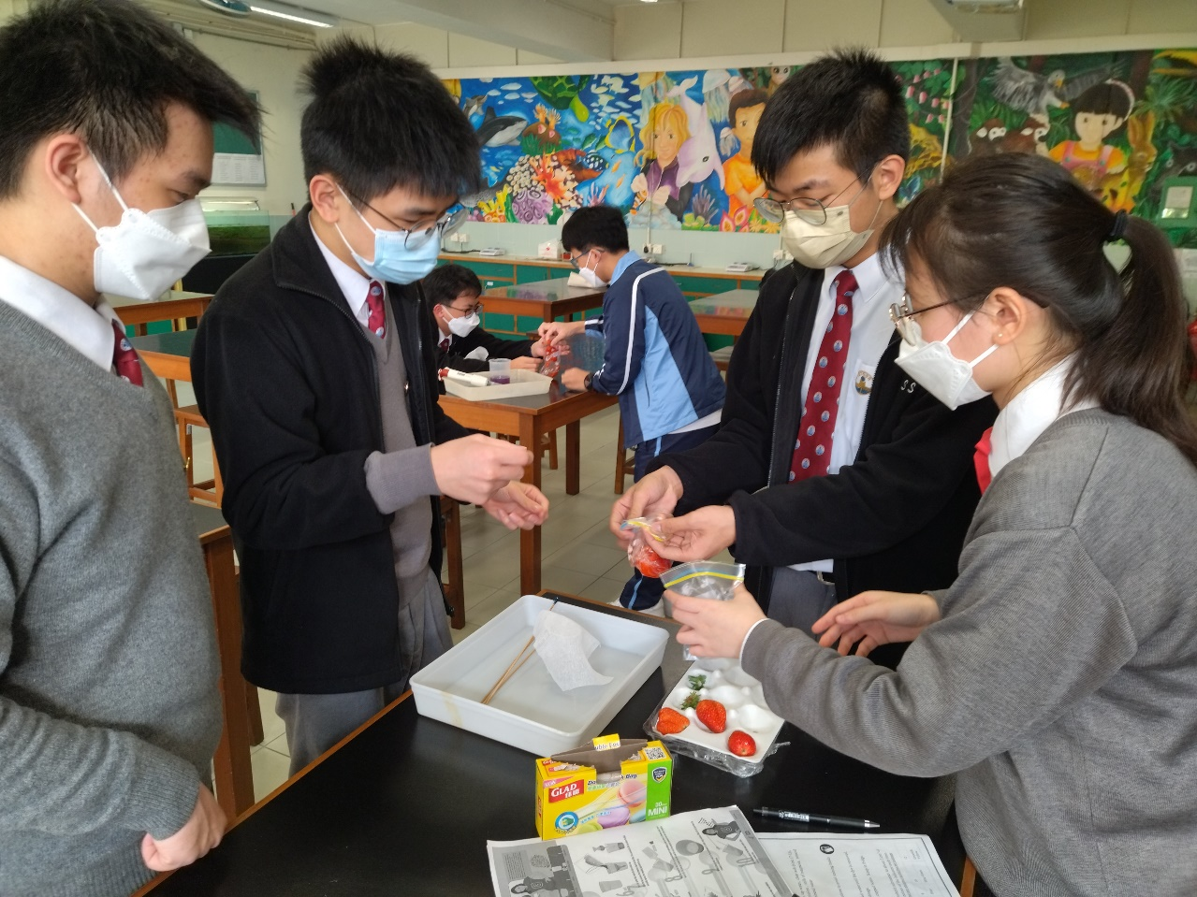
Simple extraction of DNA from food

