Slide 1

Extra-Curricular Activities (ECA)
KTGSS 2023-2024

Slide 2
Club Enrollment

Slide 3
Club Enrollment
at least ONE ECA club
no more than TWO clubs
no more than TWO Sports/Functional
Teams
Check Timetable carefully
No change of clubs after registration.
From 22/9 to 27/9
Enrollment Result Release
on 13/10
PLAY

Slide 4
REMINDERS TO S.1 STUDENTS
Must select one team from
(Scouts, Girl Guides, Red Cross, School Choir, School Band, Chinese Orchestra).
Do not clash with LEAP on Mondays and Thursdays after school.

Slide 5
How?

Slide 6
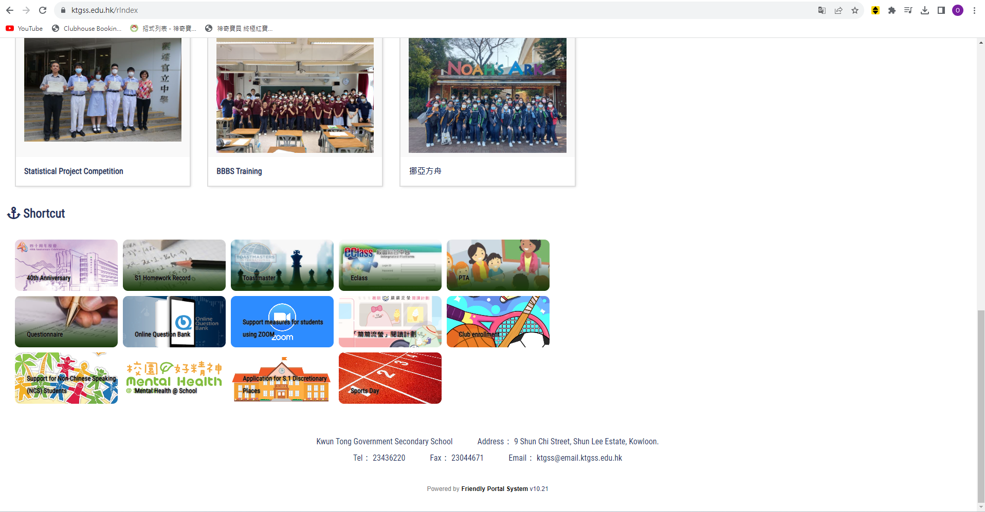
1. Go to the School Website: (ktgss.edu.hk)

Slide 7

2. Find the Icon: Club Enrollment

Slide 8
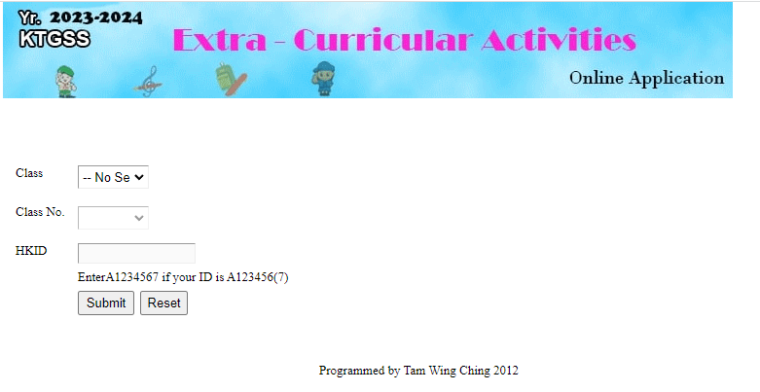
3. Enter your information
←Class: 1A
←Class Number: 1
←HKID: A1234567
X Bracket

Slide 9
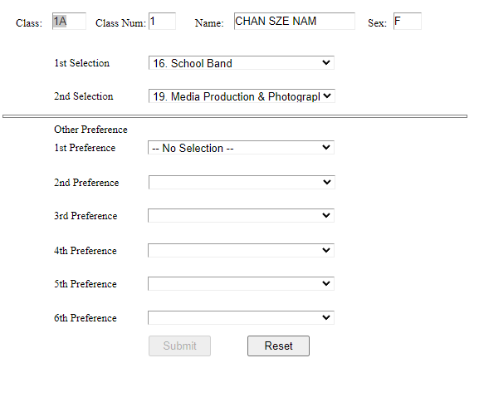
4. Select your Club
←For S1
1st Choice: 6 Teams
}
Complete ALL Preferences

Slide 10
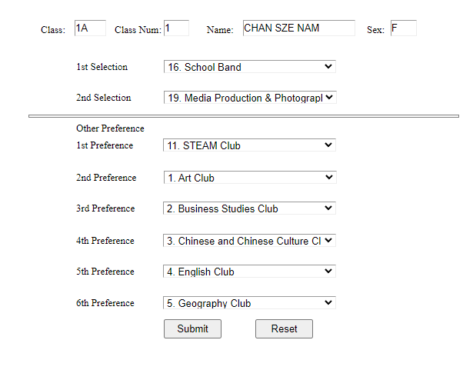
5. Submit your choices

Slide 11
CATEGORIES OF ECA
INSTRUMENTAL
SOCIAL SERVICES
ARTS
SPORTS
OTHER HOBBIES
ACADEMIC

Slide 12
38 ECA CLUBS
ARTS
1 | Art Club
2 | Business Studies Club
3 | Chinese & Chinese Culture Club
4 | English Club
5 | Geography Club
6 | History Club
7 | Japanese Club
8 | Mathematics Club
9 | Science Club
10 | Technology & Living Club
11 | STEAM Club
ACADEMIC

Slide 13
38 ECA CLUBS
12 | Chinese Orchestra
13 | Debating Club
14 | Drama Club
15 | Intangible Cultural Heritage Club
16 | School Band
17 | School Choir
INSTRUMENTAL
& CULTURAL

Slide 14
38 ECA CLUBS
18 | Audio Visual Information Technology Club
19 | Media Production & Photography Club
20 | Chess Club
21 | Gardening Club
22 | Teens Group
23 | Craft Club
OTHER HOBBIES

Slide 15
38 ECA CLUBS
24 | Community Youth Club
25 | Girl Guides
26 | Junior Police Call
27 | Library Club
28 | Red Cross
29 | Scouts
30 | Youth Pi Team
SOCIAL SERVICES

Slide 16
38 ECA CLUBS
31 | Badminton Club & Team
32 | Basketball Club & Team
33 | Billiard Club
34 | Darts Club
35 | Football Club & Team
36 | Netball Club & Team
37 | Table-tennis Club & Team
38 | Volleyball Club & Team
SPORTS

Slide 17
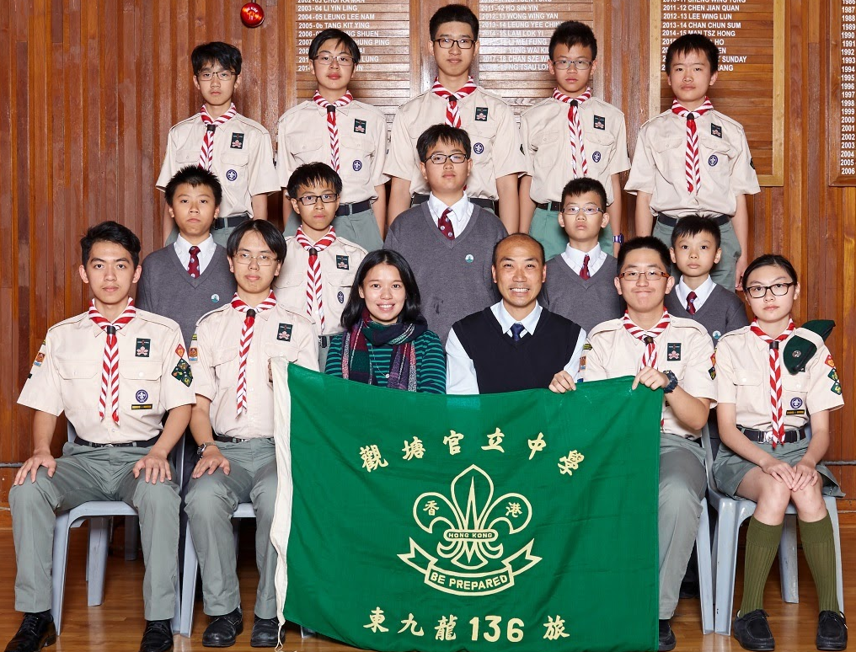
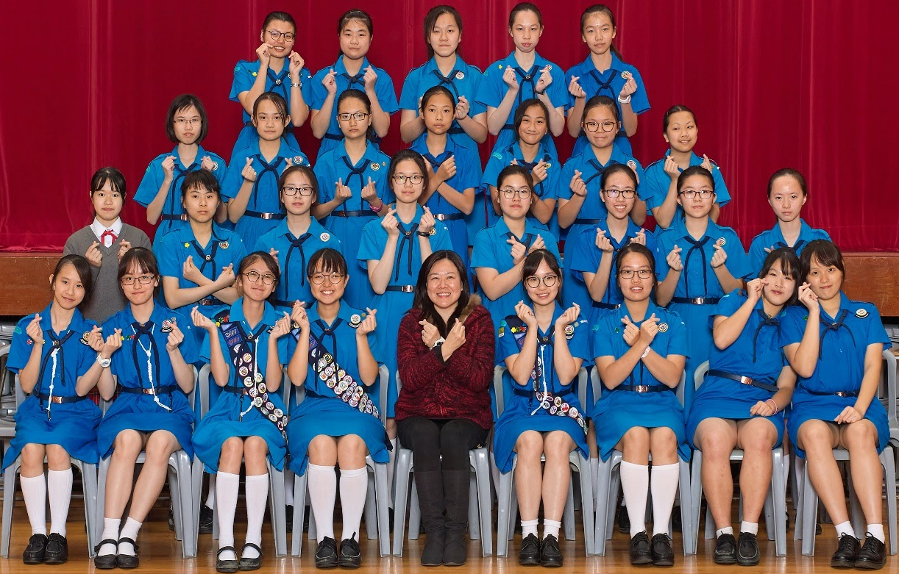
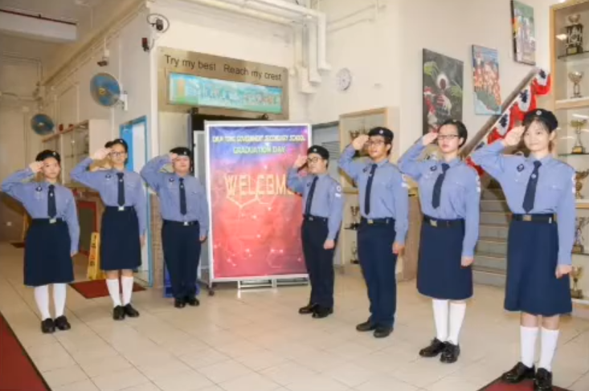
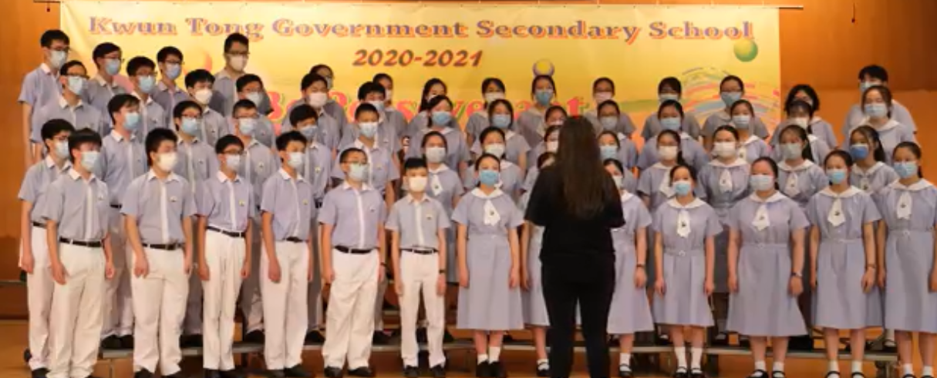
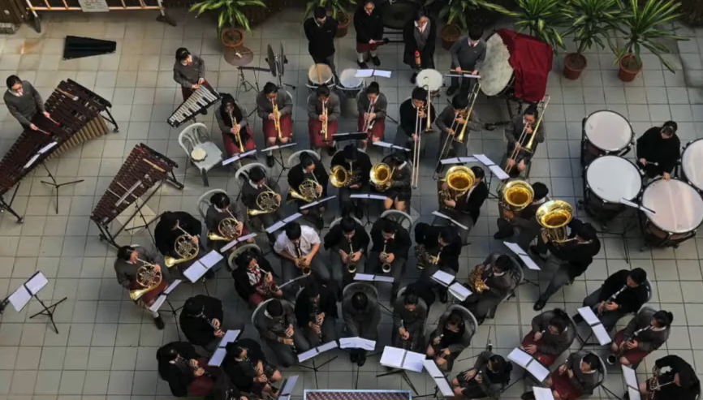
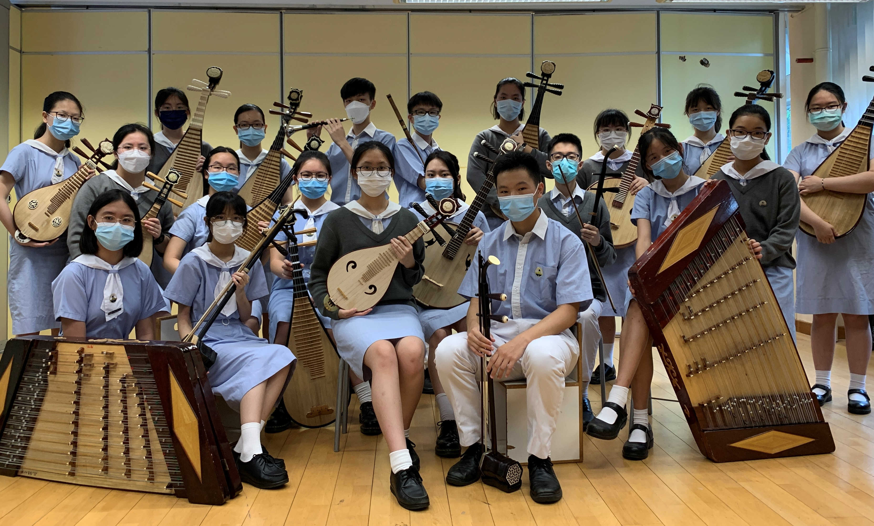
01
02
03
Scouts
Girl Guides
Red Cross
04
School Choir
05
06
School Band
Chinese Orchestra
S1 students must select one from above.

Slide 18
Where can I find the information of the clubs?

Slide 19
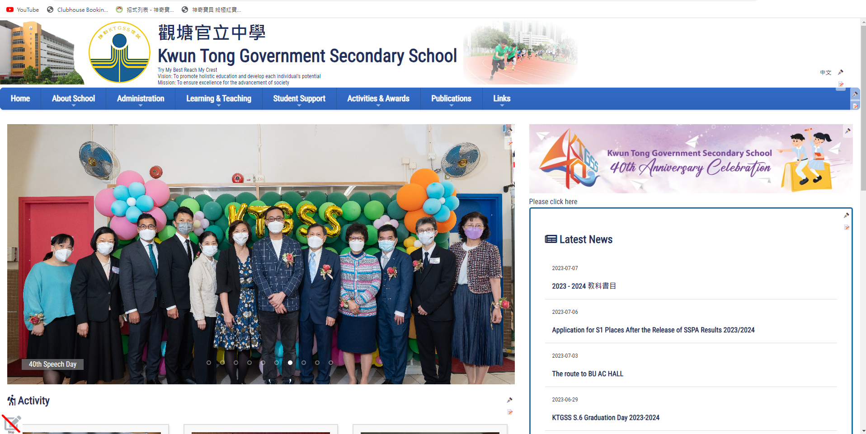
1. Go to the School Website: (ktgss.edu.hk)

Slide 20
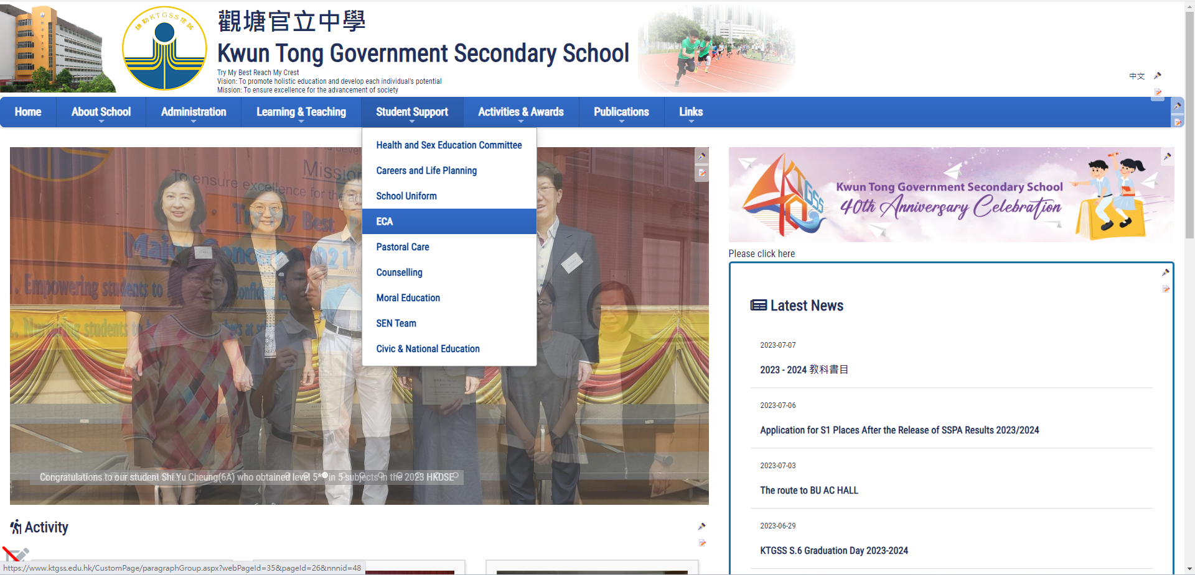
2. Student Support → ECA

Slide 21
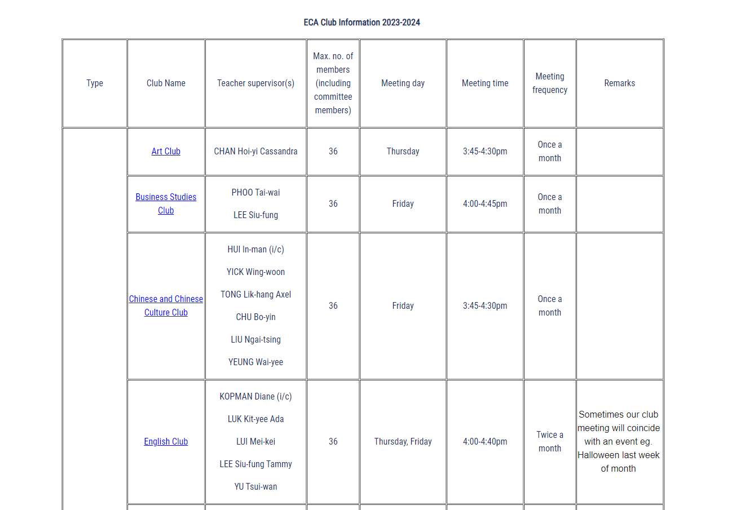
3. Clubs and Teams
PPT
VIDEO

Slide 22
REMINDERS TO ALL STUDENTS!
REGISTRATION IS NEEDED
LEAVE MUST BE INFORMED
ATTENDANCE IS IMPORTANT
Membership may be terminated if attandance is below 70% or fail to comply with the rules of the club
Registration is needed for committee members which will be counted as one ECA
In case of medical appointment /competition, you must inform the teacher-in-charge of your club/team at least 1 day in advance with a parents letter

Slide 23
SLP & OLE (S4-S6)

Slide 24
Self Learning Profile (SLP) (S6)
Self-Account
1 Dec 2023

Slide 25
Other Learning Experience (OLE) (S4-S6)_
Name
Class
Class No.
Programme Description
Role
Partner Organization
Aspect
S6: 1 Dec 2023
S4-5 : 1 July 2024

Slide 26
5 Aspects & 17 roles
Chairperson | 主席
Vice-Chairperson | 副主席
Secretary | 文書
Treasurer | 財政
Liaison Officer | 聯絡
Publicity Officer | 宣傳
General Affairs Officer | 總務
Recreation Officer | 康樂
Welfare Officer | 福利
Committee Member | 幹事
Leader | 組長
Member | 組員
Concert Master | 樂團首席
Section Leader | 聲部長
House Captain | 社長
Vice-House Captain | 副社長
Participant | 參加者
Volunteer | 義工
Team Captain | 隊長
Team Member | 隊員
Civic and Moral Ed. (德育及公民教育)
Social Services (社會服務)
Careers (與工作有關的經驗)
Arts development (藝術發展)
Sports development (體育發展)

Slide 27
Act with Integrity
Have FUN in ECA!

Slide 28
Integrity
Responsible
Reliable
Humble

Slide 29

Responsible
- Be Punctual
- Attend ALL activities and meetings

Slide 30


- Complete tasks given by teachers
- Help each other

Slide 31


- “ Every one can teach you something”
- Try to listen and learn from every one

Slide 32
Mr. Lui Hin Ming @ G/F Staff room
Ms. Chu Bo Yin @ G/F Staff room

Slide 33
Act with Integrity
Have FUN in ECA!
~ The End ~

