Slide 1


Join Us for English Fun and Games - Every Month!
Enjoy monthly activities, learn English, and make new friends.
by Siu Pik Clarrisa Poon

Slide 3

Practise English through lively games and activities
1
Vocabulary
2
Grammar
Expand your vocabulary with engaging games.
Practice grammar rules through interactive activities.
3
Pronunciation
4
Conversation
Improve pronunciation with fun tongue twisters and games.
Build confidence in speaking with role-playing games.

Slide 4
Conversational Practice
Small Group
Discussion Topics
Real-Life Scenarios
Practice speaking in a supportive environment.
Explore a variety of interesting themes.
Develop communication skills for everyday situations.
Engage in lively debates and discussions.
Improve fluency and confidence.
Practice conversations in shops, restaurants, etc.

Slide 5
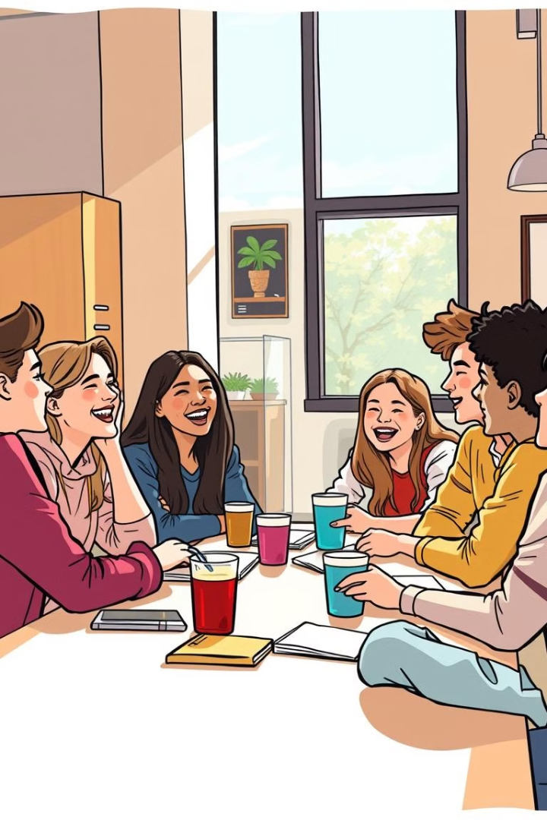



Improve your speaking skills in a supportive group setting
Friendly Atmosphere
Feel comfortable speaking without judgment.
Practice Speaking
Engage in conversations with fellow students.
Feedback and Support
Receive constructive feedback from teachers and peers.

Slide 6

Seasonal Celebrations
1
Halloween
Enjoy a fun and spooky Halloween party .
2
Thanksgiving
Share a delicious Thanksgiving feast with friends.
3
Christmas
Celebrate Christmas with festive activities and games.

Slide 7

Join us for festive events throughout the year
Cultural Events
Special Guests
Explore different cultures through festive celebrations.
Meet interesting speakers and performers.
Fun Activities
Enjoy games, crafts, and music.

Slide 8




S1 Creative Writing Competition
Prizes Awarded
Win exciting prizes for your creative writing.
Show off Your Talent
Showcase your writing skills to the world.
Submit Your Story
Write a six-word story or a longer piece.

Slide 9

Join English Club to learn English in a fun way☺

