Slide 1


Kwun Tong Government Secondary School
38th Annual Sports Day
2023-24

Slide 2
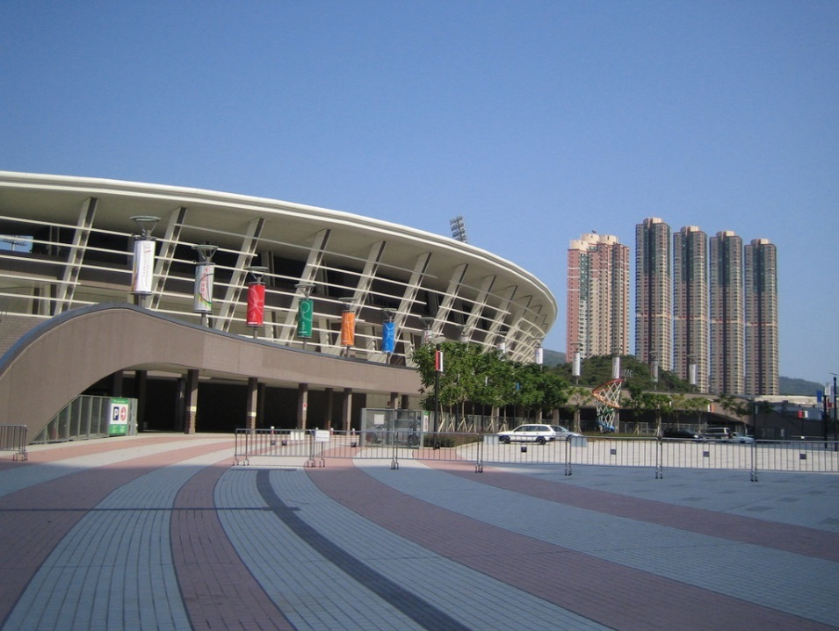
38th Annual Sports Day
Venue: Tseung Kwan O Sports Ground
Date & Time:
27 September, 2023 (Heats) 08:00 a.m. – 04:00 p.m.
28 September, 2023 (Final) 08:00 a.m. – 01:00 p.m.

Slide 3

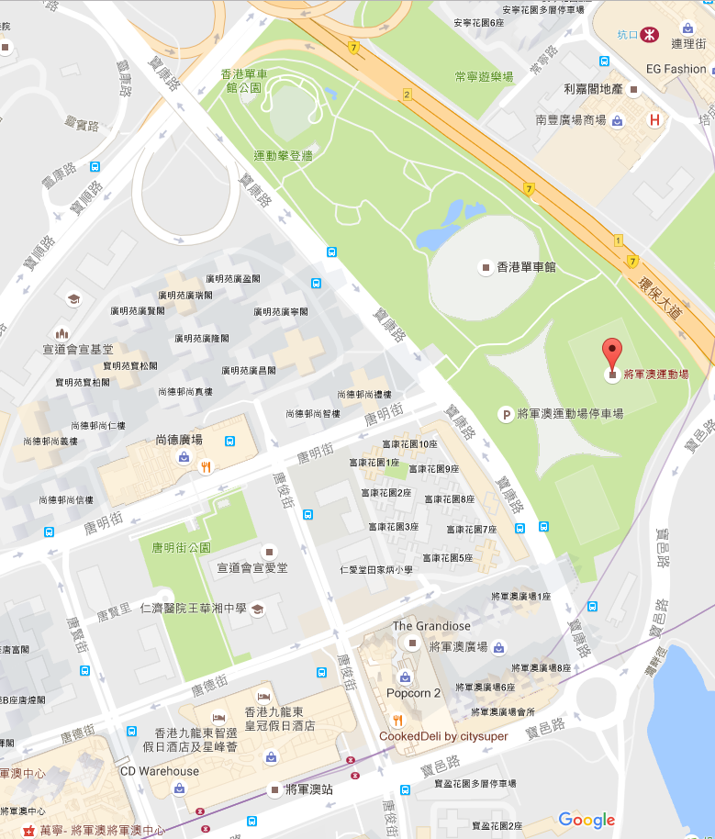

Hang Hau MTR Station
Tseung Kwan O MTR Station

Slide 4
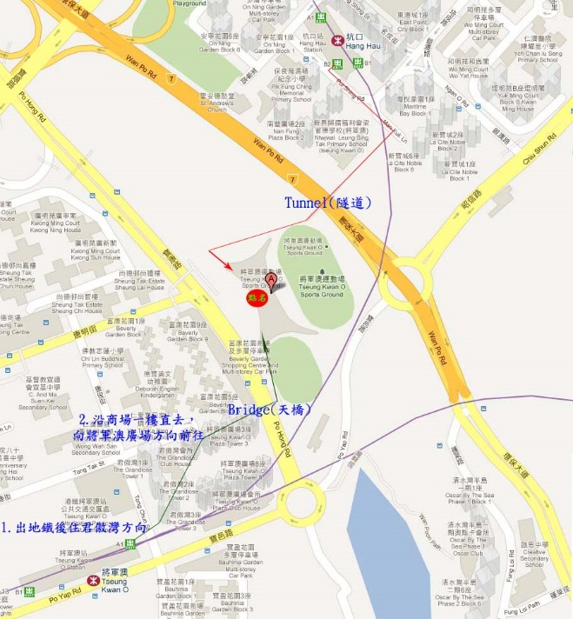

Slide 5
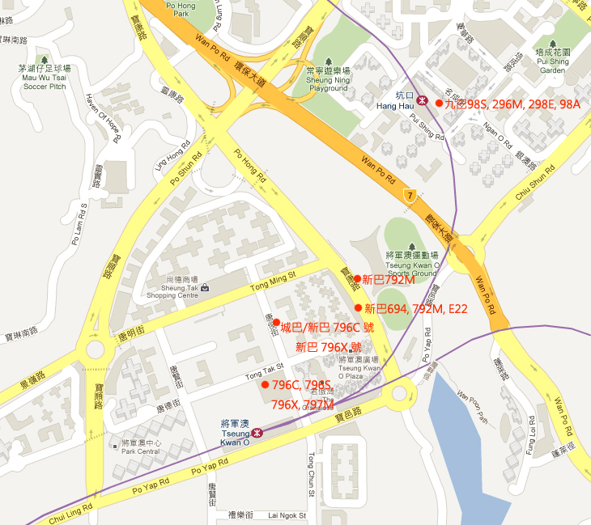

Slide 6
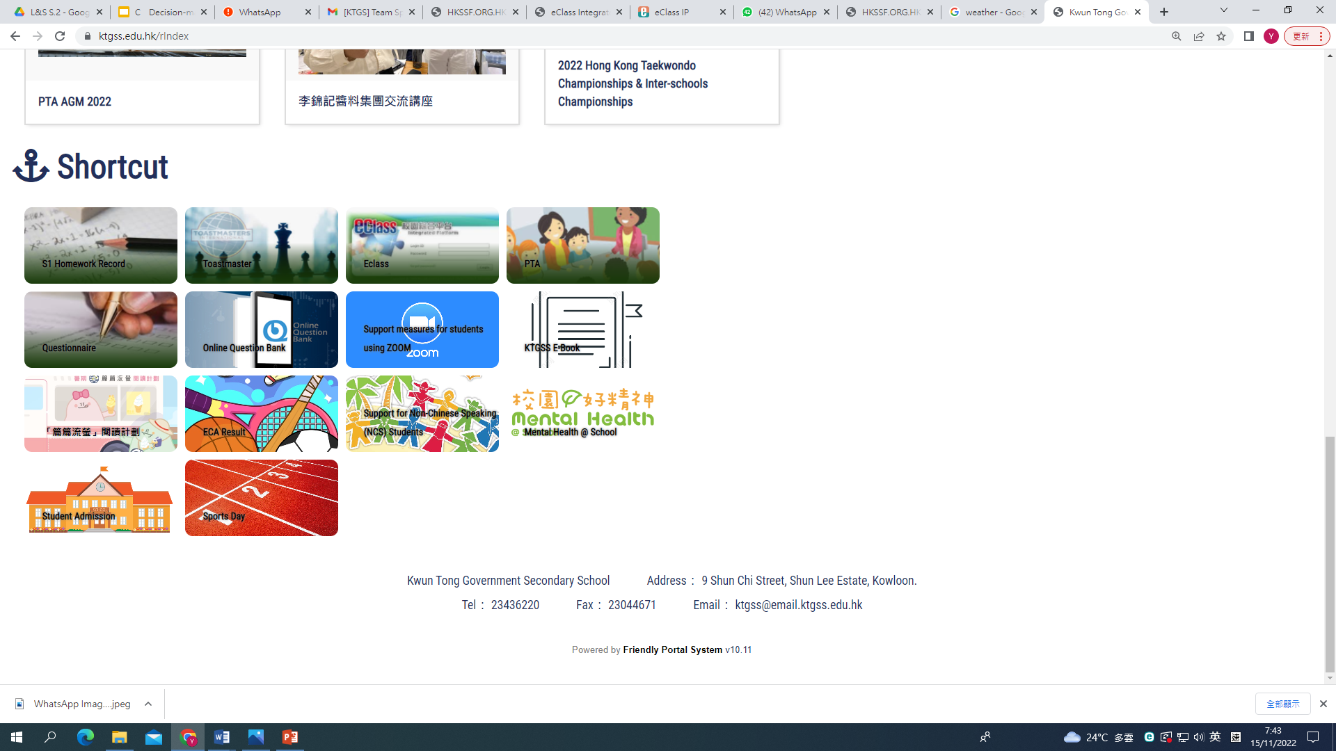
FYI

Slide 8
38th Annual Sports Day
No. of participants : 530 (18/9) 416
Total Entries : 1044 (18/9) 848
No. of students helpers : 150 (18%) 22/9/2023 Friday
Guest of honor : Ms. Leung Kam Kiu Vicki
(Our former discipline mistress )

Slide 9


Roll Call
Taken by prefects between 7:35 a.m. and 8:00 a.m. at the entrance of the Tseung Kwan O Sports Ground.
Please bring your Student Card !

Slide 10
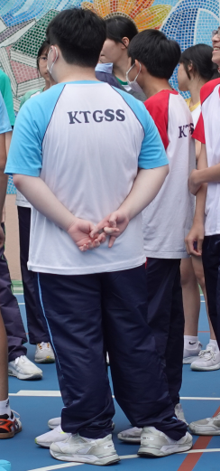
School Uniform
Roll Call : PE Uniform
Competitors : PE/House Tee + PE Shorts
Relay team : Identical tops in same color and styles
Scouts/Red Cross/ Girls Guide…

Slide 11
Sing Shun Kan Him

Slide 12
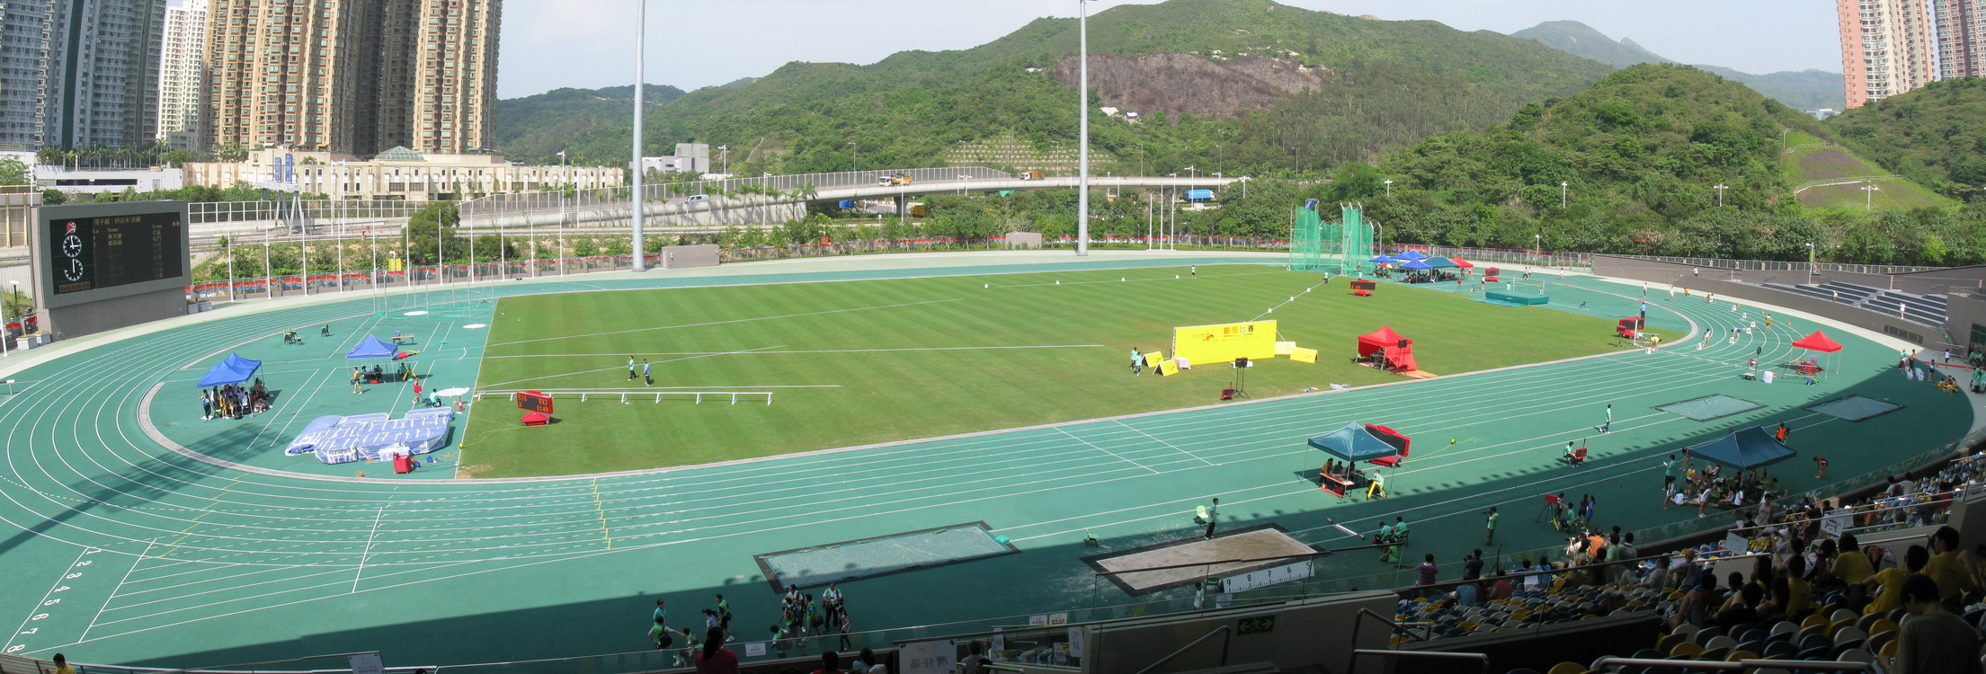
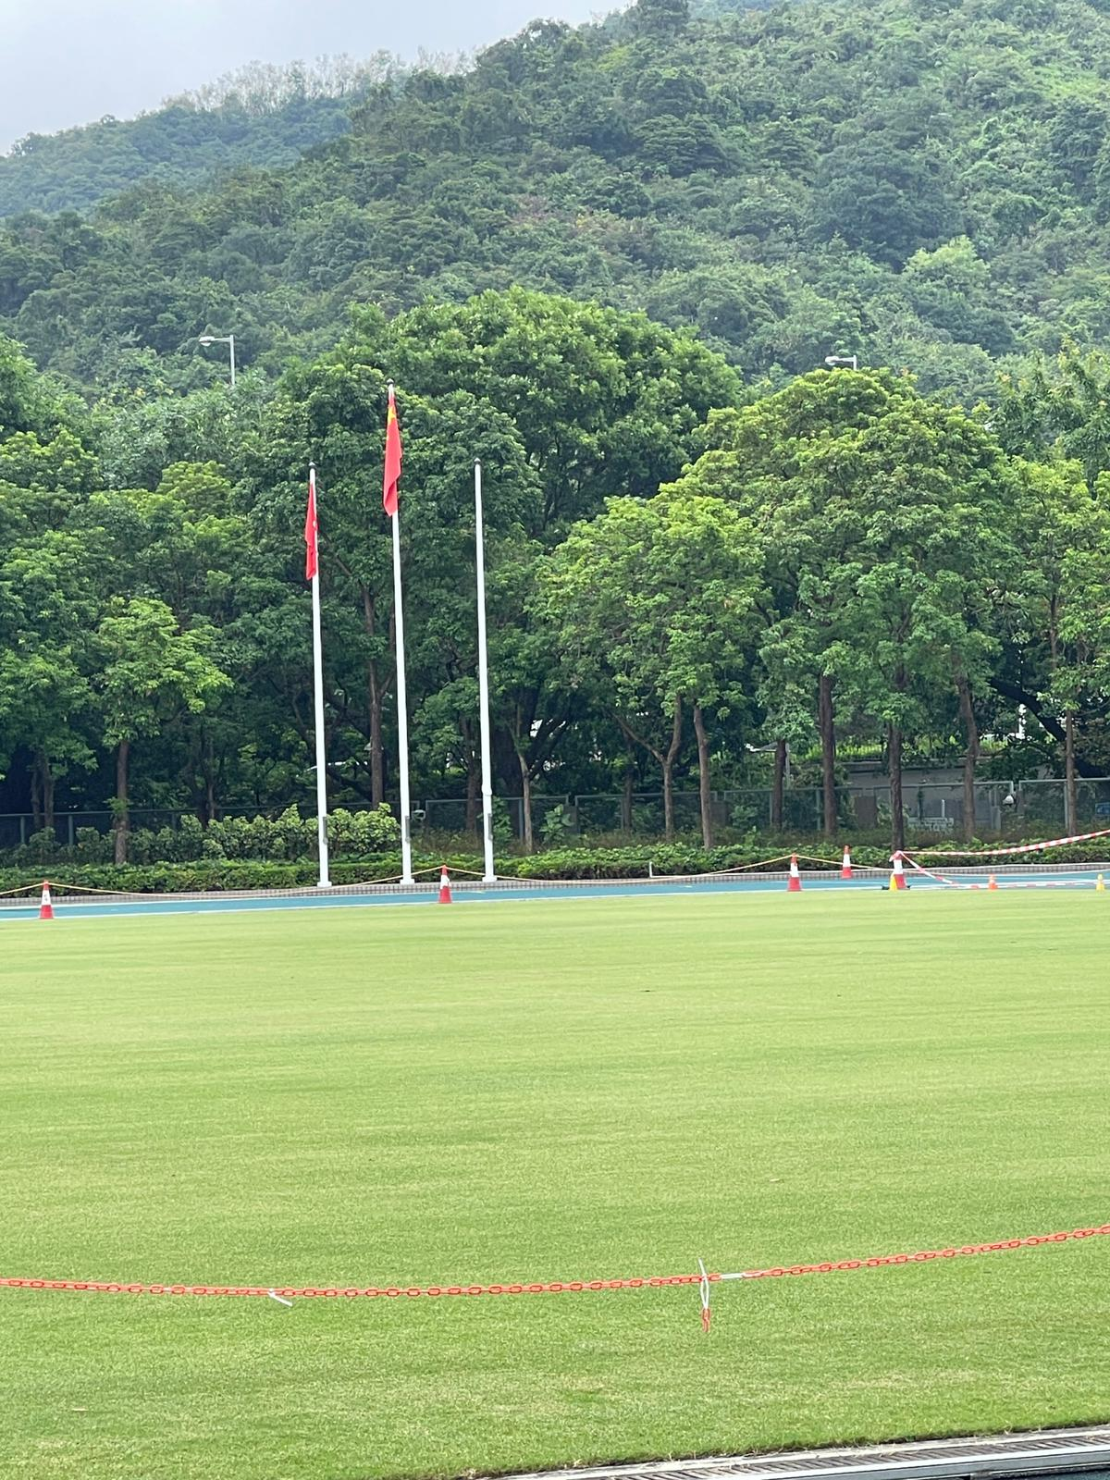
Flag Raising

Slide 13

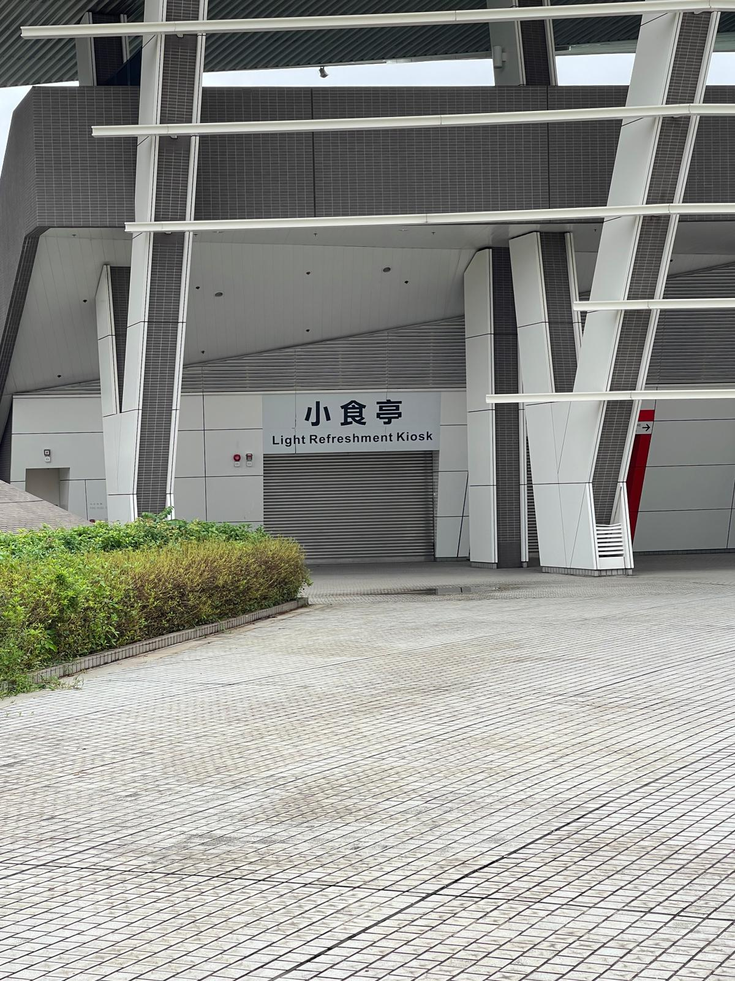

Lunch Arrangement
Time: around 1hour 15mins

Slide 15
(Heats Day)
27 September,2023(Wed)

Slide 16
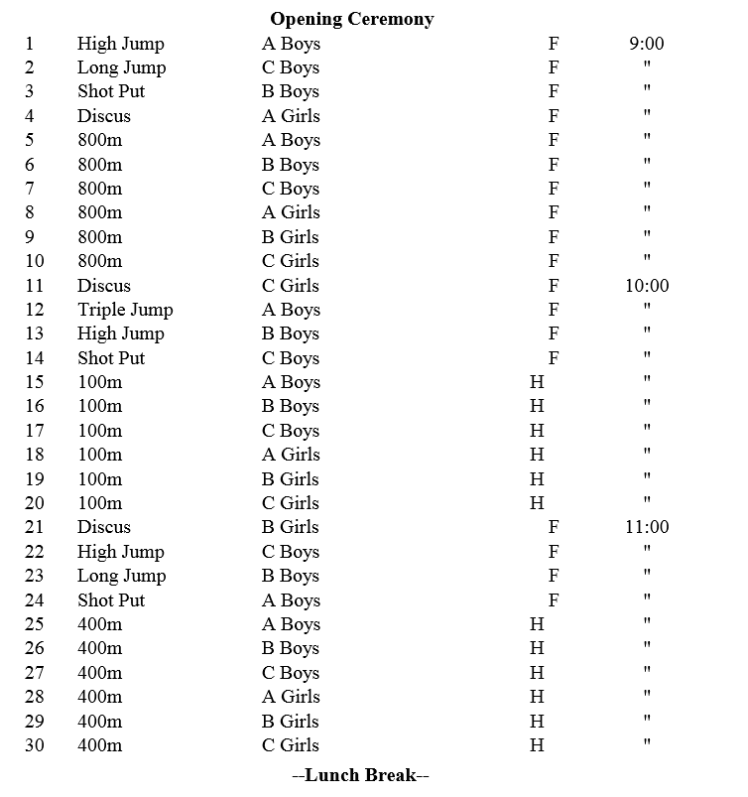

Slide 17
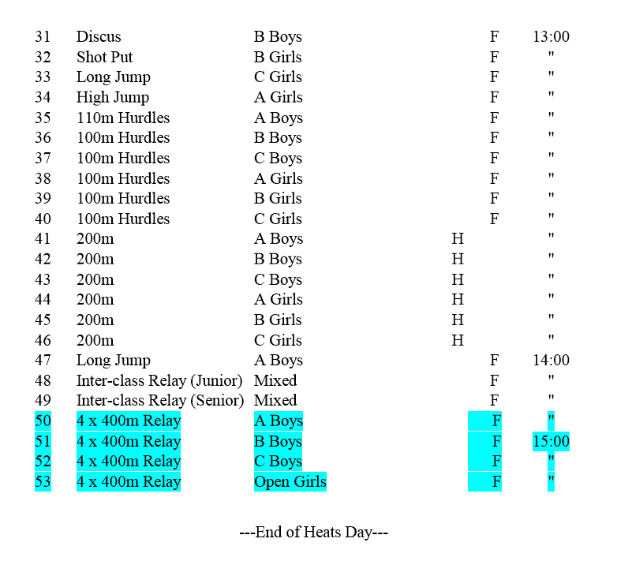

Slide 18
(Final)
28 September,2023(Thurs)

Slide 19
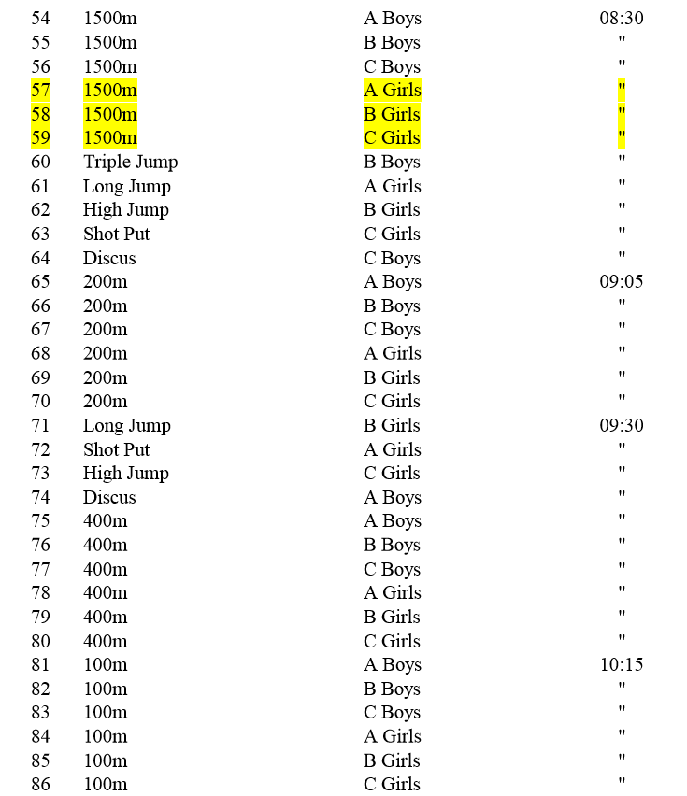

Slide 20
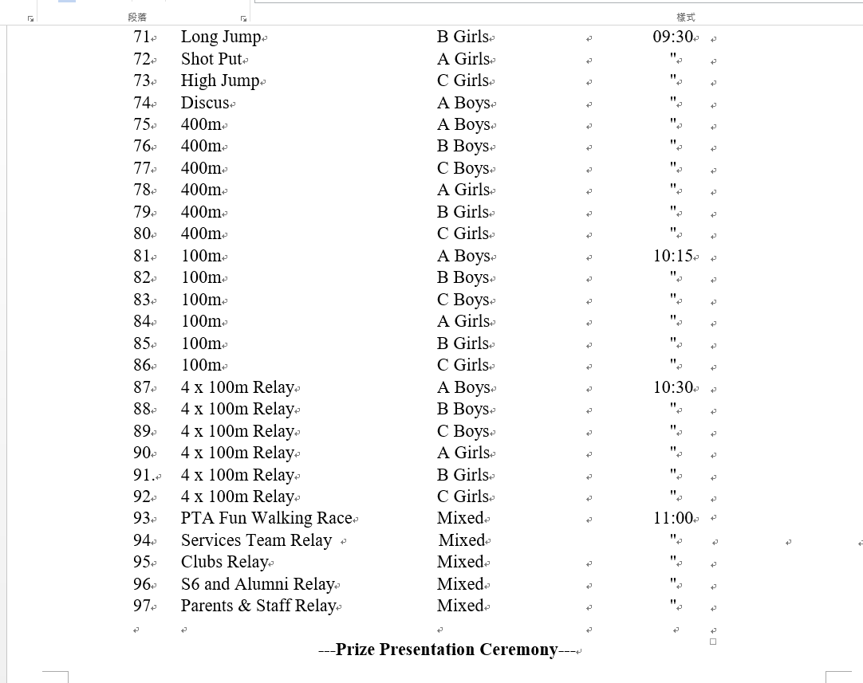

Slide 21
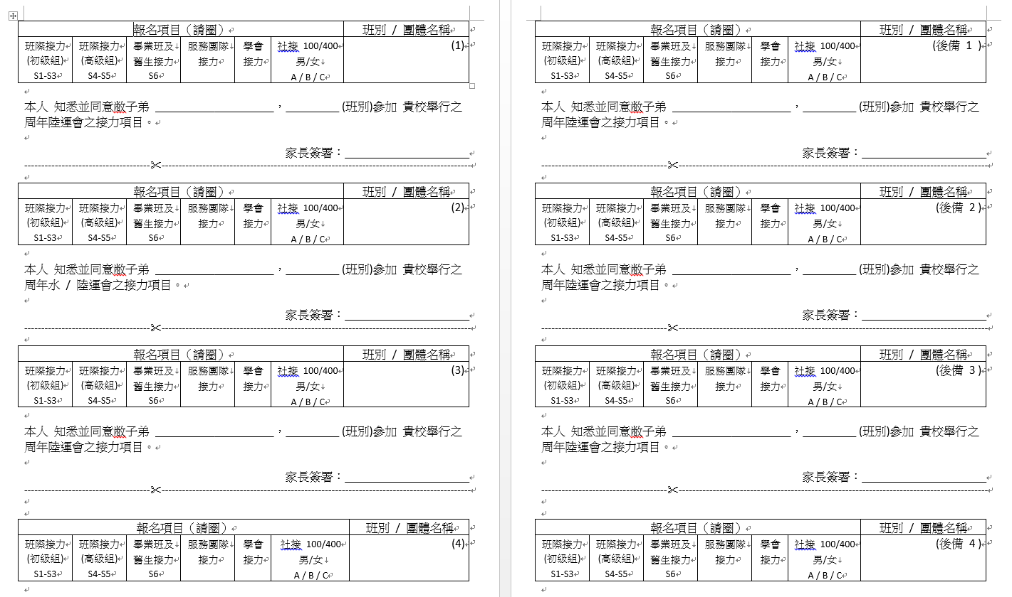

Slide 22
Sports day preparation
21/9, 25/9, 26/9 ( 4:45-5:15 )
School playground
Refer to house captain

Slide 23

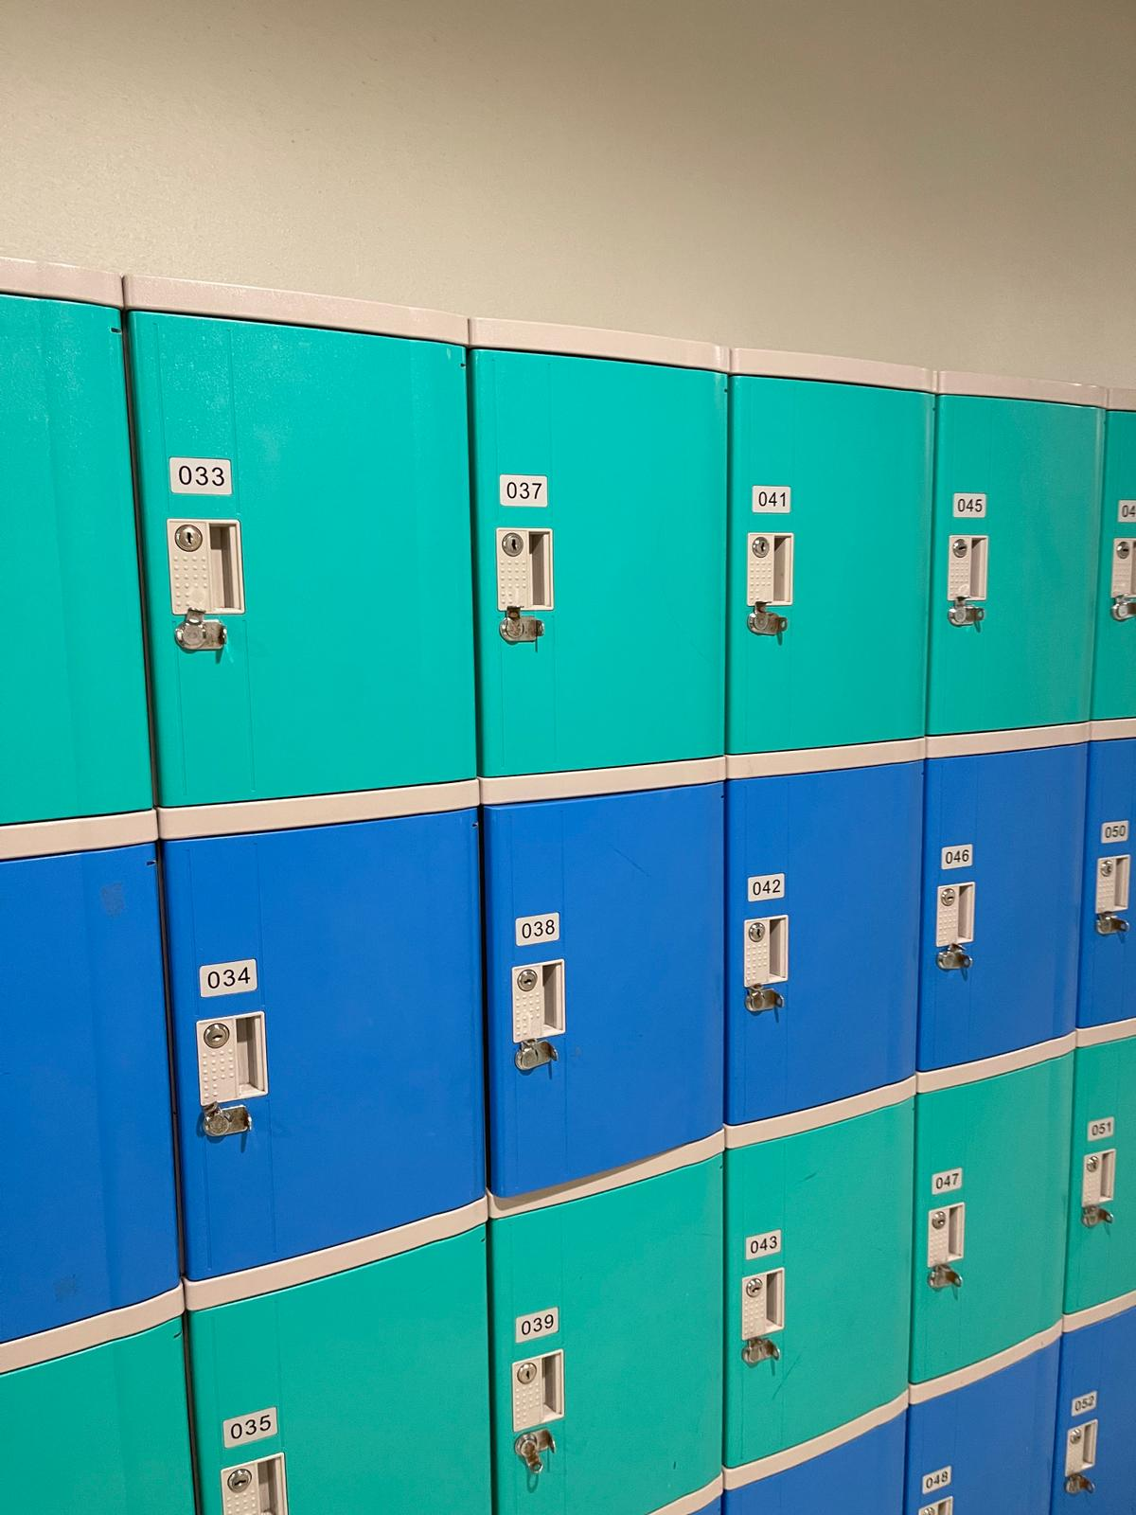

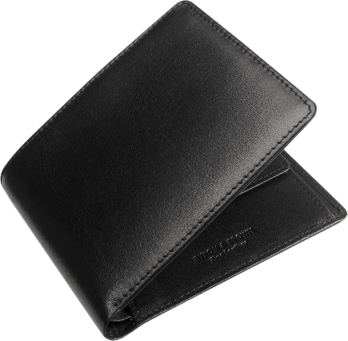
Please mind your personal belongings!

Slide 24
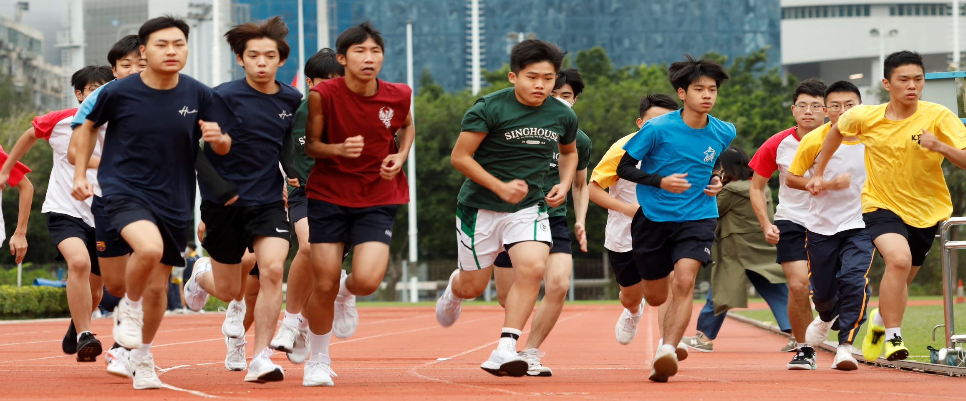
Be Safe and Have Fun
Be safe and Have Fun!

