Slide 1
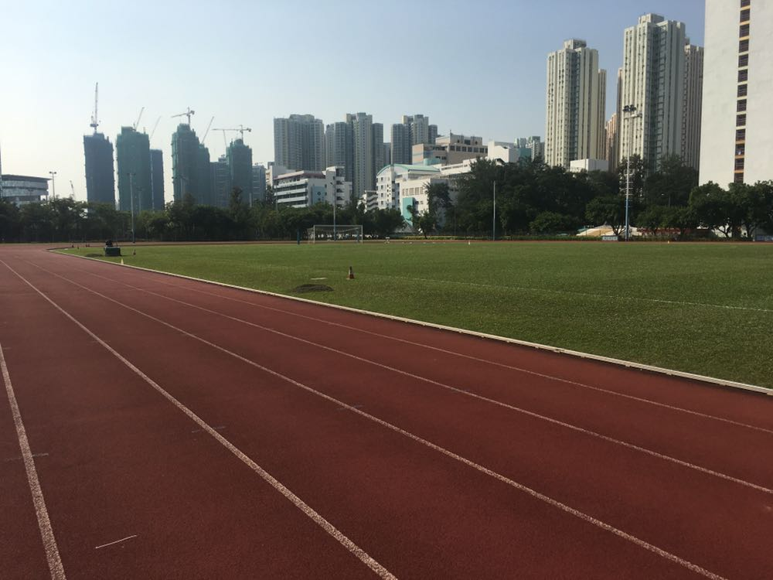

Kwun Tong Government Secondary School
39th annual
Sports Day

Slide 2
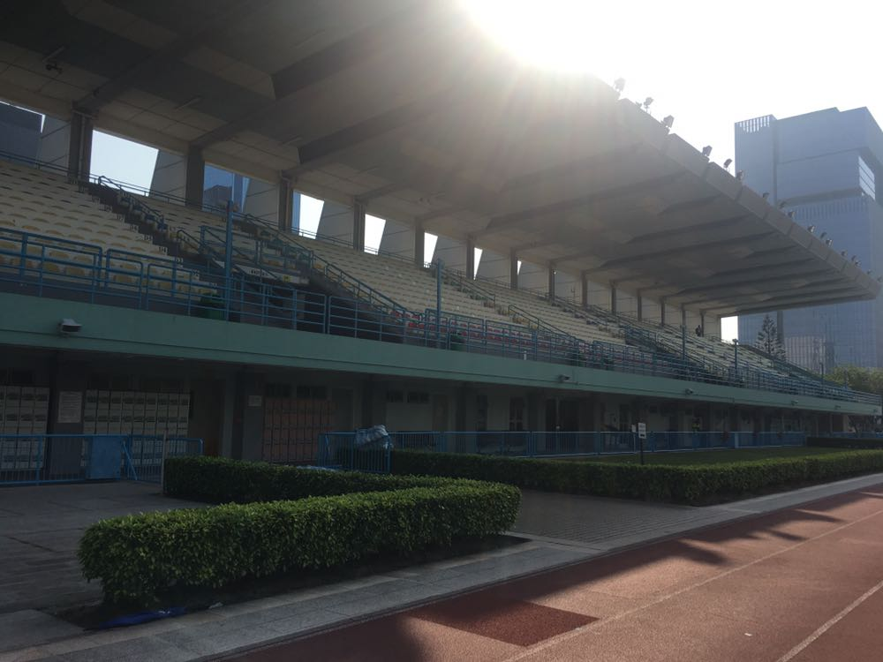
39th annual Sports Day
Venue: Kowloon Bay Sports Ground
Date & Time:
14 Oct, 2024 (Heats) 08:00 a.m. – 04:00 p.m.
15 Oct, 2024 (Final) 08:00 a.m. – 01:00 p.m.

Slide 3

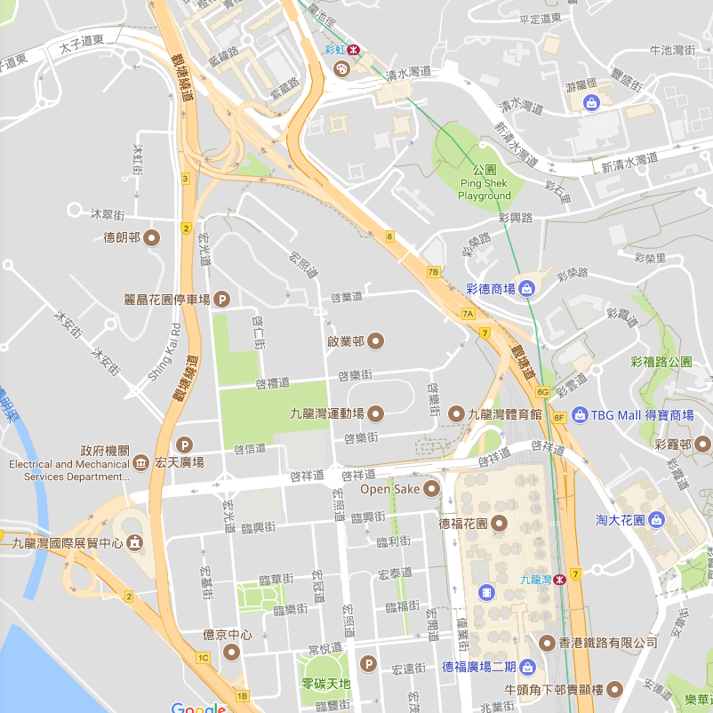

Choi Hung MTR Station
Kowloon Bay MTR Station

Slide 4
Choi Hung MTR Station
Kowloon Bay MTR Station

Slide 5
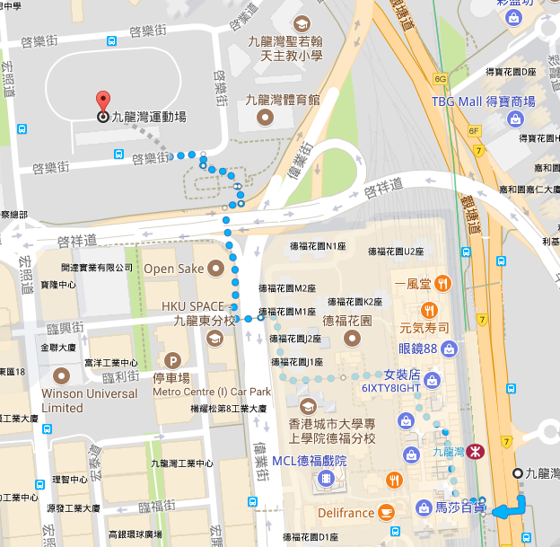
Kowloon Bay MTR Station
Exit A

Slide 6
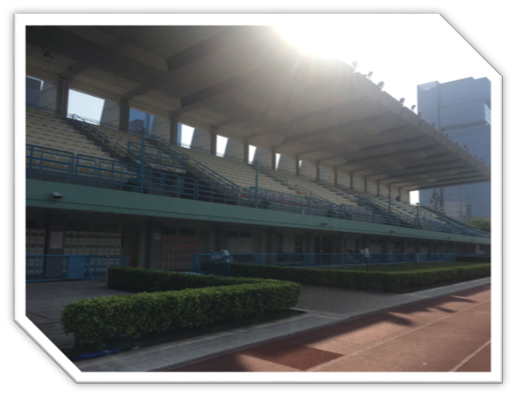
39th annual Sports Day
No. of participants : 358 (7/10)
Total Entries : 697 (7/10)
No. of students helpers : 170
Guest of honor : Mr. Tsoi Wing Keung
(Principal of Sau Kei Wan East Government Secondary School)

Slide 7


Roll Call
Taken by prefects between 7:30 a.m. and 8:00 a.m. at the Main Entrance of the Kowloon Bay Sports Ground.
Please bring your Student Card !

Slide 8
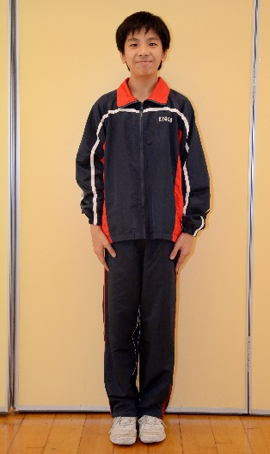

Uniform
Roll Call : Proper PE Uniform
Competitors : PE/House Tee + PE Shorts Relay team : Identical tops in same color and styles
JPC/Red Cross/ Girls Guide…

Slide 9
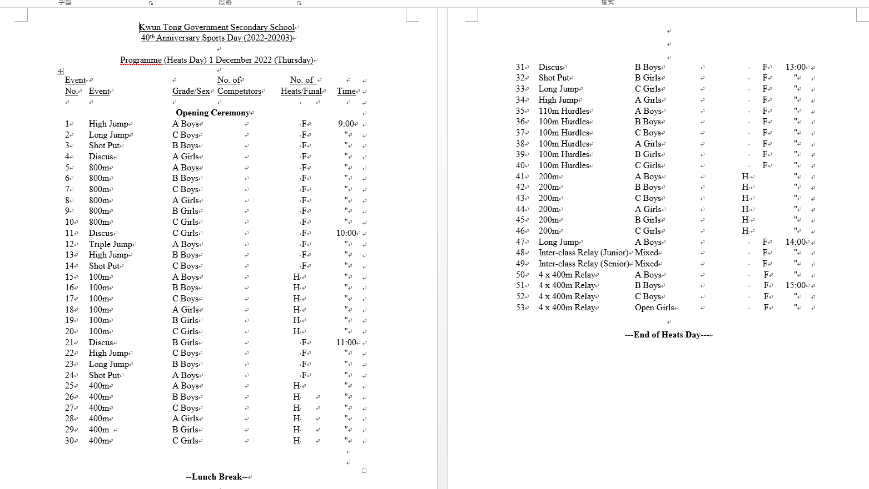

Slide 10
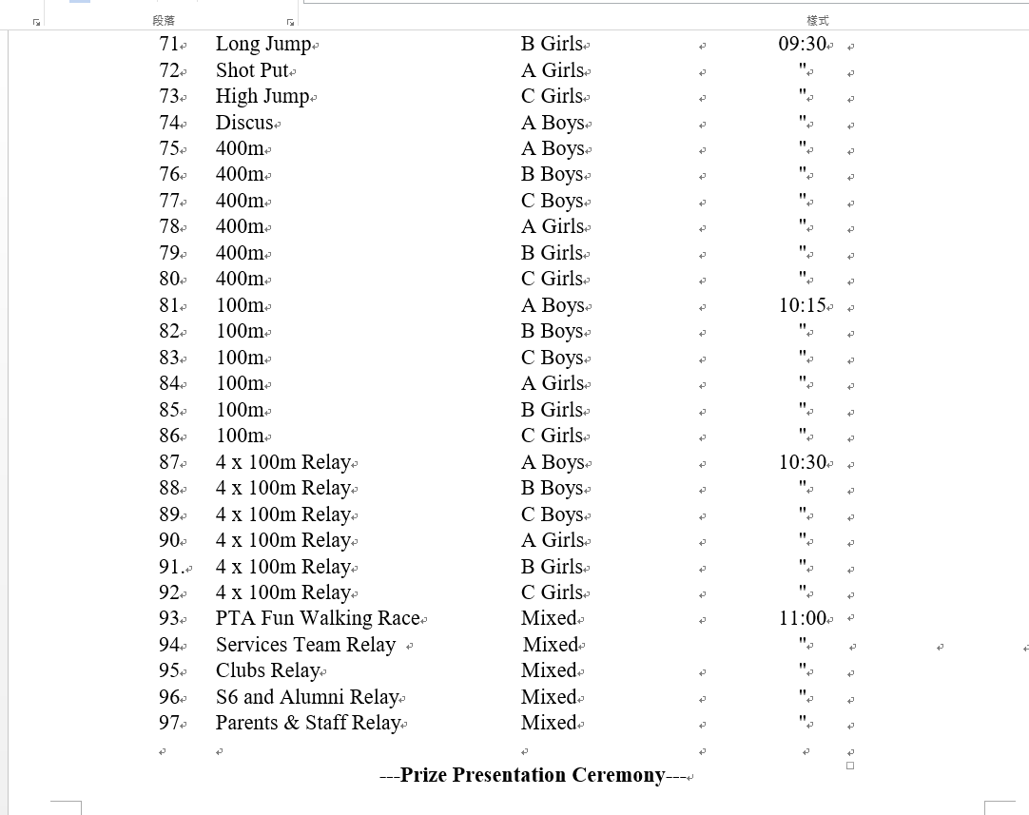

Slide 11
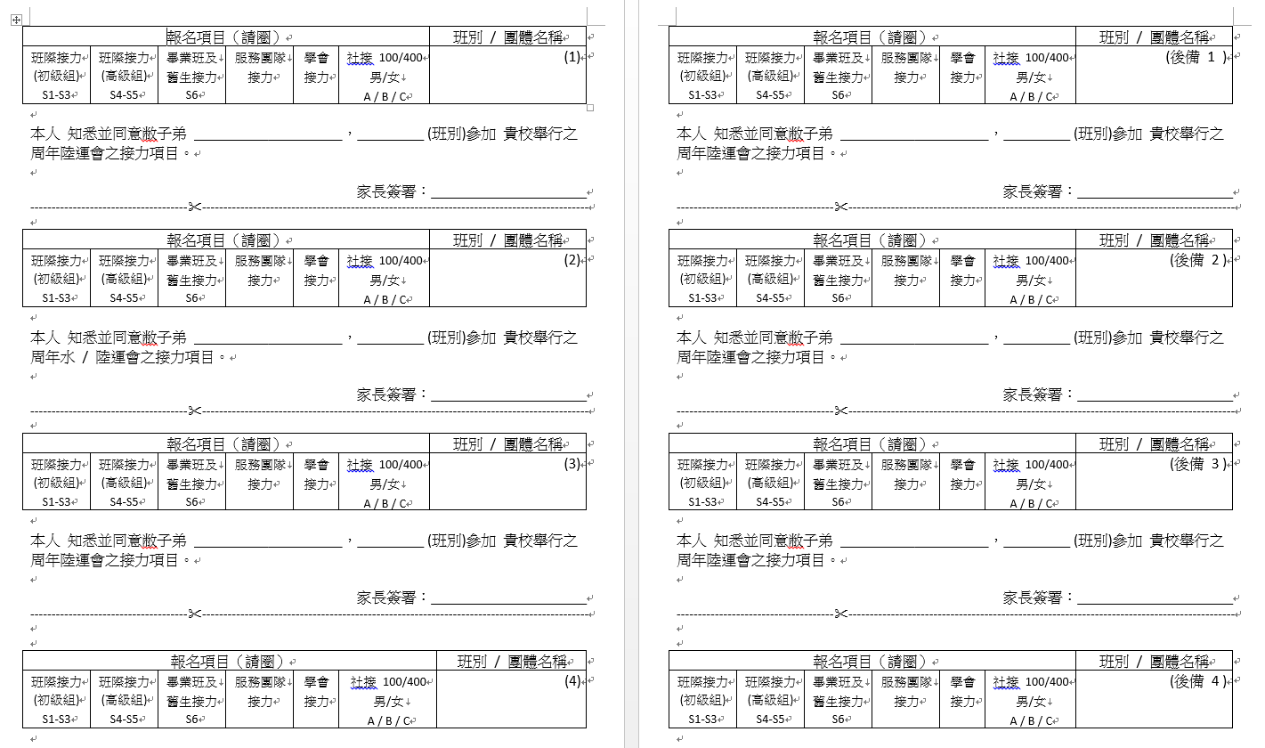

Slide 12
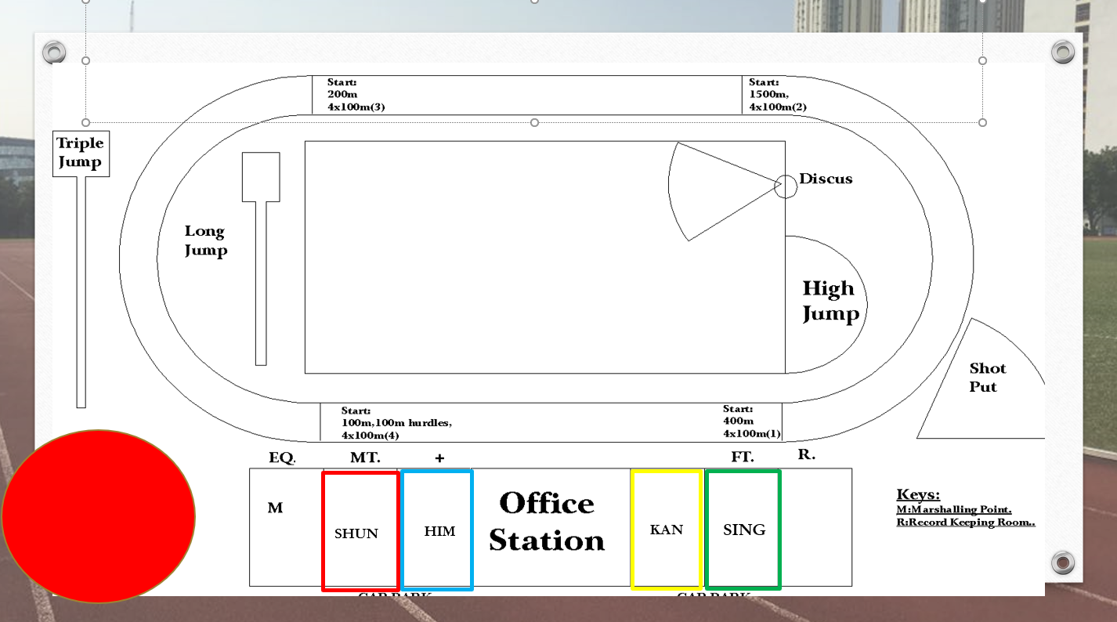
Him Shun Kan Sing
SHUN
HIM
KAN
SING

Slide 13
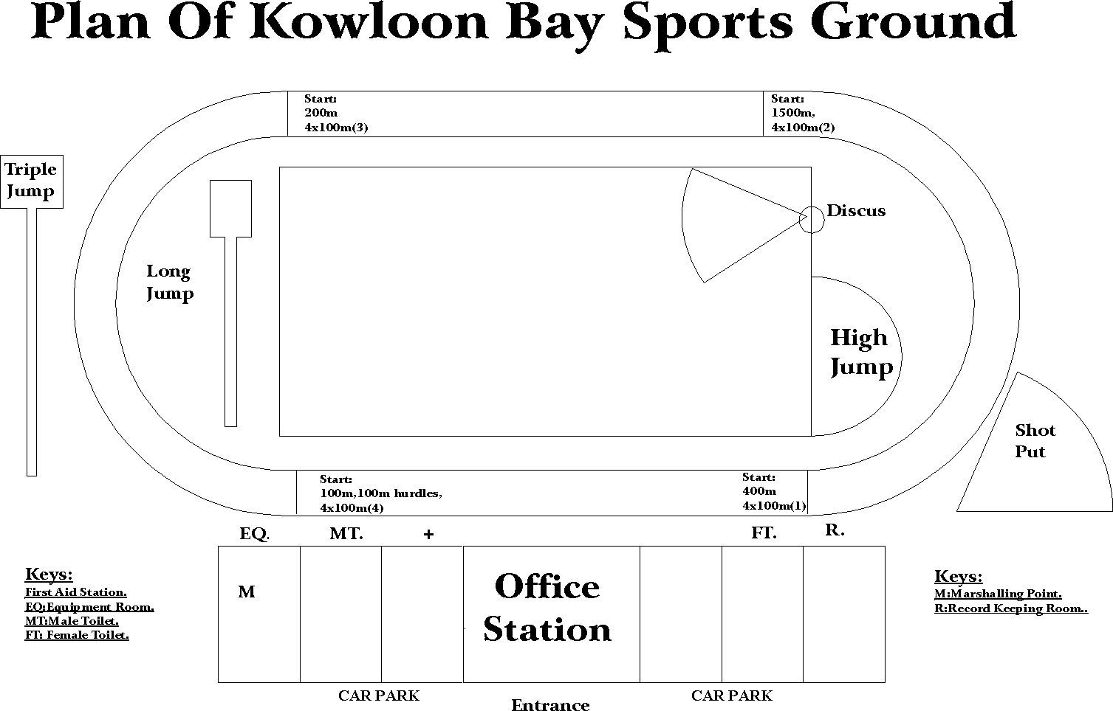
Flag raising
Him Shun Kan Sing
SHUN
HIM
KAN
SING

Slide 14
Lunch Arrangement
Time: around 1hour 15mins
Students are allowed having lunch eating or drinking at the stadium

Slide 15


Weather Forecast
Please refer to Hong Kong Observatory and the weather that day
In the event of the public announcement by the Education Bureau that all schools are suspended due of adverse weather (e.g. Typhoon, rainstorm), the gala will be cancelled.

Slide 16

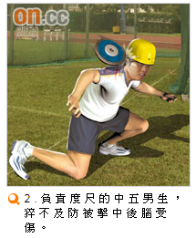
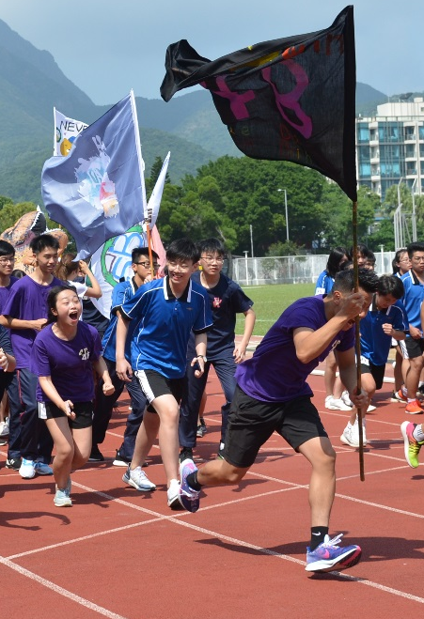
Safety First!
Be aware of 200meters event (Lane 1, 5, 6)

Slide 17
Safety Meeting
9-10-2024 (Wed Day3) 8:10am

Slide 18

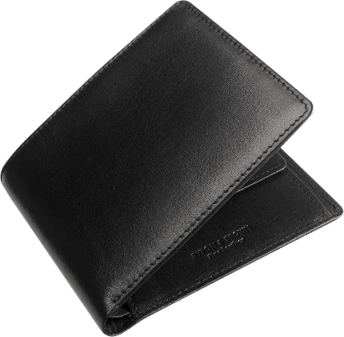
Please mind your personal belongings!

Slide 19
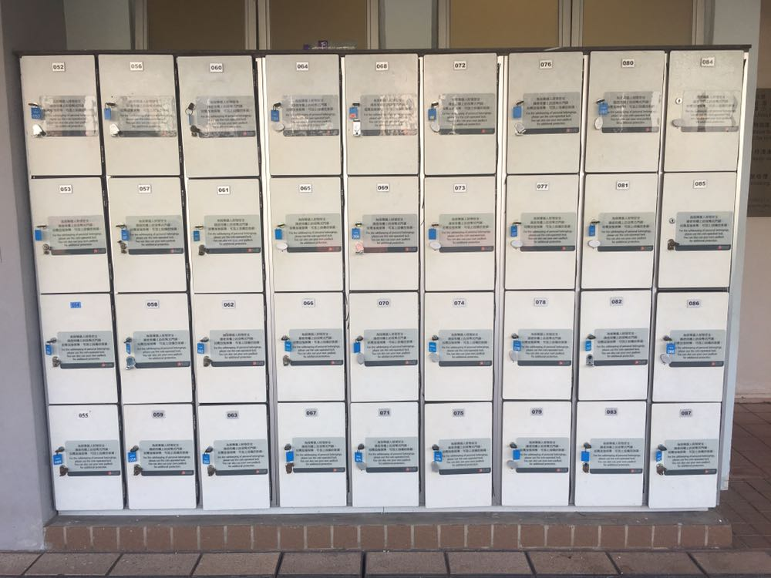
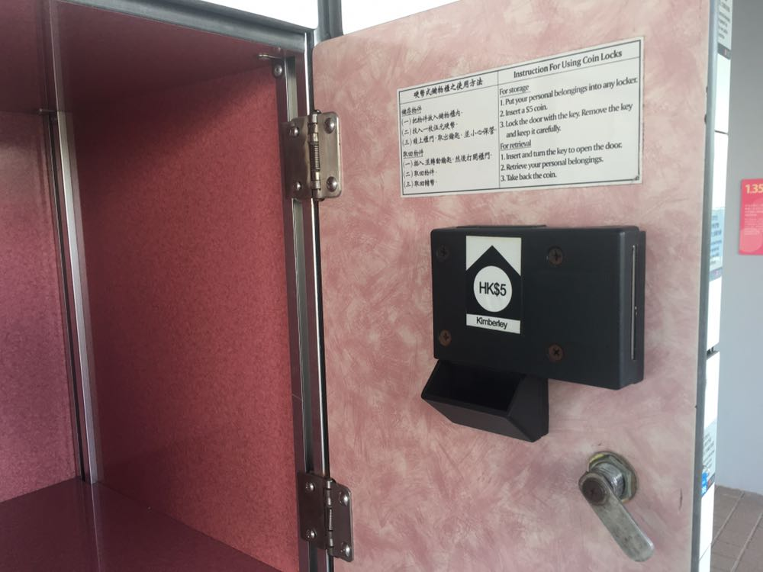
$5
overnight

Slide 20
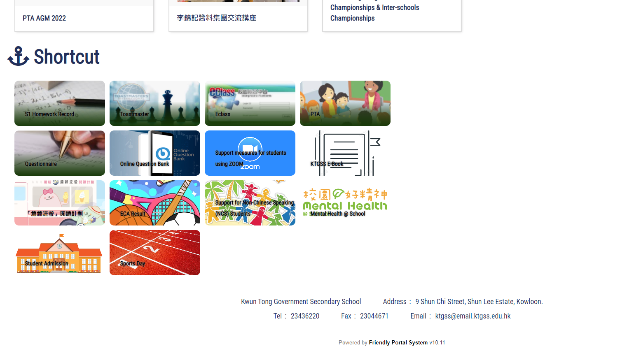

Slide 21

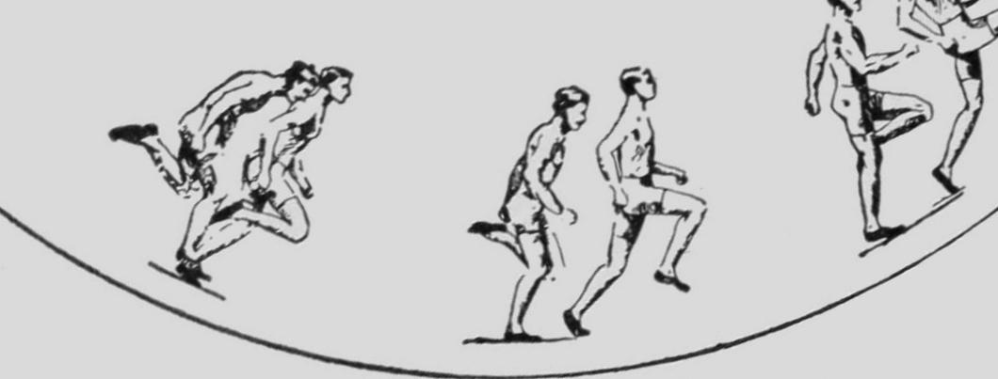
Be safe and Have Fun!

